Slide 1
Activism in Action
The Women in Surgery Committee of the American College of Surgeons
Susan Pories, MD, FACS
Chair, WiSC
Past President AWS
Director Hoffman Breast Center and Chief of Breast Surgery
Mount Auburn Hospital
Associate Professor of Surgery
Harvard Medical School

Slide 2
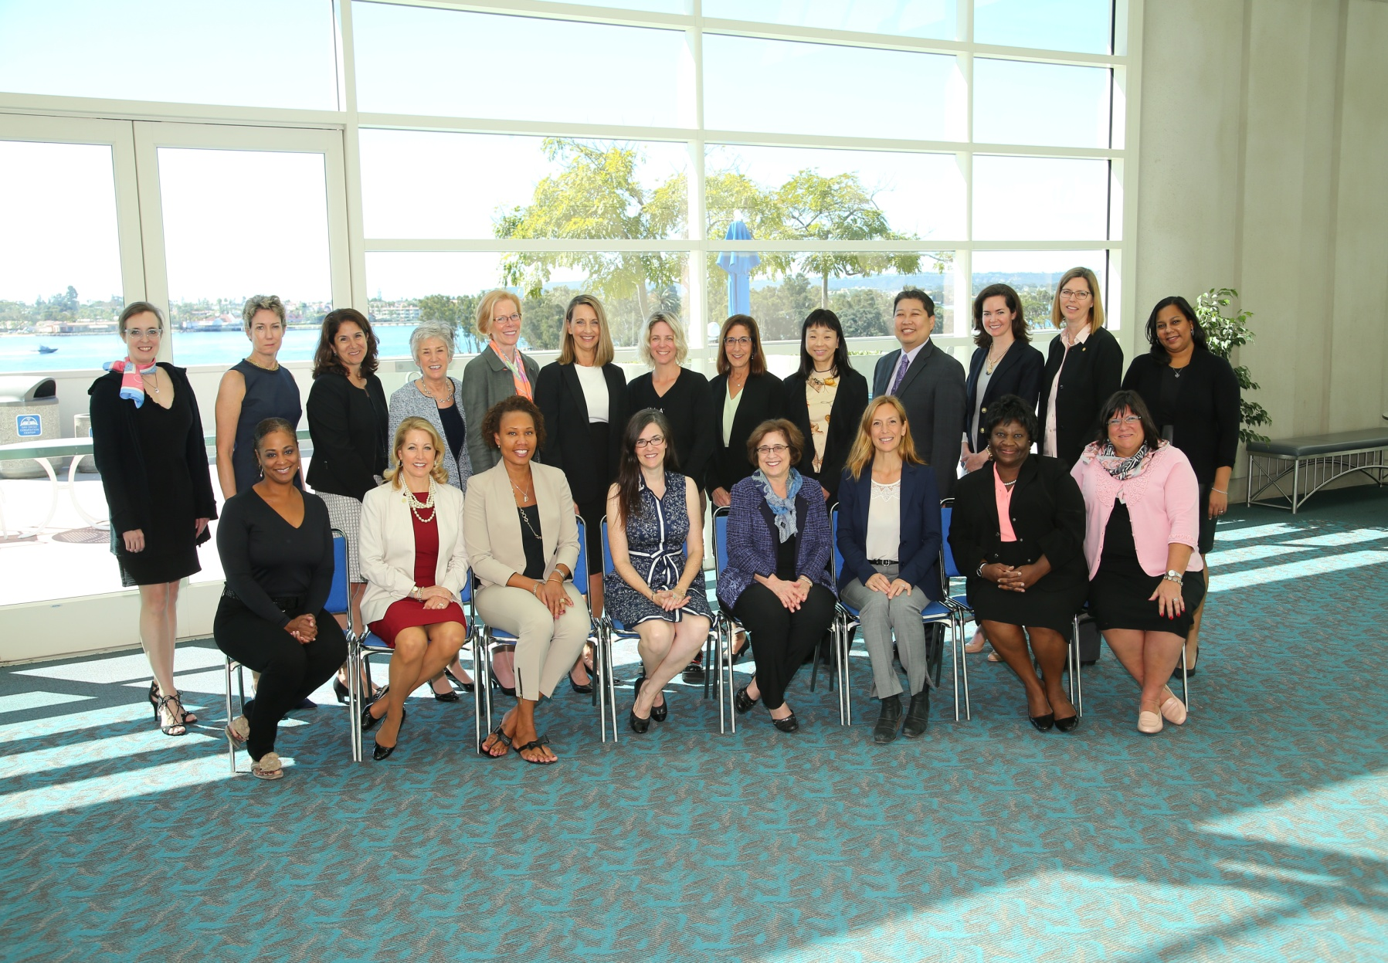
WiSC Committee 2017

Slide 3

WiSC Mission
The mission of the Women in Surgery Committee is to:
enable women surgeons of all ages and practice types to develop their individual potential as professionals,
promote an environment that fosters inclusion, respect, and success, develop, encourage and advance women surgeons as leaders, and
provide a forum and networking opportunities to enhance women’s surgical career satisfaction

Slide 4
Women in Surgery Committee 2018
Members
Susan Elaine Pories, MD FACS, Chair
Nancy N. Baxter, MD, FACS, FRCSC ,Vice Chair
Annesley Williamson Copeland, MD FACS, Liaison - Board of Governors
Steven Li-Wen Chen, MD FACS
Ainhoa Costas-Chavarri, MD FACS
Marie L. Crandall, MD FACS, Liason-AWS
Nasim Hedayati, MD FACS
Celeste Marie Hollands, MD FACS, Special Member
Kazumi Kawase, MD FACS
Mary Emily Klingensmith, MD FACS
Rosemary Ann Kozar, MD FACS, Consultant
Kate H. Kraft, MD FACS
Barbara S. Levy, MD FACS
Virginia R. Litle, MD FACS
Michele Ann Manahan, MD FACS, Liaison YFA
Daniela Molena, MD FACS
Jenny Ousley, MD
Hilary A. Sanfey, MB BCh FACS, Consultant
Shalini Sarkar, MBBS, RAS Liaison
Carrie A. Sims, MD FACS
Norma Michelle Smalls, MD FACS
Sharon Lisa Stein, MD FACS
Jamie Sue Ullman, MD FACS, Liaison
Tammara L. Watts, MD PhD FACS
Pooja Suguna Yesantharao
Tiffany Sinclair, MD|
Connie Bura, Staff
Liz McAllister, Staff
Patricia Turner, MD, FACS, Director, Division of Member Services

Slide 5
WiSC Subcommittees/Activities
Awards: Drs. Norma Smalls
Advocacy: All
Communications/Structure and Function: Dr. Barbara Levy
International: Dr. Sharon Stein
Leadership Seminars: Dr. Susan Pories
Mentoring: Dr. Nancy Baxter
Personal Empowerment: Dr. Carrie Sims
Program: Dr. AJ Copeland

Slide 6
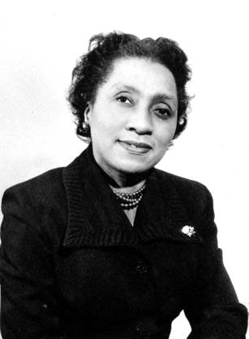
Brief History of Women in ACS
1913 – First class of ACS fellows includes 5 women
1925: Drs, Lillian K. P. Farrar and Agnes C. Vietor first women to serve on the ACS Board of Governors
1950 – Dr. Helen Octavia Dickens: first African American Woman Fellow
1993 – Dr. Olga Jonasson: first woman ACS executive
1993 - Dr. Kathryn Anderson: first woman BOR secretary
1995 – AWS recognized and Governor role created
1999 - Dr. Patricia Numann: first woman Second Vice President
2005 – Dr. Kathryn Anderson: first woman President
2006 – Dr. Patricia Numann: first woman Distinguished Service Award
2013 – Dr. Julie Freischlag: first woman BOR chair
Dr. Helen Octavia Dickens

Slide 7
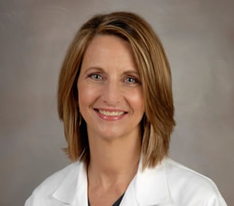
History of WiSC
1998 – Dr. Olga Johansson proposed that the BOR create a standing committee on women’s issues.
1999 – in the first report to the Regents, Dr. Jonasson removed ‘ad hoc’
2000 – the Committee on Women’s Issues held its first meeting in October
2007 – the name was changed to the Women in Surgery Committee
Chairs of WiSC have included Dr. Margaret Kemeny, Dr. Hilary Sanfey, Dr. Rosemary Kozar.

Slide 8
Awards
Nomination of Women for ACS Leadership Positions and Awards
President | Barbara Bass president (2018)
First Vice-President | Hilary Sanfey (2016)
Second Vice-President | Mary McCarthy (2016)
Board of Regents | Lena Napolitano (2018)
Lifetime Achievement Award | pending
Honorary Fellows | Clare Marx (2018) Sachiyo Suita (2016)
Surgical Volunteerism and Humanism Award | Rebekah Naylor (2016) Sherry Wren (2017)
Sheen Award | Melina Kibbe (2017)
Jacobson Innovation Award | pending

Slide 9
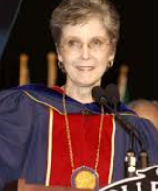
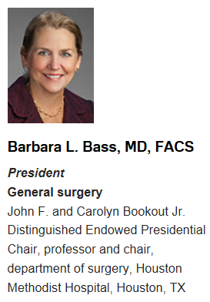
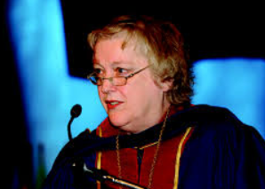
American College of Surgeons Leadership
Kathryn Anderson MD, FACS
Pediatric Surgery
Professor, University of Southern California and Chief of Surgery at Children’s Hospital, Los Angeles
Patricia Numann MD, FACS
Endocrine and Breast Surgery
Lloyd S. Rogers Professor of Surgery
State University of New York (SUNY) Upstate Medical University, Syracuse
2005
2011
2017
1913-2018

Slide 10
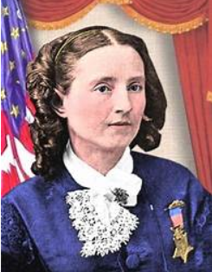
Dr. Mary Edwards Walker Award
Conceived by WiSC and awarded yearly at the Clinical Congress convocation in recognition of Inspiring women in surgery.
Dr. Walker graduated with honors from Syracuse medical School in 1855, the only woman in her class.
  First woman surgeon employed by the United States Army. Served with the Union Army in the American Civil War.
  Held as a prisoner of war for four months after being captured when crossing enemy lines to treat wounded civilians.
  Only woman to ever have received the Congressional Medal of Honor, the highest United States Armed Forces decoration for bravery.

Slide 11
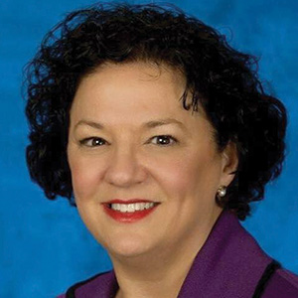
Dr. Mary Edwards Walker Award
  2016: Dr. Mary Maniscalco-Theberge
  A Colonel in the Army, Chief of the Department of Surgery at the Army and Navy hospitals, and General Surgery Residency Program Director.
  Numerous positions of leadership within ACS, Metropolitan DC chapter of the ACS, and DC chapter of the Association of Women Surgeons
  “Dr. Mary”: “You can't ask for change if you're not ready to do the work to make it happen.”

Slide 12
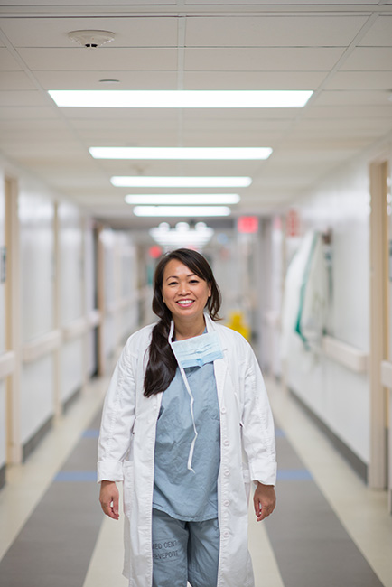

Dr. Mary Edwards Walker Award
2017: Dr. SreyRam Kuy
Associate Chief of Staff at Michael E. DeBakey Veterans Affairs Medical Center in Houston
First general surgeon to serve as chief medical officer of Medicaid for the Louisiana Department of Health.
  Developed a Zika prevention strategy for pregnant Medicaid patients
  Ensured women with breast cancer had access to reconstruction
Led coordination of disaster relief during historic flooding in Louisiana in 2016.
Notes:
Read her story in her book The Soul of a Tiger,

Slide 13
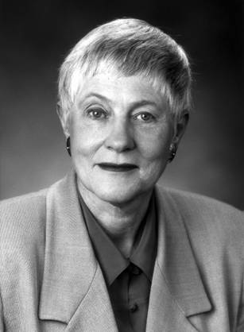
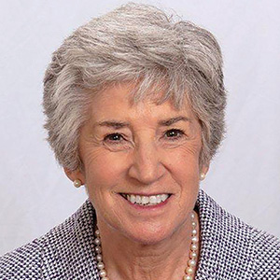
Olga Jonasson Lecture
To honor the memory of Olga M. Jonasson, MD, FACS
Dr. Jonasson was a true pioneer and trail blazer. First woman Chair of Surgery in U.S. history.
This lectureship is a testimony to leadership and education in surgery and a reflection of the capacity of women to reach academic pinnacles. Nominations for the lecture come from WiSC.
Dr. Hilary Sanfey
Led the fundraising effort

Slide 14
Olga Jonasson Lecture
Year | Lecturer | Title
2007 | Dr. Nancy Ascher | The Ultimate in Surgical Translation: Transplantation
2008 | Dr. Anna Ledgerwood | Myths in Surgical Care
2009 | Dr. Karin Muraszko | Leadership Development and Mentoring in the Age of Restricted Work Hours
2010 | Ms. Nina Totenberg | Women in the Professions
2011 | Dr. Patricia Numann | Effective Advocacy
2012 | Dr. Carol-Anne Moulton | Peeking Behind the Curtain-Surgical Judgment Beyond Cognition
2013 | Dr. Pauline Chen | Conduct Unbecoming
2014 | Dr. Barbara Bass | Our Lives as Surgeons: Finding a Sense of Place and Purpose
2015 | Dr. Julie Freischlag | Resilience
2016 | Dr. Alexa Canady | The Journey: Becoming a neurosurgeon and back again
2017 | Dr. Kathryn Anderson | A Quiet Pioneer Who Started a Revolution
2018 | Dr. Joan Reede | A Path Toward Diversity, Inclusion and Excellence

Slide 15
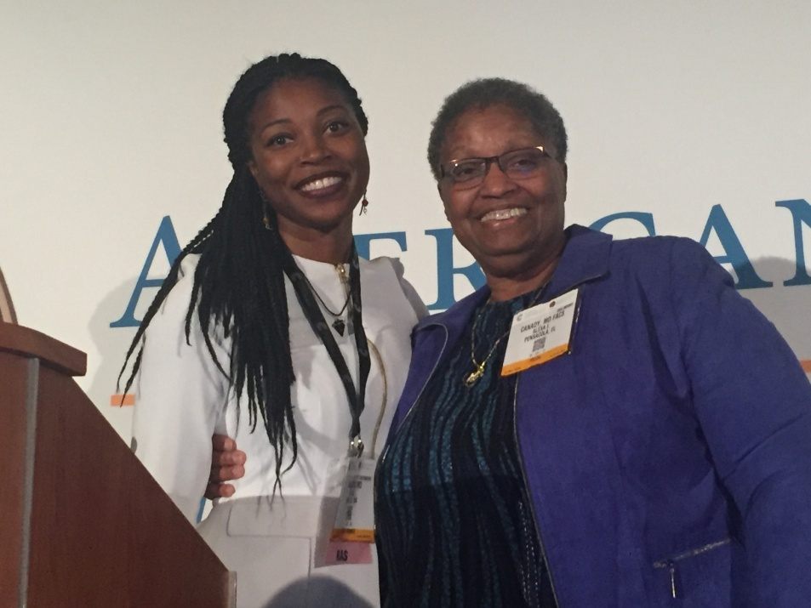
Olga Jonasson Lecture
Dr. Estelle Williams with Dr. Alexa Canady

Slide 16
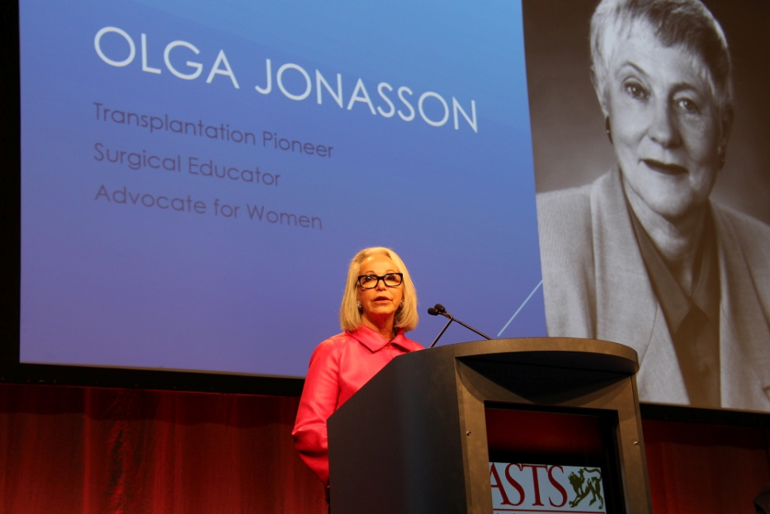
2018 ASTS Pioneer Award
Dr. Jonasson was awarded, posthumously, the 2018 ASTS Pioneer Award on Sunday, June 3rd at the American Transplant Congress (ATC) in Seattle WA.
The ASTS Pioneer award is the most distinguished award bestowed upon an individual by the ASTS for a significant contribution to the field of transplantation
ASTS gave a $5K contribution to the Olga Jonasson Lecture Fund at the American College of Surgeons a way of honoring Dr. Jonasson and her impact on transplant surgery.
Dr. Jean Emond, ASTS president announced Dr. Jonasson as the 2018 recipient of the ASTS Pioneer Award. Dr. Nancy Ascher accepted the award on her behalf.

Slide 17
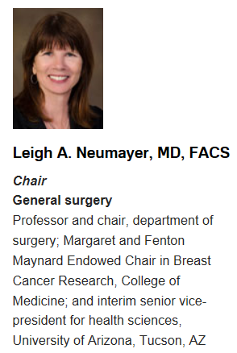
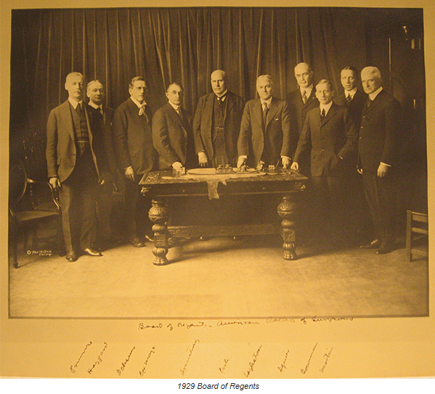
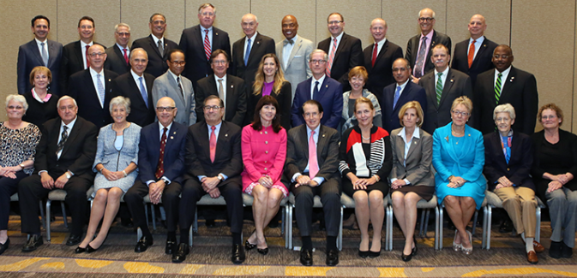
ACS Board of Regents
1929
2017

Slide 18

Advocacy
ACS Statements
  Importance of Parental Leave
  Gender Salary Equity
  Intimate Partner Violence

Slide 19
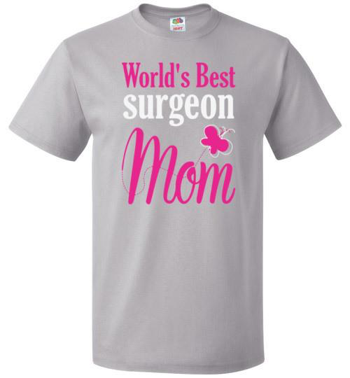
Statement on the Importance of Parental Leave
Online February 24, 2016
A successful surgical career should not preclude a surgeon’s choice to be a parent.
As a profession, surgery should be supportive of healthy pregnancy outcomes, and not punish those surgeons who choose to have children.
Parental leave terms should be explicitly included in all employment contracts.
  Flexible and equitable schedule for the surgeon taking leave and all others affected by the absence. Surgeons should not be expected to make up for call missed during leave.
  The Family Medical Leave Act (FMLA) of 1993 allows employees to take up to 12 weeks of unpaid leave.

Slide 20

Statement on the Importance of Parental Leave
  Payment for parental leave should be negotiated. The surgeon should not be responsible for costs to the practice during the period of leave.
  Institutions and practices exempt from the FMLA law are encouraged to voluntarily allow new parents the opportunity to take unpaid leave consistent with FMLA.
Surgeons who intend to breastfeed should be allowed flexibility to support expressing breast milk.
Parental leave should be considered when making decisions regarding benefits, promotion, or continued employment.

Slide 21
Statement on Gender Salary Equity
Online August 2, 2017 (developed in partnership with the Association of Women Surgeons)
Substantial pay differentials exist between male and female surgeons even after adjusting for factors such as age, years of experience, specialty, work hours, and productivity.
The American College of Surgeons supports pay equity among surgeons, regardless of gender.
Employers should promote transparency in defining the criteria for initial and subsequent physician salaries.
To ensure equitable compensation, performance reviews and benchmark salaries of all surgeons should be reviewed routinely in both academic and clinical practice settings.
Any identified pay disparity should be remedied.

Slide 22
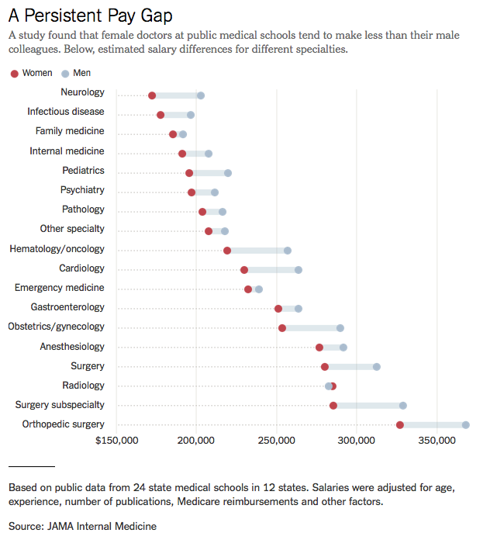

Slide 23
Statement on Gender Salary Equity
Implicit bias and compensation determination training should be provided for all individuals in a position to determine salary.
Compensation training should provide a thorough understanding of compensation policies, how rates of pay are determined, and how to communicate compensation.
Information about compensation, including summary data by rank, years of employment, and gender should be made available to all surgeons within the department.
Educational programs also should be established to help promote an understanding of self-worth and self-confidence. These educational efforts should be extended to residents and medical students so that essential negotiation skills are fostered early in training.

Slide 24
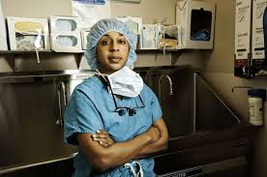
Personal Empowerment
Intimate partner violence
Bullying
Harassment
Dr. Sherilyn Gordon-Burroughs

Slide 25
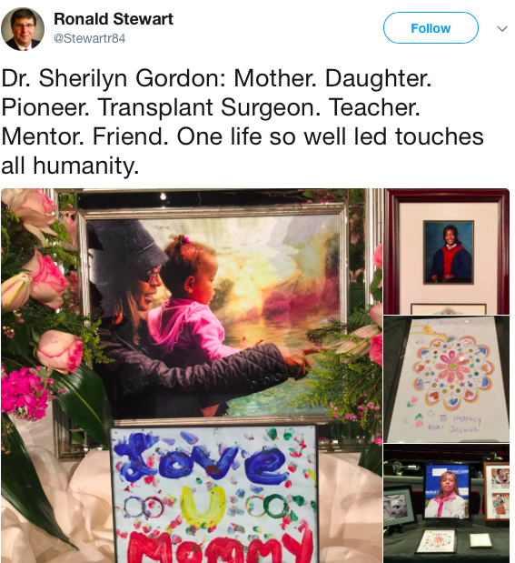
Statement on Intimate Partner Violence
Awaiting approval from BOR
Intimate partner violence (IPV) is a major public health problem.
IPV is defined as behavior designed to exert undue control over another person, using physical, sexual, verbal, or emotional abuse within the context of an intimate relationship.
IPV affects both women and men, regardless of sexual orientation, gender identity, age, socioeconomic status, education, culture, religion, race, or ethnicity. Surgical colleagues and trainees are also at risk for IPV. IPV victims may feel afraid, embarrassed or ashamed, and therefore may not be forthcoming about their circumstances.

Slide 26

Statement on Intimate Partner Violence
Women exposed to IPV have a five-fold increased risk of suicide, and 40% of female homicide victims are killed by an intimate partner.
IPV is highly likely to recur, and failure to recognize it can have lethal consequences for patients, colleagues and innocent bystanders.
Screening with explicit questioning can help identify victims of IPV.
Patients should be referred to appropriate resources and follow up for IPV. Surgical training should include education about IPV.
Surgeons should identify and intervene when colleagues and trainees are victims of IPV, or can be identified to be in an at-risk situation.
Surgeons and surgical departments should develop programs within their practices and departments to help identify and support colleagues who are victims of IPV, using national and international guidelines.

Slide 27
Structure, Function, and Communications
Women Surgeons Online Community
2016
  5,573 community members
  240 total discussion posts
  57 new threads
  183 replies to discussion
  58 replies to sender
  16 recommends
2018 (6 months)
  5,401 current community members
  203 total discussion posts
  42 new threads
  161 replies to discussion
  50 replies to sender
  29 recommends

Slide 28
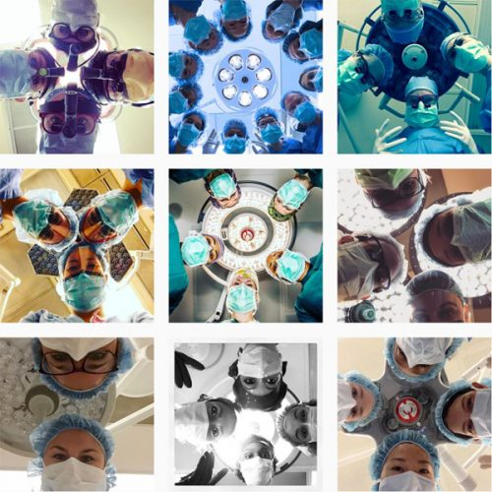
Structure, Function, and Communications
Although the ACS Women in Surgery Community does provide the option for participants to post anonymously, the Community is not the best forum for sensitive discussions.
Twitter hashtag for the Committee, #WISComm. The College will follow and retweet relevant posts.
Membership: over 50 women applied for 5 spots on the committee in 2018; Try to ensure diversity of practice, specialty, geographic location, age, URM representation

Slide 29

Mentoring Subcommittee
Mentor Program History
Established in 2013 with 6 pairs
2014 – 35 pairs
2015 – 15 pairs
2016 – 26 pairs
2017 – 21 pairs
2018 – 30 pairs
95% would recommend program to a friend

Slide 30

Program Subcommittee
2018 ACS Women in Surgery Committee Clinical Congress Events
Sunday, October 21
  Presentation of the Dr. Mary Edwards Walker Inspiring Women in Surgery Award during the Convocation Ceremony,6:00 to 8:00pm
Monday, October 22
  DC13 Negotiation Skills Training,Boston Convention & Exhibition Center, 1:00 – 5:15pm, Separate registration/fee required
  Women in Surgery Reception (preceding the AWS dinner), Boston Marriott Copley Place, 6:00 to 7:30pm (5:30 to 6:00pm special invite to international women surgeons)
Tuesday, October 24
  ME204Meet the Expert Session: Painful Choices: Temporarily Scaling Back or Leaving Clinical Practice, 11:30am – 12:30pm, Separate registration/fee required
  Olga M. Jonasson Lecture, Presenter: Joan Reede, MS, MPH, MBA – A Path Toward Diversity, Inclusion and Excellence , Boston Convention & Exhibition Center, 2:30 to 3:30pm
Wednesday, October 25
  PS307 Improving Parity in Surgery, Boston Convention & Exhibition Center, 8:00 – 9:30am
  ME304 Pregnancy during a Surgical Career: Strategies for Making it Work in Residency, Academics, and Private Practice, Boston Convention & Exhibition Center, 11:30am – 12:30pm
  PS332 Recognizing and Responding to Distress in Your Colleagues and Yourself, Boston Convention & Exhibition Center, 4:15 – 5:45pm

Slide 31
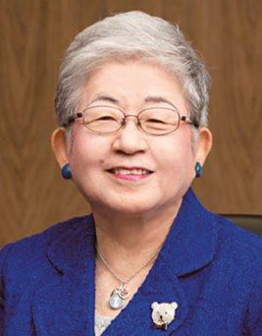
International
4,252 International Fellows of ACS. 221 (5%) are women.
There are 42 International Chapters of ACS. None of the presidents are women.
Women surgeons who are Honorary Fellows include:
  Angelita Habr-Gama of Brazil
  Sirpa Asko-Seljavaara of Finland
  Claire Nohoul Fekete of France
  Eilis McGovern of Ireland
  Valerie Lund of the UK
  Clare Marx of the UK
  E. Catherine Hamlin of Ethiopia
  Sachiyo Suita of Japan
  Cheng-Har Yip of Malaysia
  Orgoi Sergelen of Mongolia
As a point of reference: Breakdown of women Honorary Fellows of total Honorary Fellows by region:
  Africa: 1 woman, 8 total Honorary Fellows
  Asia Pacific: 3 women, 31 total Honorary Fellows
  Europe: 5 women, 66 total Honorary Fellows
  Latin America: 1 woman, 15 total Honorary Fellows
  Middle East: 0 women, 2 total Honorary Fellows
  Total: 10 women Honorary Fellows of ACS, 122 total Honorary Fellows

Slide 32
International Subcommittee
WiSC survey was sent via email to 444 female international members
  114 respondents.
  50% current ACS Fellows
  Location of respondents: Europe 22, Asia 20, S. America 18, Mexico 15, Middle East 14, Central American 9,Africa 6, Caribbean 6, Australia 2.
  37% married.
  38% single.
  > 60% no children.
  16% have organization for women surgeons in their own country,
  16% unsure if there is such an organization.
  20% are members of AWS.
Barriers:
>30% of respondents: work life balance, overt discrimination, and balancing career with a spouse/partner
16% sexual harassment
30% of respondents attend ACS annually, 30% never attend. Financial constraints major issue for over 70% of respondents.
Interest in CC included Scientific programming (82%), CME opportunities (73%), networking with surgeons from their specialty(64%), international exposure (59%), networking with women surgeons (53%).

Slide 33

International Subcommittee
Accomplishments/Goals:
Invite international women to join our on-line ACS community for networking opportunities
Invite international women to come early to the WiSC reception for networking
Empower international women in surgery to assume leadership roles in their home societies and in local chapters of ACS
Increase ACS membership for International Women in Surgery
Encourage women to apply for ACS international scholars
Create a presentation for ACS leaders traveling to international meetings to use to talk about the role of women in surgery.
Develop strategies to provide mentorship to the international ACS/OGB COSECSA scholars
Create a resource suppository for international women on the ACS website
Women in surgery directory

Slide 34
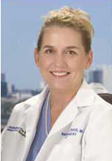
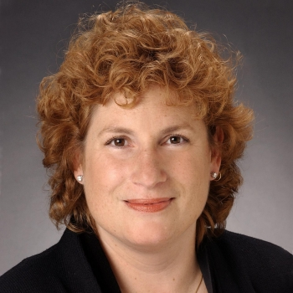
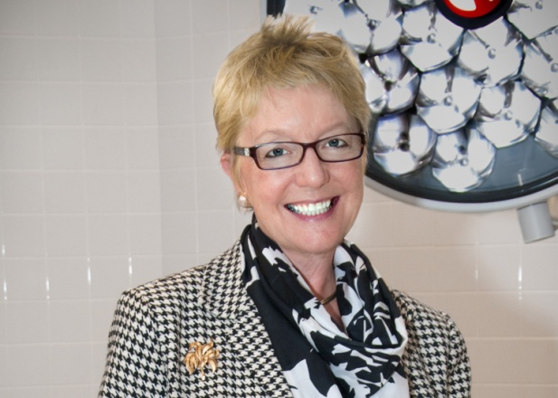
Leadership Training
Case based leadership course with invited facilitators at Spring Meeting. Included all of WiSC committee, AWS Council invited, women from Diversity Committee, and Mentor-Mentee pairs
  Dr. Barbara Bass 2016
  Dr. Sherry Wren 2017
  Dr. Diana Farmer 2018
  Evaluations 2018 – 100% Very Good to Excellent

Slide 35
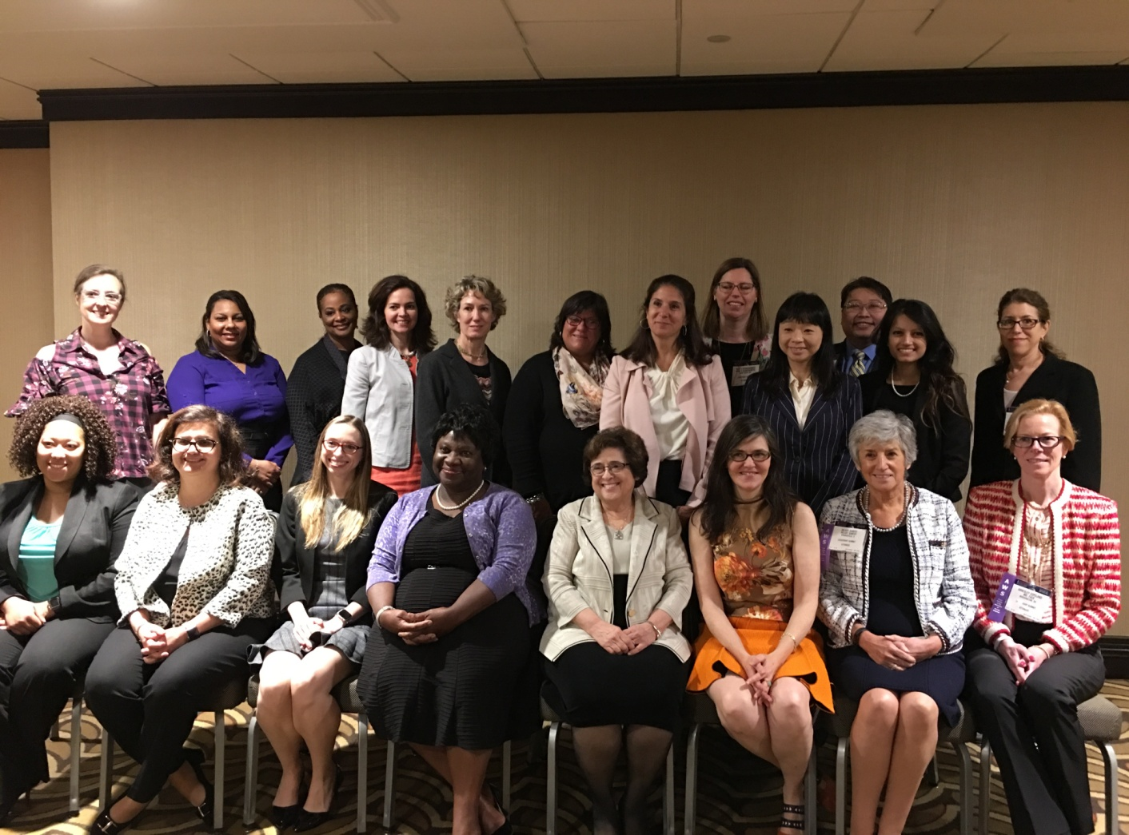
WiSC Committee 2018

Slide 36
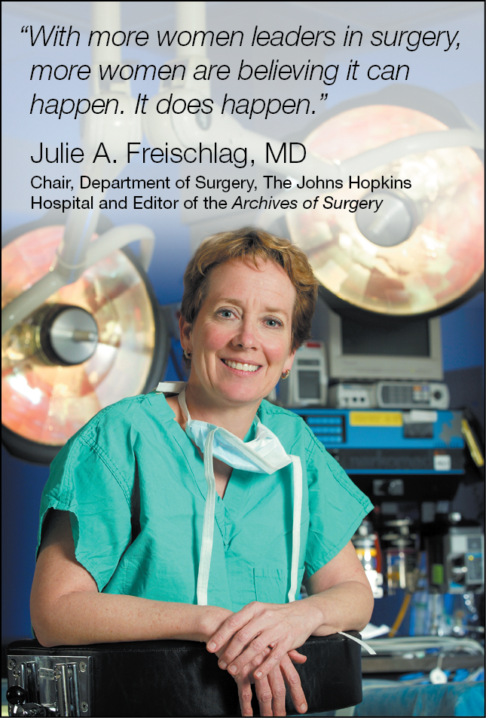
U.S. Supreme Court Justice Sonia Sotomayor, the first Hispanic on the high court: “A role model in the flesh provides more than inspiration; his or her very existence is confirmation of, ‘Yes, someone like me can do this.’”

Slide 37
Mentoring Women Surgeons
ACS-WiSC Program
Carrie Sims, MD, PhD
University of Pennsylvania

Slide 38
Objectives
Define and discuss benefits of mentoring
Describe ACS-WiSC Mentorship Program
Share WiSC results and potential opportunities

Slide 39
Definition
“Mentoring is an activity in which a more senior or experienced person who has earned respect or power within their field takes a junior or less experienced person under their wing to teach, encourage, and ensure the protégé’s success”
Mentor vs Coach vs Sponsor
Friendly but not your friend
Selfless support
Sanfey H, Hollands C, Gantt NL. Am J Surg 2013

Slide 40
Why is mentorship important?
Lack of mentorship identified as one of the most important factor hindering career progress
  98% list as mentoring as essential for success
Faculty with mentors do better
  More confident, higher leadership aspiration
  Spend ~2X more time on scholarly activity
  ⬆ Awards, grants, publications, promotions
  Greater career satisfaction
Chew LD et al. Acad Med 2003 Mayer AP et al. Med Teach 2014
Pololi L et al. Acad Med 2002 Lord JA et al. Acad Med 2012
Reis A et al. Acad Med 2012 Mayer AP et al. Med Teach 2014
Pololi LH et al. J Cont Educ 2015

Slide 41
Mentorship is Elusive
National Survey of Academic Centers (n=2178)
  Only 30% satisfied with the quality and quantity of mentoring
  35% “seriously considered leaving in the last year”
    58% reported inadequate mentoring vs
    14% with positive mentoring (p<0.001)
Mentored faculty are more likely to be men (OR 2.9)
WOMEN ARE AT RISK
Pololi LH et al. J Cont Educ 2015
Chew LD et al, Acad Med 2003

Slide 42
Mentee Application
Personal Statement
CV
WiSC Mentorship
Committee
Mentor Application
CV
Specialty
Areas of Need
(Research, Professional, Work-Life etc.)
Geography
Assessment Tool
Mentorship Expectations
Action Plan
Quarterly Committee Check In
End of Program Survey
Meet at ACS

Slide 43
ACS-WiSC Mentorship Program
2014 35 pairs
2015 15 pairs
2016 26 pairs
2017 21 pairs
Survey
50 Mentees
(81% response)

Slide 44
Demographics
Specialty
Bariatric | 4%
Breast | 6%
Cardiothoracic | 2%
Colo-Rectal | 10%
Endocrine | 4%
ENT | 4%
General Surgery | 34%
Orthopedics | 2%
Pediatric Surgery | 8%
Plastics | 2%
Surg Onc | 4%
Trauma/Critical Care | 10%
Urology | 2%
Vascular | 10%
Other | 2%

Slide 45
Aspects of the WiSC Program You Found Valuable
Feature
Lunch Meeting during Clinical Congress | 60%
The Relationship with Mentor | 60%
Developing an Action Plan | 18%
Networking | 14%
Establishing a consistent schedule for communication with my mentor | 8%

Slide 46
 | All | ≥3 Months (n=24) | ≤ 6 Months (n=26) | P Value
Well Paired
Accessible
Helped Create Plan to Achieve Goals
Helped Achieve Goals
Time-Management/Work-Life Skills
Set High Expectations
Helped Develop Professional Skills
Provided Career Development Opportunities
The Mentorship Program provided Networking opportunities.
Benefitted from Participating in Program
Would Recommend Program
Mentorship programs are essential for young surgeons.
Mentorship programs exclusively with female surgeons provide added value.

Slide 47
 | All | ≥3 Months (n=24) | ≤ 6 Months (n=26) | P Value
Well Paired | 3.9 ± 1.2
Accessible | 4.1 ± 1.0
Helped Create Plan to Achieve Goals | 3.9 ± 1.0
Helped Achieve Goals | 3.6 ± 1.0
Time-Management/Work-Life Skills | 3.6 ± 1.0
Set High Expectations | 4.0 ± 1.0
Helped Develop Professional Skills | 3.4 ± 1.1
Provided Career Development Opportunities | 3.5 ± 1.2
The Mentorship Program provided Networking opportunities. | 3.9 ± 1.2
Benefitted from Participating in Program | 4.0 ± 1.0
Would Recommend Program | 4.2 ± 1.0
Mentorship programs are essential for young surgeons. | 4.5 ± 0.9
Mentorship programs exclusively with female surgeons provide added value. | 4.3 ± 0.8

Slide 48
 | All | ≥3 Months (n=24) | ≤ 6 Months (n=26) | P Value
Well Paired | 3.9 ± 1.2 | 4.3 ± 1.0 | 3.2 ± 1.1 | <0.001
Accessible | 4.1 ± 1.0 | 4.6 ± 0.6 | 3.3 ± 1.1 | <0.001
Helped Create Plan to Achieve Goals | 3.9 ± 1.0 | 4.3 ± 0.8 | 3.3 ± 0.8 | <0.001
Helped Achieve Goals | 3.6 ± 1.0 | 3.9 ± 0.9 | 2.9 ± 0.8 | <0.001
Time-Management/Work-Life Skills | 3.6 ± 1.0 | 4.0 ± 0.7 | 2.8 ± 1.0 | <0.001
Set High Expectations | 4.0 ± 1.0 | 4.5 ± 0.6 | 3.3 ± 1.0 | <0.001
Helped Develop Professional Skills | 3.4 ± 1.1 | 3.8 ± 1.0 | 2.7 ± 0.8 | <0.001
Provided Career Development Opportunities | 3.5 ± 1.2 | 4.0 ± 1.1 | 2.7 ± 0.8 | <0.001
The Mentorship Program provided Networking opportunities. | 3.9 ± 1.2 | 4.1 ± 1.1 | 3.4 ± 1.0 | <0.05
Benefitted from Participating in Program | 4.0 ± 1.0 | 4.4 ± 0.9 | 3.3 ± 0.9 | <0.001
Would Recommend Program | 4.2 ± 1.0 | 4.5 ± 1.0 | 3.7 ± 0.8 | <0.01
Mentorship programs are essential for young surgeons. | 4.5 ± 0.9 | 4.5 ± 1.0 | 4.6 ± 0.5 | 0.7
Mentorship programs exclusively with female surgeons provide added value. | 4.3 ± 0.8 | 4.3 ± 0.9 | 4.4 ± 0.6 | 0.7

Slide 49
Conclusions
Mentorship is vitally important
Gender-specific mentorship is perceived to add value
Time invested correlates with perceived benefits
Pairing is critical

Slide 50
Thank You!
Connie Bura, Associate Director of Member Services, ACS
WiSC Subcommittee Members
    Susan Pories
    Rosemary Kozar
    Hilary Sanfey
    Nancy Baxter
    Virginia Litle
RCSI

