Slide 1
Resources for Optimal Care of the Injured Patient
2026 Standards Revision
Jon Perlstein, MD, FACS
VRC Program Area Chair

Slide 2
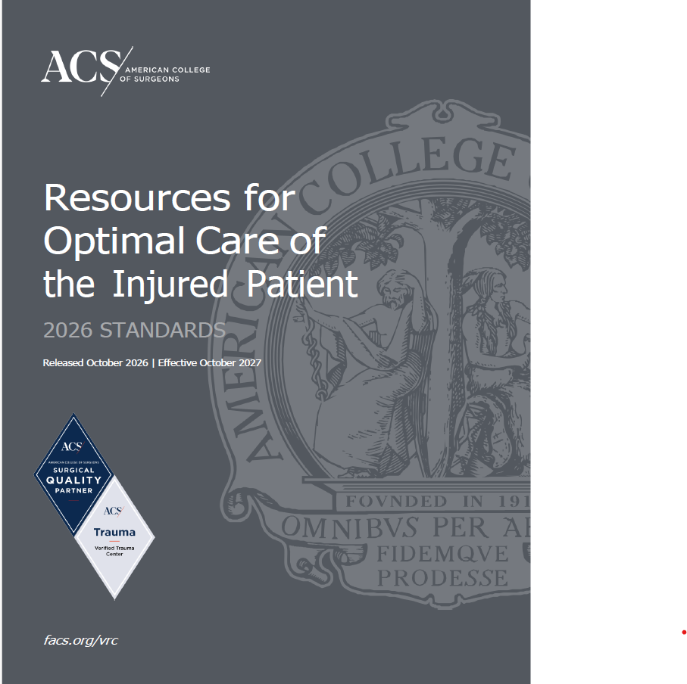
Resources for Optimal Care of the Injured Patient
2026 Standards Revision
Notes:
We can add the confirmed released/effective date after it is final

Slide 3

Resources for Optimal Care of the Injured Patient: 2026 Standards
2026 Standards Revision
Changes in effect for site visits beginning October 2027
Notes:
JP – you have 5 min to present standards. You can speed through these slides

Slide 4
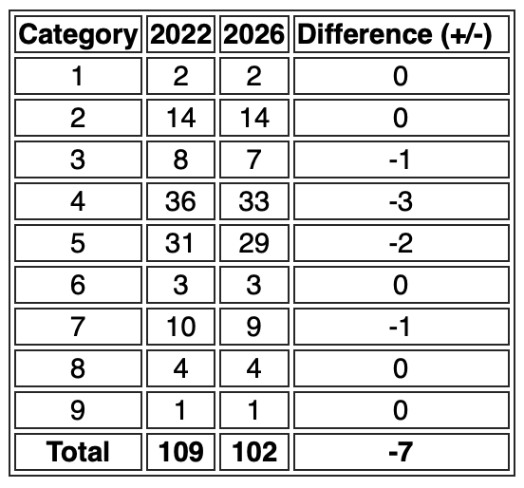
Improvements and Changes to Standards
Updated standards to reflect current best practices in trauma care
Consolidated and revised requirements for clarity, feasibility, and alignment
Added a new standard and incorporated stakeholder/public comment feedback

Slide 5
Substantive Standards Changes
2.8 Trauma Medical Director Requirements
2.10 Trauma Program Manager Requirements
4.21 Surgical Specialists Availability
4.31 Trauma Registry Staffing Requirements
5.1 Clinical Practice Guidelines
5.18 Treatment Guidelines for Neurological and Spinal Cord Injuries New!

Slide 6

Standards Changed from TYPE I to TYPE II
Standard | Standard Title
2.7 | Trauma Multidisciplinary PIPS Committee
4.5 | Emergency Department Director
4.21 | Surgical Specialists Availability
4.23 | Soft Tissue Coverage Expertise
4.24 | Craniofacial Expertise

Slide 7
Neurosurgeon and Orthopaedic Surgeon Requirements
Standard | Standard Title | Standard Restructured
4.9 | Neurosurgeon Requirements | Changed from TYPE I to TYPE II Continuous neurosurgical coverage separated from board certification into a standalone standard Continuous coverage remains a TYPE I
4.11 | Orthopaedic Surgeon Requirements | Changed from TYPE I to TYPE II Continuous orthopaedic surgical coverage separated from board certification into a standalone standard Continuous coverage remains a TYPE I

Slide 8
2.8 Trauma Medical Director Requirements
Currently
Adult surgeons can currently direct a pediatric program providing they have an affiliate TMD from a pediatric Level I center
Goal
Expect programs to engage their own pediatric surgeon as a liaison - build the pipeline of pediatric surgeons invested in trauma care
 | Current | Future | Applicable standard
Affiliate TMD | Yes | No | 2.8 Trauma Medical Director Requirements
PALS | Yes | No | 2.8 Trauma Medical Director Requirements
Pediatric specific CME | 9 of 36 | 12 of 36 | 2.8 Trauma Medical Director Requirements
Pediatric liaison | No | Yes – with 12 hrs trauma CME/50% attendance at PIPS committee | 2.8 Trauma Medical Director Requirements 4.4 Specialty Liaisons to the Trauma Service 7.6 Trauma Multidisciplinary PIPS Committee
Pediatric surgical response criteria | No | Yes | 2.8 Trauma Medical Director Requirements

Slide 9

2.10 Trauma Program Manager Requirements
TOPIC completion is now required for all TPMs.
  TOPIC Certificate
New TPMs at Level I/II adult and pediatric programs must have at least three years of trauma patient care experience.
  Effective for first-time TPM hires on or after October 1, 2027.

Slide 10
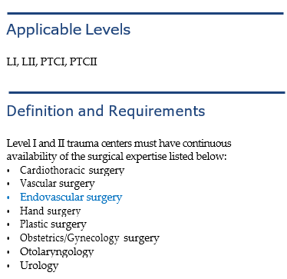
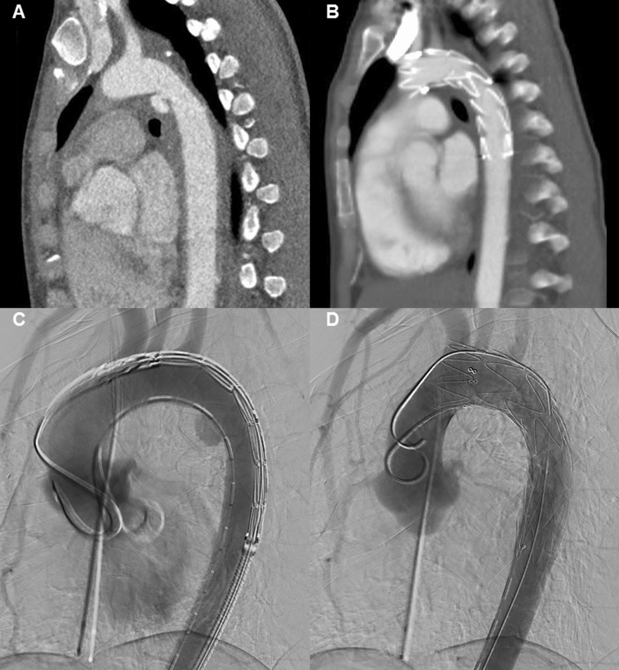
4.21 Surgical Specialist Availability
Changed surgical specialist availability from Type I to Type II
Added requirement for endovascular capability

Slide 11
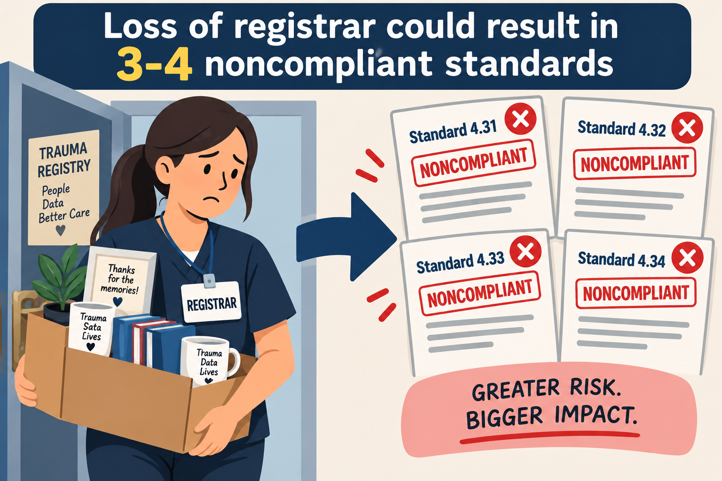
4.31 Trauma Registry Staffing Requirements
Current state – 4 standards
4.31Trauma Registry Staffing Requirements
4.32 Certified Abbreviated Injury Scale Specialist
4.33 Trauma Registry Courses
4.34 Trauma Registrar Continuing Education

Slide 12
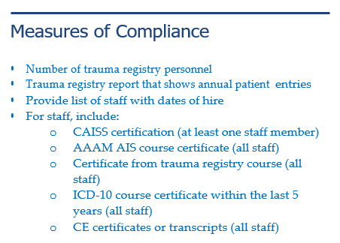
4.31 Trauma Registry Staffing Requirements
!
4.31

Slide 13
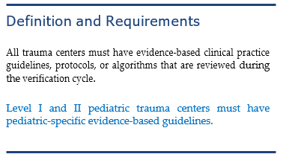



5.1 Clinical Practice Guidelines
Added pediatric-specific guideline requirements

Slide 14
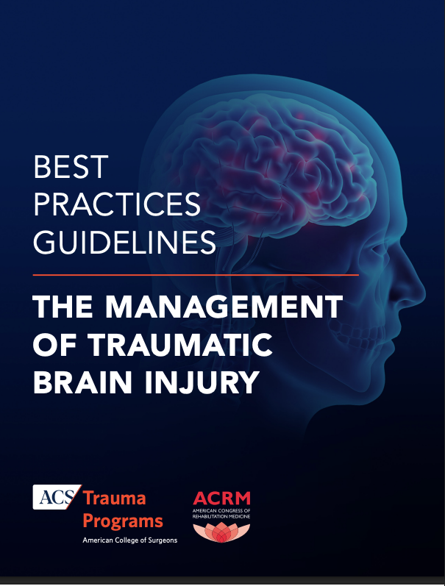

5.18 Treatment Guidelines for Neurological and Spinal Cord Injuries New!
Applicable to LI, LII, LIII-N and all pediatric centers
All trauma centers must have treatment guidelines that cover the following:
Which patients require neurosurgical consultation for traumatic brain injury (TBI)
Management of severe TBI to include intracranial hypertension
Management of spinal cord injury

Slide 15
Return to In-Person Site Visits!
Andrew Bernard, MD, FACS
VRC Program Area Vice Chair

Slide 16
In-Person Site Visits
Consultation site visits: October 1st
Initial verification site visits: January 1st
Renewal and corrective action site visits will remain virtual
Notes:
ANDREW:
We are now moving forward with in person site visits.
Consultations scheduled on or after October 1st will be conducted in person
Initial verification site visits scheduled on or after January 1st will be conducted in person
Renewals and corrective action site visits will continue to be conducted virtually

Slide 17
Virtual vs. In-Person: What will change?
Our goal is consistency!
What will be different?
  Travel
    Hospital will cover hotel and food while on site
    ACS will cover transportation
  Tour
Notes:
Andrew
It’s important that our site visits are as consistent as possible, whether it is virtual or in person.
Travel: The hospital will be responsible for hotel accommodations for the reviewers and meals during the site visit, like breakfast and lunch. There will be no dinners and no expectations to take reviewers for dinner.
The most significant change to the agenda will be the tour. In person visits will make it much easier on the centers preparing for their site visits, and allows reviewers an opportunity for a thorough assessment of a trauma center for consultations and initial verification visits

Slide 18
Virtual vs. In-Person: What remains the same?
Pre-selected Chart Review
Pre-review call
PRQ meeting
Notes:
Andrew
Processes that were implemented for virtual site visits, like the PCR process, pre-review call, and a PRQ meeting instead of the original dinner will remain the same for in person site visits. These processes have proved to be helpful to centers and allows the reviewers a better focus on assessing the center. (Say this however you choose)

Slide 19
Michael Dingeldein, MD, FACS
COT Pediatric Surgery Chair

Slide 20
2.8 Trauma Medical Director Requirements
Currently
Adult surgeons can currently direct a pediatric program providing they have an affiliate TMD from a pediatric Level I center
Goal
Expect programs to engage their own pediatric surgeon as a liaison - build the pipeline of pediatric surgeons invested in trauma care
 | Current | Future | Applicable standard
Affiliate TMD | Yes | No | 2.8 Trauma Medical Director Requirements
PALS | Yes | No | 2.8 Trauma Medical Director Requirements
Pediatric specific CME | 9 of 36 | 12 of 36 | 2.8 Trauma Medical Director Requirements
Pediatric liaison | No | Yes – with 12 hours trauma CME/50% attendance at PIPS committee | 2.8 Trauma Medical Director Requirements 4.4 Specialty Liaisons to the Trauma Service 7.6 Trauma Multidisciplinary PIPS Committee
Pediatric surgical response criteria | No | Yes | 2.8 Trauma Medical Director Requirements

Slide 21
VRC and the Registry of the Future
Avery B. Nathens, MD, PhD
Medical Director, Trauma Quality Programs

Slide 22
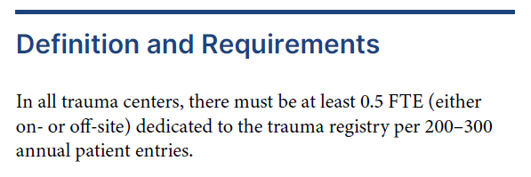
4.31 Trauma Registry Staff Requirements

Slide 23
4.31 Trauma Registry Staff Requirements
The ACS recognizes that evolving technologies, including AI-assisted data extraction tools, may support trauma registry operations.
…We are evaluating opportunities to leverage these technologies to enhance efficiency, data quality, and registry performance while ensuring appropriate human oversight, validation, and decision-making throughout the data abstraction process.

Slide 24
Automated Data Extraction (ADE)
Standards Development Workgroup
The charge:
  Develop recommendations and propose standards governing the use of automated data extraction for trauma registry data collection and reporting
  Identify the validation methodologies, human workforce requirements, monitoring processes, and accountability mechanisms necessary to ensure that data obtained through automated extraction offers clinically meaningful insights on the quality of care and that data are comparable across institutions

Slide 25




Laying the Foundation for Collaboration
POTENTIAL
Efficiency
Data/insights
Real-time PI
AI contribution
Registrar contribution
Speed - fast first run for each record
Scale – every note
Pattern detection- gaps, conflicts, outliers
Clinical judgement- context/nuance
Standards expertise– NTDS definitions, applied correctly to clinical scenarios
Accountability – ownership/signoff for records
+
Notes:
WHAT THIS SLIDE SHOWS: a conceptual framework for human-in-the-loop registry work. Read it like a building: the potential is the roof, two pillars hold it up, and it all stands on guardrails.
THE POTENTIAL (roof), drawn from the ACS TQP Automated Data Extraction (ADE) Working Group terms of reference: ACS describes automated data extraction as a major and inevitable evolution in trauma registry operations and supports responsible adoption. The potential: streamlined data collection with less manual abstraction; real-time potential to enhance performance improvement and patient care; and data that stay comparable across institutions for benchmarking.
PILLAR 1, WHAT AI BRINGS: speed (fast first drafts), scale (it can read every note on every case without tiring), and pattern detection (missing data, internal conflicts such as GCS vs. intubation status, implausible values).
PILLAR 2, WHAT REGISTRARS BRING: clinical judgment, standards expertise (NTDS definitions applied correctly and consistently; consistency of the registry has always come from registrars and the data dictionary), and accountability for every record.
WORDING NOTE: consistency is deliberately not listed as an AI strength, so the slide doesn't imply registrars are the inconsistent partner. AI's advantage is speed and scale, not better consistency.
GUARDRAILS (foundation), taken from the ADE guiding principles: data quality first (efficiency without compromising accuracy, completeness, reliability, validity); human accountability (automation reduces manual abstraction but does not eliminate the need for qualified human oversight; responsibility stays with trauma center personnel); transparency and auditability (all automatically extracted data traceable to source documentation); continuous monitoring (ongoing validation and maintenance to sustain performance).
TIE TO THE TRUST SLIDE: formality and conflict resolution again. Written standards and audit trails are the formality; human review of extraction errors is how disagreements between person and machine get resolved.

Slide 26

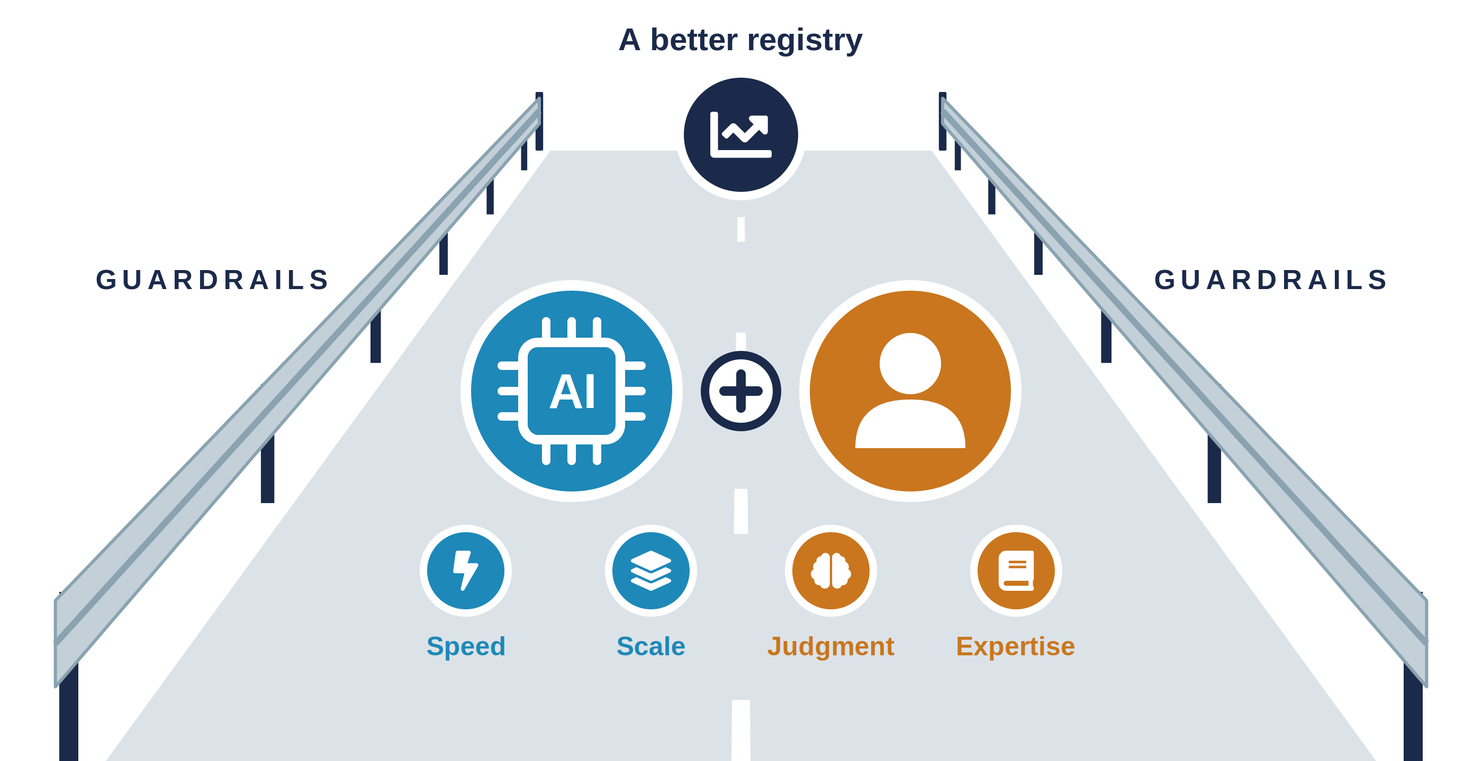
Trust?
Registry
of tomorrow
Quality first
Accuracy>speed
Auditability
Data traceable to sources
Human accountability
Continuous monitoring
Advance
innovation
Technologic neutrality

Slide 27

Automated Data Extraction Working Group
Trauma registry professionals
Trauma clinical leadership
Trauma program managers
AAAM
Health informatics
ACS TQP Staff/leadership
Vendors (advisors)
Notes:
SOURCE: ACS Trauma Quality Programs, Automated Data Extraction (ADE) Standards Development Working Group, Terms of Reference (revised). Seat counts and roles as listed in the terms of reference; ACS TQP leadership roles/titles are still TBD. Confirm the document is cleared for public presentation before the talk.
WHY THIS GROUP EXISTS: As trauma centers use EHRs, interoperability standards, and automated extraction for registry work, the data used for quality improvement, benchmarking, verification, and research must stay accurate, reliable, auditable, clinically meaningful, and comparable across institutions. The group will identify the validation methods, human workforce requirements, monitoring processes, and accountability mechanisms needed to make that true.
WHO'S AT THE TABLE (~15-20 members): trauma registry professionals (3); trauma clinical leadership (3), including trauma medical directors and VRC reviewers; trauma program managers (3); a health informatics expert (1); ACS TQP leadership (3); ACS TQP staff (clinical data standards and training, data and report operations, trauma center programs, VRC standards, research); and vendor advisors (1-2) from registry software and extraction-solution companies, serving in a non-voting advisory role to supply technical expertise while avoiding conflicts of interest. Meets monthly for about 6 months.
WHAT IT WILL DELIVER: an ADE Standards Framework (governance, validation, monitoring, accountability, oversight); proposed VRC standard language covering a data quality plan (validation approaches, sampling strategies, accuracy thresholds, revalidation triggers, audit methods, consistency over time); a human workforce and competency framework (functional roles, core competencies, staffing, training); and vendor/technology assessment criteria (documentation, validation evidence, transparency, auditability).
SCOPE: data mapping and specification management; validation before implementation (including high-risk clinical variables); ongoing data quality monitoring; exception management (hybrid abstraction workflows, error resolution, manual review); vendor and technology oversight; data provenance and lineage; human workforce requirements.
EXPECTED OUTCOMES: recommendations toward VRC standards that protect registry data integrity, support innovation while keeping rigorous quality expectations, establish clear accountability for data quality, and scale across centers of varying size and technical sophistication.
TIE TO THE TALK: this working group is itself an inter-institutional collaboration, and it's built with the scaffolding the literature recommends: formal terms of reference, defined seats (including a clear, non-voting role for vendors to manage conflicts of interest), a time-limited charge, and concrete deliverables. And registrars have a seat at the table.

Slide 28
Standards framework
Data oversight, governance and validation
Protects the integrity of registry data
Trauma registry professionals – roles, competencies, training
Leverages expertise of trauma registry professionals
Vendor criteria – validation,
transparency, auditability
Supports innovation with rigorous quality
Notes:
SOURCE: ACS Trauma Quality Programs, Automated Data Extraction (ADE) Standards Development Working Group, Terms of Reference (revised). Seat counts and roles as listed in the terms of reference; ACS TQP leadership roles/titles are still TBD. Confirm the document is cleared for public presentation before the talk.
WHY THIS GROUP EXISTS: As trauma centers use EHRs, interoperability standards, and automated extraction for registry work, the data used for quality improvement, benchmarking, verification, and research must stay accurate, reliable, auditable, clinically meaningful, and comparable across institutions. The group will identify the validation methods, human workforce requirements, monitoring processes, and accountability mechanisms needed to make that true.
WHO'S AT THE TABLE (~15-20 members): trauma registry professionals (3); trauma clinical leadership (3), including trauma medical directors and VRC reviewers; trauma program managers (3); a health informatics expert (1); ACS TQP leadership (3); ACS TQP staff (clinical data standards and training, data and report operations, trauma center programs, VRC standards, research); and vendor advisors (1-2) from registry software and extraction-solution companies, serving in a non-voting advisory role to supply technical expertise while avoiding conflicts of interest. Meets monthly for about 6 months.
WHAT IT WILL DELIVER: an ADE Standards Framework (governance, validation, monitoring, accountability, oversight); proposed VRC standard language covering a data quality plan (validation approaches, sampling strategies, accuracy thresholds, revalidation triggers, audit methods, consistency over time); a human workforce and competency framework (functional roles, core competencies, staffing, training); and vendor/technology assessment criteria (documentation, validation evidence, transparency, auditability).
SCOPE: data mapping and specification management; validation before implementation (including high-risk clinical variables); ongoing data quality monitoring; exception management (hybrid abstraction workflows, error resolution, manual review); vendor and technology oversight; data provenance and lineage; human workforce requirements.
EXPECTED OUTCOMES: recommendations toward VRC standards that protect registry data integrity, support innovation while keeping rigorous quality expectations, establish clear accountability for data quality, and scale across centers of varying size and technical sophistication.
TIE TO THE TALK: this working group is itself an inter-institutional collaboration, and it's built with the scaffolding the literature recommends: formal terms of reference, defined seats (including a clear, non-voting role for vendors to manage conflicts of interest), a time-limited charge, and concrete deliverables. And registrars have a seat at the table.

Slide 29

Apply today!

Slide 30
Questions??

