Slide 1
NTEPS/RMOCC
Jeremy W. Cannon, MD, SM, FACS
Chair, ACS/COT NTEPS Program Area
September 26, 2026

Slide 2
Disclosure
UpToDate authorship: Post-injury Resuscitation
  (Royalties)
Flosonics, Limax: trial design consultant
  (Consulting fees)
Funding from DARPA, DOD, NIH, ASPR
RESPOND-US: Strategic Advisory Cmte

Slide 3

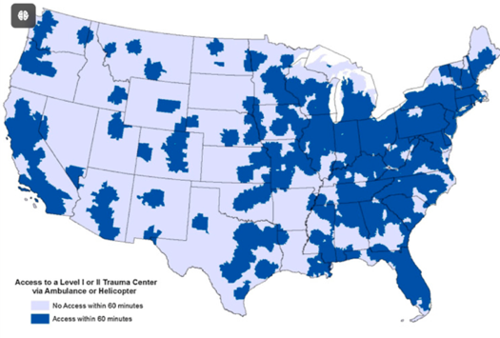
In 2026, the U.S. still does not have a Trauma System
2009 Scudder Oration: “Wherever the Dart Lands”¹
Regional Fragmentation
+ Inconsistent Coordination
= Variable Access
Brent Eastman
“Islands of excellence in a sea of chaos”
https://pmc.ncbi.nlm.nih.gov/articles/PMC5292279/
¹Eastman AB. J Am Coll Surg. 2010 Aug;211(2):153-68.

Slide 4

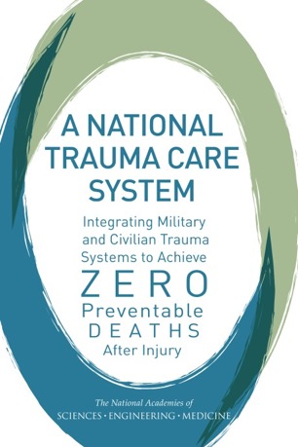
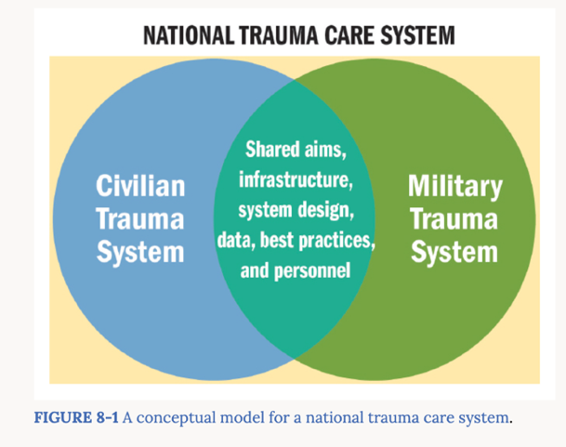



2016 NASEM Report
“Military and civilian trauma care and learning will be optimized together, or not at all.”
The Hudson Institute
Nadia Schadlow
60-year “crisis of repetition”
https://www.nap.edu/catalog/23511
https://www.hudson.org/national-security-defense/america-crisis-repetition-hurting-national-security-nadia-schadlow

Slide 5
What will it take to break this cycle?

Slide 6
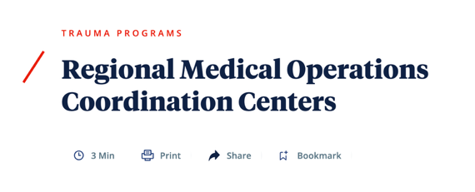

Session Overview
RMOCC Standards - Cannon
RESPOND-US - Cannon
Advocacy - Sakran
NIDHC, LSCO, NDMS Pilot - Freeman
NASEM/RMOCC Action Collaborative - Capella
Q&A
https://www.facs.org/quality-programs/trauma/committee-on-trauma/regional-committees-on-trauma/field-program/rmoccs/

Slide 7


Network of RMOCCs
Basis for National Trauma and Emergency Preparedness System
RMOCCs
Regional Medical Operations Coordination Centers
“A construct for regional patient distribution to avoid or mitigate crisis conditions by equitably deploying health care resources across a state, territory, or region”
RMOCCs -->> NTEPS
Notes:
What happens if the “event” or MCI exceeds your region’s capabilities and you need to go beyond your regional medical operations coordinating center?
The basic building block for a NTEPS is a network of RMOCCs so that a region could be easily linked in with other RMOCCs for additional resources.

Slide 8

RMOCC Standards: Process & Current Status
Core workgroup draft: Surgeons, EMS, Emergency Management
Informed by ASPR MOCC Toolkit, COVID MOCC experience, STRAC, ATHS
Multidisciplinary workgroup survey & reconciliation COMPLETE
Key stakeholder survey COMPLETE
Workgroup review and comment
Second draft
Stakeholder comment
Third draft
Approval and Legal Review
Release
First draft
Comprehensive, Strategic, Balanced, Maximally Inclusive

Slide 9
Standards Overview
Organized in four domains, several key themes
Domain 1: Governance & Structure
Domain 2: Capabilities
Domain 3: Data Collection & Performance Improvement
Domain 4: Legal & Operational Compliance
Ongoing daily operations, not an episodic capability stood up for disasters
Physician medical direction and oversight
Suggested activation tiers: routine → increased readiness → partial → full
Performance improvement focused on RMOCC performance
Explicit non-interference with existing referral and transfer relationships
National Expectations -->>
Regional Implementation

Slide 10
Beyond Standards: NTEPS Next Steps
ACS/COT NTEPS Program Area collaborating with NIDHC, key stakeholders
Standards Rollout
NIDHC/STRAC- collaboration for NDAA funded RMOCC sites
Support for ongoing RMOCC sites (e.g., Kentucky, Indiana)
Development of supportive materials/education
Advocacy and communication
Goal: RMOCC Integration -->> NTEPS Creation

Slide 11


Readiness and Emergency Systems Partnership for Operational National Disaster Response – US
Organizational Background +
Ongoing Mission
“Medical Readiness IS Combat Readiness."
September 2026 | COT Clinical Congress Meeting
www.respond-us.org

Slide 12
RESPOND-US: A WHOLE OF NATION EFFORT
WHY DO WE NEED RESPOND-US?
WHAT IS RESPOND-US?
THE HOW OF RESPOND-US
>100,000
<10%
1 DoD TC
A Non-Profit Military-Civilian Advocacy Alliance Created to Ensure the United States is Medically Ready to Deliver Coordinated Trauma and Emergency Medical Care on Day One of Future Conflicts & National Emergencies
Member Organizations
Strategic Advisory Cmte
60++ Hill & Pentagon Meetings
"In a large-scale conflict, civilian healthcare will not be a backup plan — it will be the main effort. But it is not organized, resourced, or integrated to function that way." – M. Davis, The Hill
Mike Davis. The Hill (May 2026) | Jeremy Cannon et al., J Trauma Acute Care Surg 2020 | Eric Goralnick et al., JAMA 2025

Slide 13


RESPOND-US Membership & Partnership Overview
Seat at the National Policy Table
Annual Hill Days
    SASC, HASC, Defense Appropriations, + Others
FY27 NDAA Language + $20M House Approps
Direct SAC Input on RESPOND-US Priorities
Peer Network of Leading AMCs & Orgs
Cooper University Health Care, CU Anschutz, Penn Medicine, UPMC, University of Utah
THOR Research Network Partnership
Shared research, training, and Department of Defense partnership models
Unified voice behind a national readiness legislative and policy agenda
Future Directions
Grow Membership + Partnership Base
Unified Advocacy Voice Behind Readiness
Lessons Learned Forum + Line Leaders Summit
Actively Developing 2027 Legislative Agenda
RESPOND-US | COT Clinical Congress Meeting

Slide 14
RMOCCs -->> NTEPS
The Time Is Now
RMOCCs represent additive capability. NTEPS offers a strategy for maturing and connecting existing RMOCC nodes into a national capability.

Slide 15
Advocacy around RMOCCs
September 26, 2026
Joseph V. Sakran, MD, MPH, MPA, FACS

Slide 16
Legislative Efforts to Advance RMOCCs
The American College of Surgeons continues to pursue multiple legislative avenues to advance NTEPS and
Regional Medical Operations Coordination Centers (RMOCCs).
2
$50M
1
Legislative Tracks
Proposed Grant
ACS-Endorsed Bill
Active pathways advancing RMOCC goals
Federal funding for RMOCC development
ABC-ED Act leverages existing programs

Slide 17
Two Key Legislative Tracks
ACS is advancing RMOCCs through two parallel pathways in Congress.
Track 1: HPP Reauthorization
Track 2: New Grant Program
ForthcomingPAHPA reauthorizationlegislation expected to include HPP language enabling grants for regional Health Care Coalition coordination.
ACS draft legislation would create anew federal grant programto support the development and maintenance of RMOCCs nationwide.
PAHPA
HPP
ACS DRAFT
$50M

Slide 18
PAHPA Reauthorization & HPP
The forthcoming PAHPA reauthorization offers a key vehicle for embedding RMOCC-enabling language into federal law.
PAHPA Reauthorization Expected
Regional Coordination Language
Forthcoming legislation anticipated to includeHospital Preparedness Program (HPP) reauthorizationas a core component, providing a legislative window for RMOCC-aligned provisions.
Proposed language would allowHPP grants to be used to enhance regional coordinationbetween Health Care Coalitions — directly supporting RMOCC infrastructure.

Slide 19
ABC-ED Act
What It Does
Key Features
ACS-endorsed legislation thatutilizes existing federal grant programsto expand statewide and regional bed tracking and capacity management systems — without requiring new appropriations frameworks.
ACS-endorsed legislation
Leverages existing federal grant mechanisms
Statewide bed tracking expansion
Regional capacity management systems
Builds RMOCC situational awareness infrastructure
Why It Matters
Real-time bed and capacity visibility is foundational to RMOCC function, enabling coordinated patient movement and resource allocation during surge events.

Slide 20

New Federal Grant Program for RMOCCs
ACS draft legislation proposes creating a dedicated federal grant program that goes beyond existing authorities to directly fund RMOCC establishment and long-term maintenance.

Slide 21
$50 Million Grant Program
Administered by theAdministration for Strategic Preparedness and Response (ASPR), funds would establish and sustain RMOCCs to support both acute care coordination and emergency medical response.
$50M
ASPR
2
Grant Size
Administering Body
Core Missions
Proposed federal appropriation
Administration for Strategic Preparedness and Response
Acute care coordination & emergency medical response

Slide 22
RMOCC Grant: Core Functions
Grant funds would support the daily operational capabilities essential to RMOCC performance.
Daily Monitoring
Regional Coordination
Data Systems
Patient, resource, and transportation tracking on a continuous basis
Facilitate coordination across health systems, agencies, and jurisdictions
Infrastructure to collect, integrate, and share real-time operational data

Slide 23
RMOCC Grant: Capacity Building
Beyond daily operations, the grant would fundlong-term capacity and readinessacross the RMOCC ecosystem.
Training & Mobilization
Best Practices
Operational Needs
Workforce readiness and rapid deployment of RMOCC personnel and protocols
Implementation of evidence-based standards for RMOCC operations
Funding flexibility to address additional RMOCC infrastructure and support requirements

Slide 24

Congressional Engagement Strategy
ACS staff is actively engaged on Capitol Hill to build awareness and secure legislative champions for the RMOCC grant program.
01
02
Socializing the Concept
Identifying Champions
ACS staff areactively meeting with congressional officesto introduce the RMOCC grant concept and educate Members and staff on its purpose and need.
Working to identifypotential congressional sponsorsin both chambers who can introduce and advance the legislation.

Slide 25
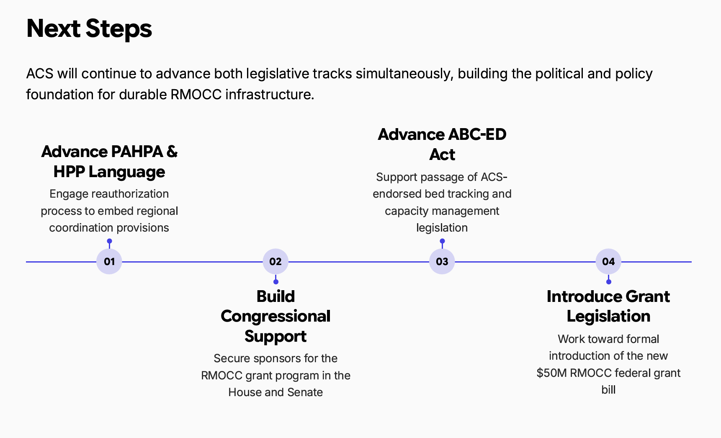

Slide 26
Large-Scale Combat Operations and U.S. Healthcare
Implications to military-civilian coordination
Jeffrey D. Freeman, PhD, MPH
Executive Director | Special Assistant to the President
National Institute for Defense Health Cooperation (NIDHC)
Uniformed Services University (USU)

Slide 27
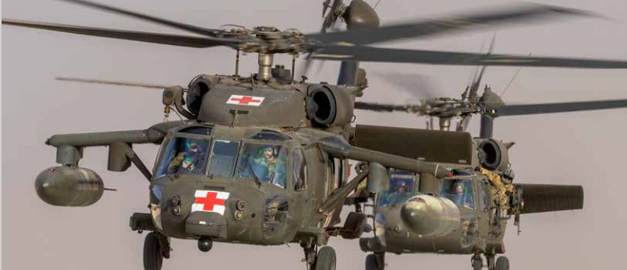
The Forward Pull of War
OCONUS medical and transport capabilities are severely limited, which will create a vacuum effect

Slide 28

Reversing the Paradigm
In a large-scale conflict, the military will need to reverse the traditional support structure for crisis

Slide 29
NDMS Pilot Program
National Institute for Defense Health Cooperation

Slide 30
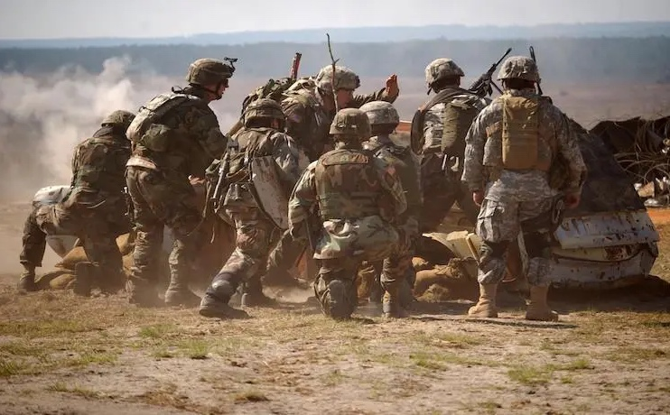
National Disaster Medical System Pilot
Motivated by concerns that the NDMS lacked the capacity to meet the requirements of a LSCO¹
Congressionally authorized (FY20 NDAA) program to assess and strengthen the National Disaster Medical System (NDMS)
The NDMS Pilot is required to:
  Address requirements of a LSCO or other catastrophic events
  Establish partnerships with healthcare organizations
  Ensure coordination with the Federal Interagency
  Be conducted over five years at no less than five sites
  The National Center for Disaster Medicine and Public Health (now NIDHC) was chosen as the Office of Primary Responsibility
¹Kirsch, Thomas D., et al. "Validation of Opportunities to Strengthen the National Disaster Medical System: The Military–Civilian NDMS Interoperability Study Quantitative Step." Health security (2023).

Slide 31
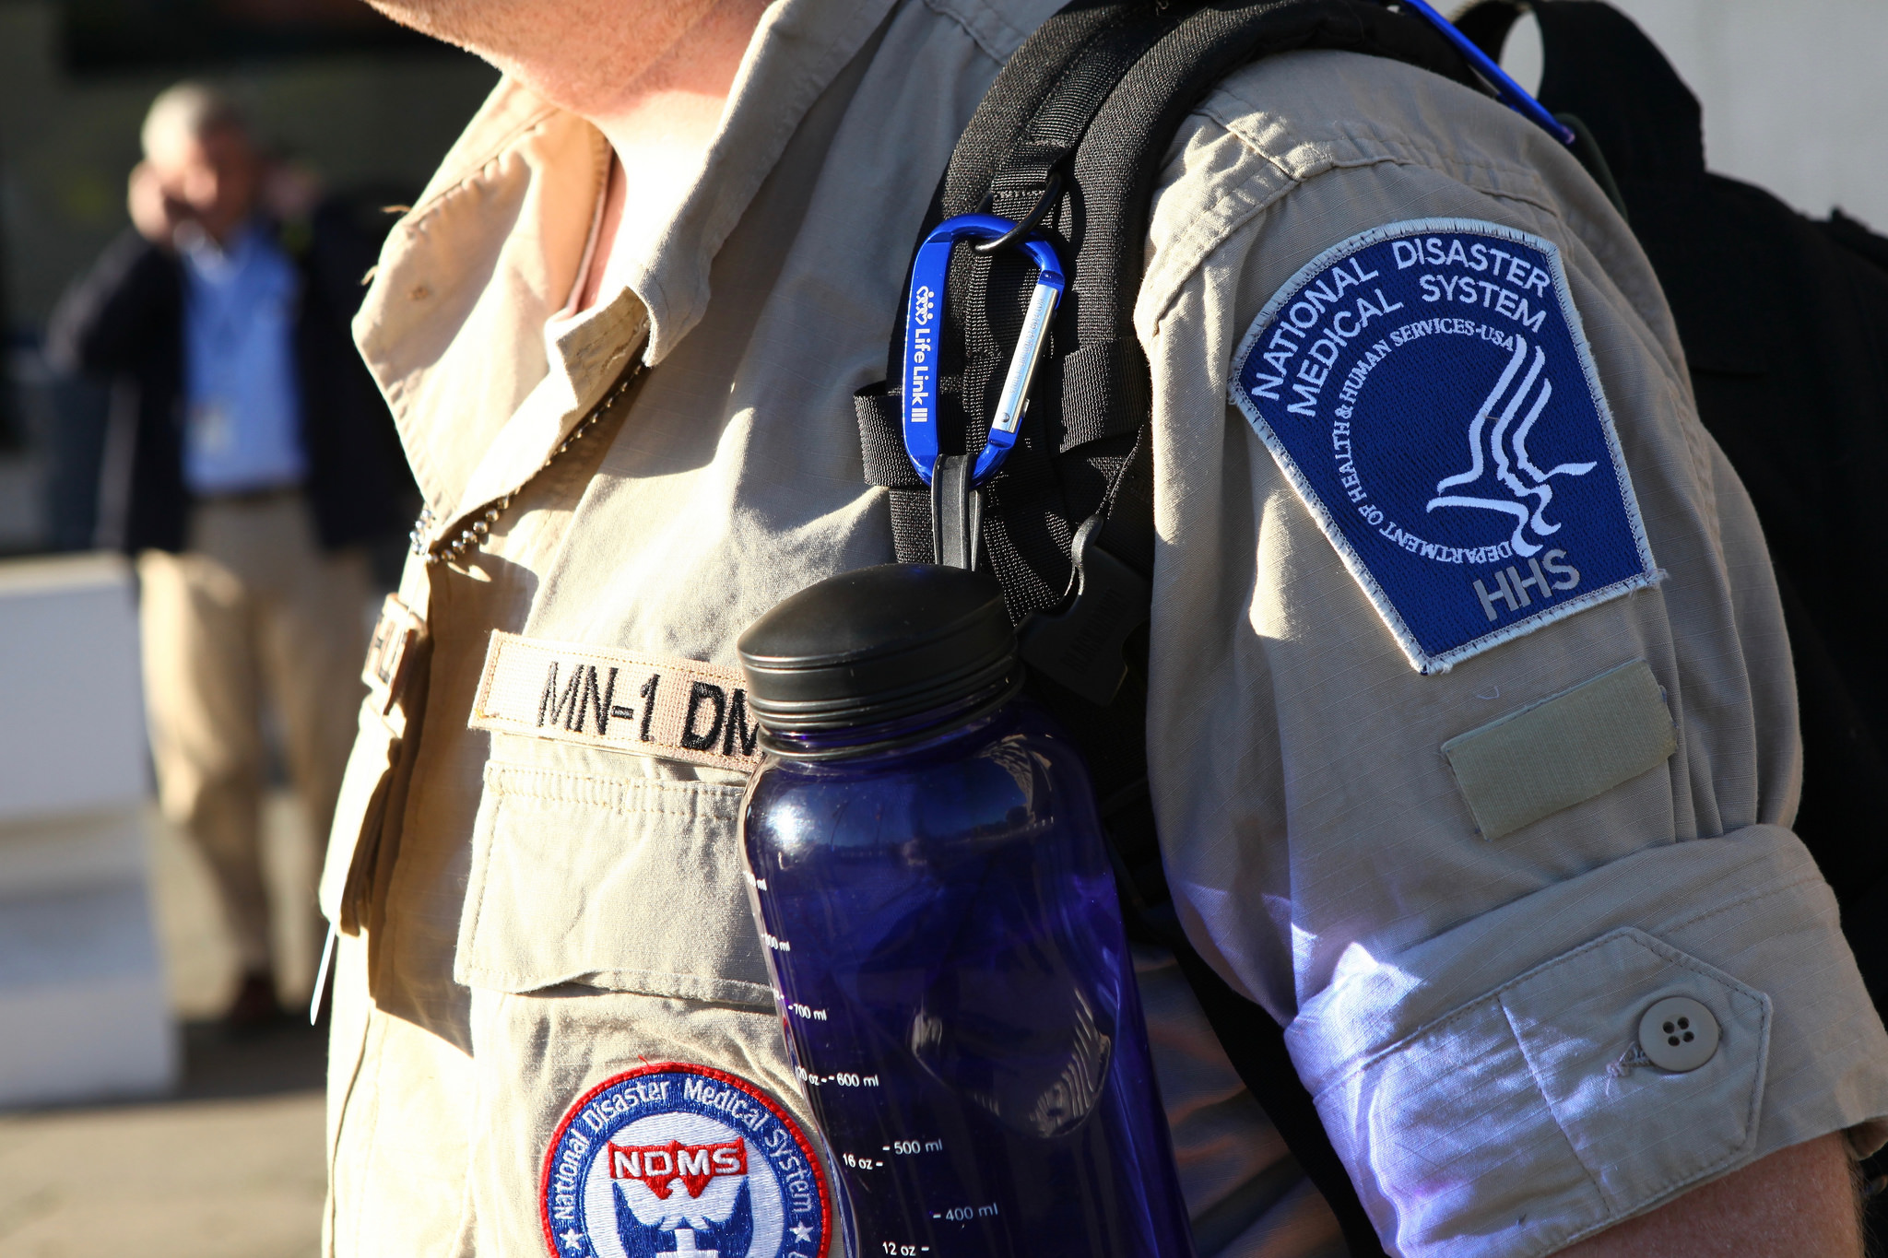
NDMS Pilot Findings
At present, the NDMS has insufficient authorities, funding, and capabilities needed to respond
Warfighting mission of the NDMS absent from law
Interagency agreements no longer active
Funding inadequate for NDMS to meet basic obligations
Capabilities insufficient for large-scale response
Misaligned expectations of federal, state, and local partners

Slide 32

System Constraints
Designed for geographically limited acute-onset disasters, not prolonged widespread catastrophes
Coordination structure lacks significant capability
Surge capacity is reliant on a fragile design
Primarily deploys a restrained augmentation model
System must support two missions within one construct

Slide 33
Looking Ahead
National Institute for Defense Health Cooperation

Slide 34
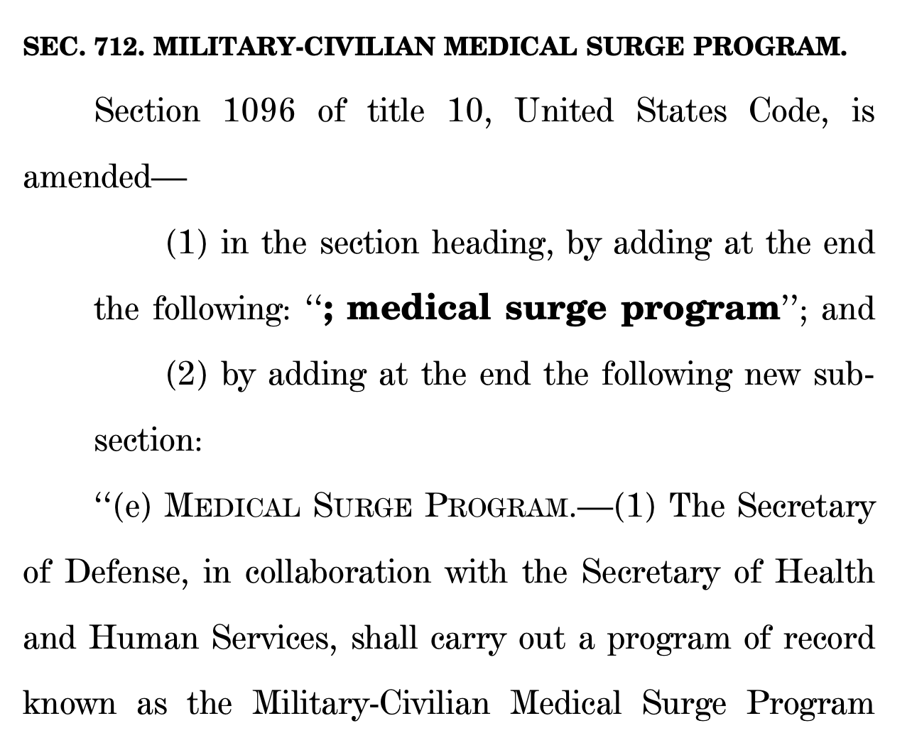
MIL-CIV Medical Surge Program
Congress authorized the Military-Civilian Medical Surge Program in the FY26 NDAA
Address issues of civilian mobilization and support
Avoid infringement on HHS ESF-8 responsibilities
Mitigate the simultaneity challenge facing the nation
Provide optionality to the Military Health System

Slide 35

Thank you
nidhc@usuhs.mil

Slide 36

High-Level Recommendations
In the simplest terms, NDMS authorities, roles, responsibilities, and funding must be strengthened
Wartime obligations of the NDMS need to be codified in law with appropriate oversight
Interagency agreements defining roles and responsibilities need to be re-established and maintained
DoW must avoid assumptions-based planning through an MHS-governed medical mobilization architecture
DoW must do more for its partners to ensure they are resourced and able to support when needed

Slide 37
Specific Actions
Recommended system improvements must sufficiently address long-established capability gaps
ASPR NDMS Teams of Responders need to be replenished, reconfigured, routinely trained and exercised
Training and education itself must be extended to nonfederal partners (the horsepower of the system)
Develop and deploy an alternative skilling model to avoid sole reliance on augmentation models
Units of action with core capabilities enabling coordination at scale should provide support to the FCCs
National-level data and coordination should be enabled thru these units of action with integration to JTS
Wartime mobilization and sustainment framework should be defined for both war and disaster missions

Slide 38
NASEM AC-MOCCs Update
Jeannette Capella, MD, MEd, FACS, MAMSE
Chair, Disaster Program Area, ACS-COT

Slide 39
Acronymology
NASEM – National Academy of Sciences, Engineering and Medicine
Forum on Medical and Public Health Preparedness for Disasters and Emergencies
AC – Action Collaborative
MOCC – Medical Operations Coordination Center

Slide 40
NASEM Action Collaborative
What is it? Public-private partnership convened by NASEM to bring together leaders from various sectors—such as universities, government, healthcare, and nonprofits—to tackle complex, systemic challenges through evidence-based solutions.
Why do it this way?
Neutral respected convening body
Goal oriented
Member driven

Slide 41
NASEM Forum Membership
ASPR
ABA
ACEP
ACS-COT
AHA
AMA
APHL
ASTHO
NACCHO
NAEMSP
NAEMT
NFPA
NHTSA
SCCM
MITRE
CDC
CSTE
GMR
HCA
HDA
IDSA
MGH
Mt Sinai
USUHS
UNMC
TCAA
USDOD/W
USDHS

Slide 42

AC-MOCCs Transitions Initial Priorities into Focused Deliverables in Year One
FIRST-YEAR PROGRESS & INITIATIVES
It has been one year since the initial convening of the NASEM (AC-MOCCs). Over the past year, initial priorities have successfully translated into concrete deliverables:
• Functional Typology Paper: Drafting a forthcoming foundational paper on MOCC operational models.
• Geospatial Infrastructure Mapping: Developing a national baseline map of MOCC-related infrastructure.
• Data & Tech Exploration: Conducting structured evaluation of supporting data platforms.
RESEARCH AGENDA & NEXT STEPS
The collaborative is actively expanding its evidence base and preparing for near-term implementation:
• Evidence & Research Agenda: Developing a broader MOCC research agenda to guide future policy and practice.
• Patient Transfer Models: Proposing an expert discussion examining patient transfer center dynamics and MOCC integration.
• Concrete Execution: Well-positioned to move from strategic planning into active deliverable rollouts over coming months.

Slide 43
AC-MOCCs Workstreams
Operations
Functional Typology Paper
Establishes a shared operational foundation and functional typology for MOCCs across diverse use cases.
2. Capacity
Geospatial Infrastructure
Develops a national baseline map of MOCC infrastructure to enable a common operating picture.
3. Data & Tech
Platform Exploration
Evaluates technical infrastructure, data needs, and interoperability barriers with key stakeholders.
4. Communication
Foundational Messaging & Materials
Curated Literature Review of Best Evidence
MOCC Research Framework and Agenda
Identify gaps and expand the evidence base

Slide 44
Operations Workstream
Paper Objectives & Operational Foundation
Core Goal
The overarching goal of this deliverable is to help establish a shared conceptual and operational foundation for Medical Operations Coordination Centers (MOCCs) across a wide range of use cases.
Functional Typology
Intended to provide a common way of describing the significant variation in MOCC functions and functionality, deliberately doing so without prescribing a single, rigid organizational model or a strict set of capabilities.
Publication Status
The manuscript has been carefully refined through extensive input from Operations Workstream members and is currently nearing submission for formal publication. Once available, it will be shared with the broader AC-MOCCs community.

Slide 45
Capacity Workstream:
Geospatial Infrastructure Mapping
Primary Objective
Establishing a Common Operating Picture
The effort drives a national baseline geospatial visualization of medical coordination infrastructure across the United States to inform future planning for a scalable, multi-layered MOCC system.
Timeline: Preliminary mapping products expected for collaborative discussion over the next month.
Key Focus Areas & Capabilities
National Dataset Integration
Systematically integrates multiple national-level datasets to evaluate how MOCCs align with existing healthcare infrastructure.
Regional Coordination
Enhances operational sightlines to support seamless coordination across regional healthcare jurisdictions.
Patient Movement Routing
Maps critical transit corridors and load-balancing mechanisms for effective patient transfer management.
Large-Scale Medical Surge
Establishes dynamic asset tracking and surge capacity readiness during healthcare crisis events.

Slide 46
Data and Technology Platforms Workstream
Workstream Overview
Objectives
The Data and Technoloy Platforms Workstream is currently focused on systematically gathering critical information and perspectives related to the technical and data infrastructure required to support MOCC operations.
The initiative directly engages key stakeholders to systematically address technical infrastructure and interoperability barriers across systems.
Stakeholder Engagement
Targeted Discussions
Planned activities include conducting targeted, 1-on-1 discussions with a curated group of:
• Data & Platform Vendors
• Health System IT Leaders
• Key Operational Stakeholders
Designed to better understand implementation challenges, interoperability barriers, data needs, and systems improvement opportunities.
Next Phase
Steps & Reconvening
Currently reconvened to shape key foundational elements prior to launching formal engagement.
Key Focus Areas:
Shape the discussion guide
Identify the right participants
Refine overall strategic approach
Target: Finalize strategy before formal outreach begins.

Slide 47
Communications Workstream
PHASE 1 • INITIAL FOCUS
Foundational Messaging & Materials
Led by John Armstrong
Originally focused on developing core communications materials to establish a clear, standardized understanding of the MOCC concept across various sectors.
Key Deliverables Developed:
Standardized definitions & fact sheets
Targeted talking points & messaging resources
Draft materials and concepts have been successfully developed but revisions needed.
PHASE 2 • CURRENT PRIORITY
MOCC Research & Evidence Agenda
Next Critical Workstream Phase
Building directly on the foundational messaging work, the group is now actively exploring a broader research and evidence agenda to advance the field.
Strategic Focus Areas:
Identifying key knowledge gaps in the field
Establishing clear research & evaluation priorities
This phase will guide future evaluation frameworks and evidence-building strategies across participating partner institutions.

Slide 48
Patient Transfer Center Models & MOCC Integration
INITIATIVE LEAD: JOHN HICK
Real-World System Models
Gather direct insights on current operational models and daily management challenges from active health systems.
Examining centralized transfer functions to inform broader healthcare coordination.
Technology & Data Infrastructure
Identify specific technology, data requirements, and key lessons learned from centralized operations.
Running in parallel with primary workstreams, this expert discussion engages health systems operating centralized transfer and capacity-management functions to extract actionable operational insights.
MOCC Alignment & Intersections
Map exact intersections and relationships between transfer centers and overarching MOCC functions to ensure system-wide alignment.

Slide 49
Jeannette Capella, MD, MEd, FACS, MAMSE
jmcapella44@gmail.com

