Slide 1
Regional Committees on Trauma Update
Jeffrey A. Bailey, MD, FACS
Chair, Regional Committees on Trauma (RCOT)

Slide 2
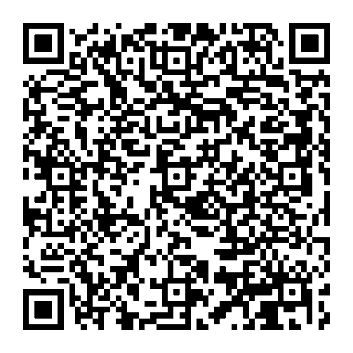
Welcome to new RCOT members !
RCOT S/P/C Chairs

Slide 3
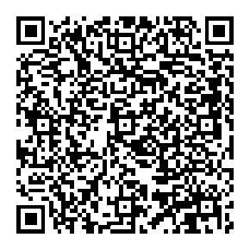
RCOT Project
In depth update of Regional COT Procedures Manual and Operational Manual (2-3 Years)
  PHASE 1
    Discovery and Review of Legal Relationships between RCOTs and ACS
    Agreements, Bylaws, Timeline, Next Steps
  PHASE 2
    Consensus on Approach and Scope, Survey’s, Focus Groups, RCOT Board Collaboration
  What is the definition of a Regional COT?
  How is a Regional COT formed? Required Process, MOUs,
  What criteria are used to determine the appropriate Region for a new Regional COT?
  How do we successfully expand the Regional COT footprint?
  Standardizing and updating financial tool kit (US only)
  And Much More...
RCOT S/P/C Chairs

Slide 4
Field Program Refresh:
Individual Topic-Specific Webinars (coming soon)
Pediatric Readiness Series Continues
Discussion about Universal Unique Identifier “UUID” (how can you help?) Analytics/EMS Spring 2027
Building your relationship with National Assoc of State EMS Officials (NASEMSO)
How to navigate your trauma system/work with your state trauma systems manager
VRC Updates - Standards release expected Fall 2026
Make the most of your TQIP Collaboratives
ATLS 11 Best Practices, new opportunities in Trauma Education
Other?
RCOT S/P/C Chairs

Slide 5
50th Anniversary of RFTPC (2028)
Outreach to past winners (first 10 years)
Honorary judges, moderators and/or discussants
Past RCOT Chair participation as special guests
Special anniversary celebration booklet (ACS-IC collaboration)
Website updates, including photo collage, celebrating 50 years of research
RCOT S/P/C Chairs

Slide 6
FTL Transition to State Structure
FTL & FTL Transition structured under Membership Program
18-month FTL term + 2-year Transition term
NOW continue as “Active Member” in your State COT
Local Participation through State Chair
Exposure to State COT, attend State Meetings, raise your hand, show up!
Mentoring continues to support future growth within the trauma community.
RCOT S/P/C Chairs

Slide 7
RCOT Participation Timeline
FTL RAS YFA
FTL
Transition
S/P/C
Active
Member
S/P/C
Vice Chair
S/P/C Vice Chair
Region Chief
Central COT
RCOT Leadership & COT Service Timeline
S/P/C
Vice Chair
S/P/C Chair
Region Chief
Central COT
RCOT Leadership & COT Service Timeline
S/P/C Chair
Region Chief
Central COT
COT Service Timeline
Central COT
Pathways of Participation
Notes:
Continued participation as Active Member in the State COT is strongly encouraged prior to being considered for a State Vice Chair appointment (that includes former FTL and FTL Transition members)

Slide 8
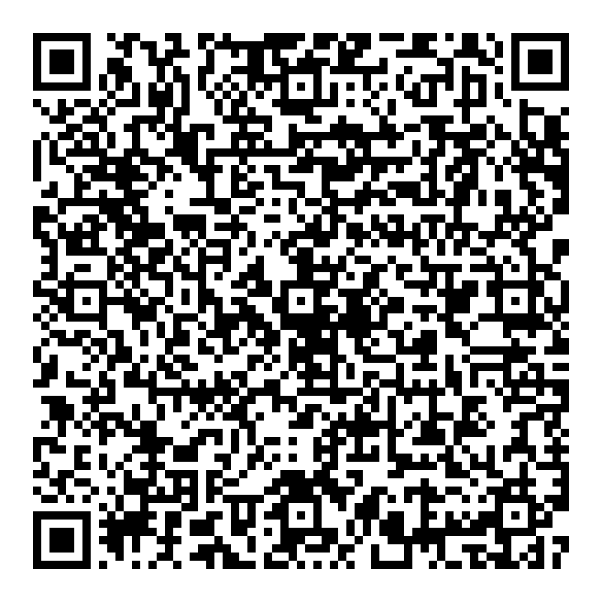
ME

