Slide 1
Blood Management
Moderator: Peter E. Fischer, MD, MS, NRP
Chair, Systems Program Area
COT Member Meeting at ACS Clinical Congress · Saturday, September 26, 2026 · 3:00 PM

Slide 2
 | Speaker | Topic
Systems Program Area Chair | Peter Fischer MD, MS, NRP, FACS | Session Introduction
EMS Program Area Chair | Carlos H. Palacio, MD, FACS | State of Prehospital Blood Programs
PIPS Program Area Chair | Bryce Robinson, MD, MS, FACS, FCCM | Transfusion Guidelines
NHTSA Office of EMS Director | Gamunu Wijetunga | EMS and Prehospital Blood
Blood Centers of America President/CEO | Bill Block | Vulnerabilities in Blood Supply
Systems Program Area Chair | Peter Fischer MD, MS, NRP, FACS | Questions

Slide 3
Carlos H. Palacio, MD, FACS
Chair for the Southern Texas Committee on Trauma
State of Prehospital Whole Blood Program

Slide 4
NO DISCLOSURES

Slide 5
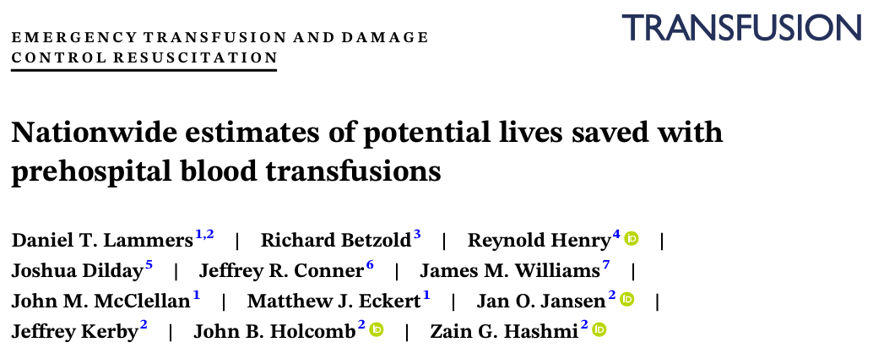
Prehospital whole blood
Notes:
EMS could potentially save >10000 lives a year by transfusing blood prior to arriving to the hospital
Efforts toward making policy level interventions aimed at increasing the availability , adoption and sustainment of prehospital whole blood program

Slide 6
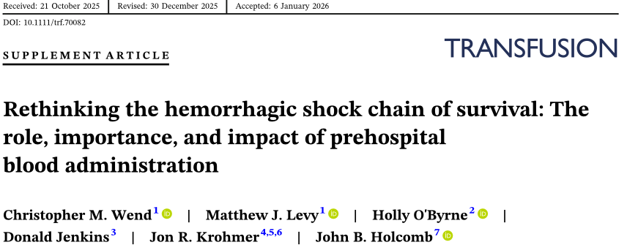

Prehospital whole blood

Slide 7
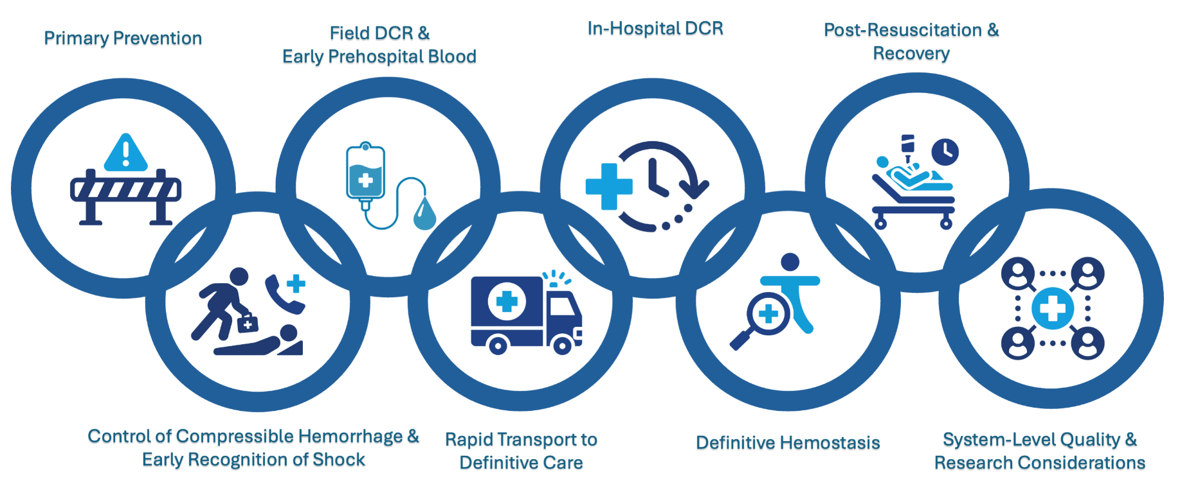
Prehospital whole blood

Slide 8
Prehospital blood Efficacy Landscape
Trial/Study | Intervention | Result
PAMPer Trial | Thawed Plasma Vs. Crystalloid (Air Transport) | Decreased 24-hour and 30-day mortality. Lower Prothrombin time ratio.
COMBAT Trial | Thawed Plasma Vs. Crystalloid (Ground Transport) | Stopped for futility. No mortality benefit at 28D for plasma alone
RePHILL trial | RBC + Lyophilized Plasma Vs. Saline | No difference in primary composite outcome, but limited by incomplete enrollment
PAMPer Secondary analysis | RBC’s alone or RBC + Plasma Vs. Crystalloids | Decreased 30-day morality. Highest survival benefit in the RBC + Plasma Cohort.

Slide 9
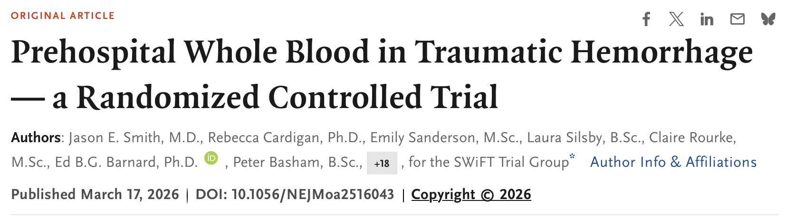
Prehospital whole blood
Clinical interpretation
Do not confuse “whole blood not superior to components” with “ Prehospital blood is not beneficial
Notes:
SWIFT: UK Based RCT: PRBCs & Plasma vs WB (not crystalloid) on helicopters. Very well done trial
Among participants with life threatening hemorrhage, pre hospital transfusions of 2 units of whole blood was not superior to standard of care ( 2 plasma + 2 PRBC)
In reducing the risk of dead or massive transfusion in 24Hours
314 WB and 302 in the standard-care group. Primary outcome: death from any cause or massive transfusion (≥10 units of blood components or products) within 24 hours.
Outcomes appeared to be similar in the two groups. More serious adverse events occurred in the standard-care group than in the whole-blood group (37 and 31, respectively).
Average time to blood administration was 67 minutes from injury. Concern for survival bias.
Samall dose, 1 or 2 units , there is no whole blood in trauma center in UK

Slide 10
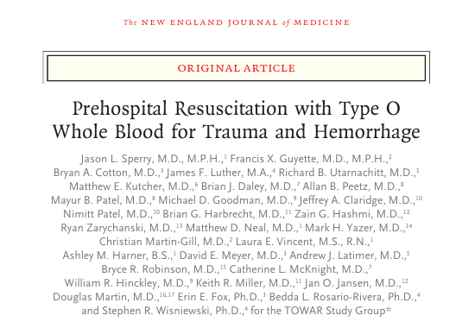
Prehospital whole blood
Clinical interpretation
The use of whole blood for prehospital transfusion did not result in lower 30-day mortality than the use of blood components
Notes:
TOWAR trial
Primary outcome was 30 day Mortality
Secondary was death at 3-6-24Hr
Blood transfusion requirements (24Hrs
Inclusion criteria was with SBP less 90
Clustered randomization → Component vs Whole blood arm, young vs older
NO difference in the 30 day outcome. Unable to demonstrate the difference between both groups
Incidence adverse event was very low

Slide 11
2026 Landmark Trials
U.S Pragmatic Phase 3 trial
NEJM, 2026
Whole blood Vs As-indicated components, tested across 44 air-medical bases nationwide
UK SWiFT trial
NEJM, 2026
Two units of whole blood was not superior to standard component care for death or massive transfusion inn Traumatic hemorrhage
Bottom Line
Both trials support equipoise between whole blood and components – protocol should favor whichever product is available and get to the patient faster
Notes:
PAMPER mortality was 30% (Saline vs plasma) and we brought it down to 24% in all patients with TOWAR ( Component vs whole blood)
Flexibility to use whole blood or component . We have the ability to change therapies depending on our needs and environment
TrooP will give us an answer of in hospital whole blood

Slide 12
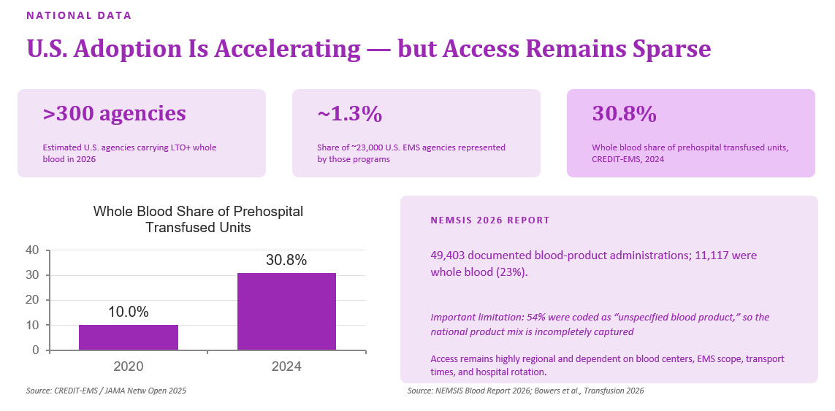

Slide 13


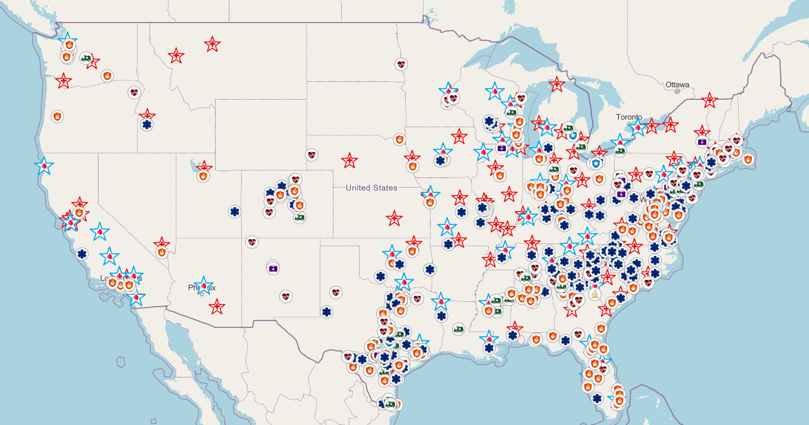


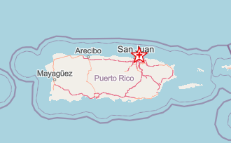
Current programs
www.prehospitaltransfusion.org

Slide 14
Prehospital whole blood
Major Challenges
EMS reimbursement based on transportation to ED
  Mileage and level of care based. TRICARE
CMS Regulatory modification for ground ambulances
  Blood added to ALS / no additional reimbursement
Hospital transfusion committee participation
  Trauma surgeons influence

Slide 15
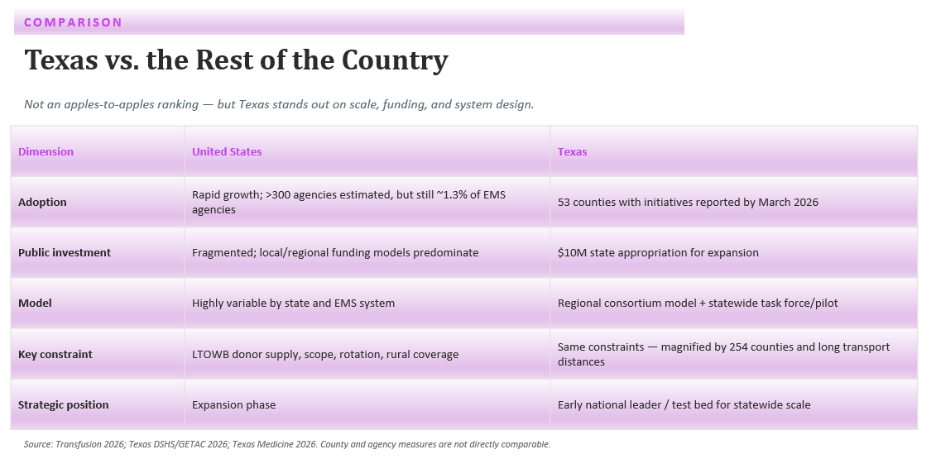

Notes:
At least 20 coalition
Arkansas
Georgia
Colorado
California
Delaware
Michigan

Slide 16
What Remains Unsettled?
Whole blood vs. balanced components
Recent randomized trials do not show clear superiority of 1–2 units of whole blood.
Dose and timing
Benefit may depend more on how early blood is given — and whether enough is given — than on product label alone.
Supply and cost
National scale-up could require substantial new LTOWB donor recruitment; rotation models are critical to stewardship.
Equity
Rural and long-transport regions may have the most to gain yet face the hardest logistics.
The next frontier is not “Can EMS give blood?” — it is “Can we deliver it reliably, early, and equitably?”
Source: CREDIT-EMS 2025; NEJM 2026 trials; Transfusion 2026 scaling model
Equity

Slide 17
Where we are in 2026 ?
1
Prehospital blood is becoming mainstream.
National use is rising quickly, but most EMS agencies still do not carry it.
2
LTOWB is operationally attractive, re imbursement challenge still present.
One product delivers RBCs, plasma and platelets; current guidance favors LTOWB when available.
3
Superiority over components is not proven.
Recent RCTs support equipoise between whole blood and component-based prehospital transfusion.

Slide 18
THANK YOU SO MUCH !

Slide 19
Transfusion Best Practice Guidelines
Bryce Robinson, MD, FACS, FCCM; PIPS Chair

Slide 20
Disclosure
None

Slide 21

Best Practice Guideline: Transfusion in Trauma
Expansion of the 2014 “Massive Transfusion in Trauma” BPG
Expert Panel Leads:
  Matthew Neal, MD, FACS
  John Hess, MD, MPH, FACP, FAAAS
Panel of 30+ to include surgeons (adult and pediatric), blood bankers, and nurse leaders
Release at TQIP 2026 (Anaheim, 11/13)

Slide 22
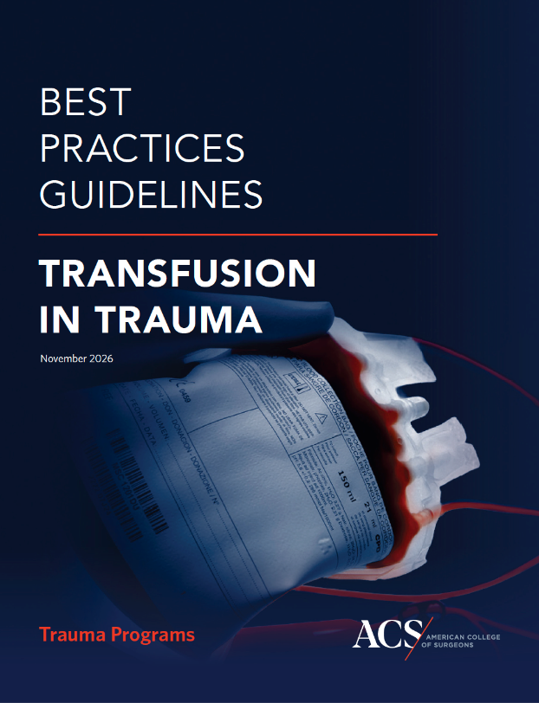
BPG Transfusion in Trauma - Focus
Scalable guideline for all centers caring for the injured
Much more than an “MTP guideline”
Consideration of special populations (pediatrics and geriatrics)
Alignment with “Resources for Optimal Care” documents
Implementation and integration into centers’ education and PIPS plans

Slide 23

BPG Transfusion in Trauma - Contents
Initiating Transfusion
Blood and Hemostatic Adjuncts
Special Patient Considerations
Medical Oversight
Massive Hemorrhage Protocols
Hemostatic Adjuncts
Laboratory Evaluation
MHP Cessation
Transfusion Triggers after Hemostasis
Special Patient Considerations

Slide 24


BPG Transfusion in Trauma - Transfusion Svcs
Needed collaboration between Transfusion Medicine, Trauma Support Services, and the Trauma Team
  MHP generation and management
  Blood product storage and release
  Blood administration
  Transfusion services integration into PIPS

Slide 25
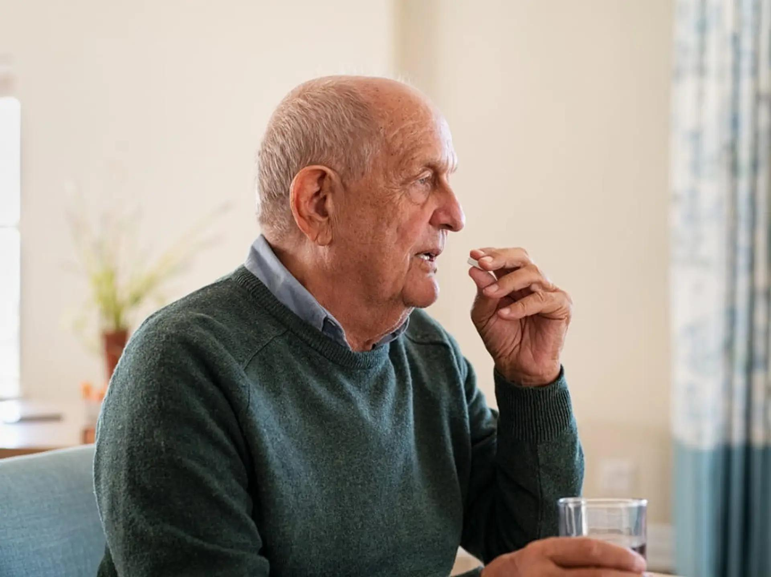
BPG Transfusion in Trauma - New Content
Anticoagulation Reversal
  Vitamin K antagonist
  Direct oral anticoagulants
  Direct thrombin inhibitors
  Bleeding management of those with antiplatelet agents

Slide 26
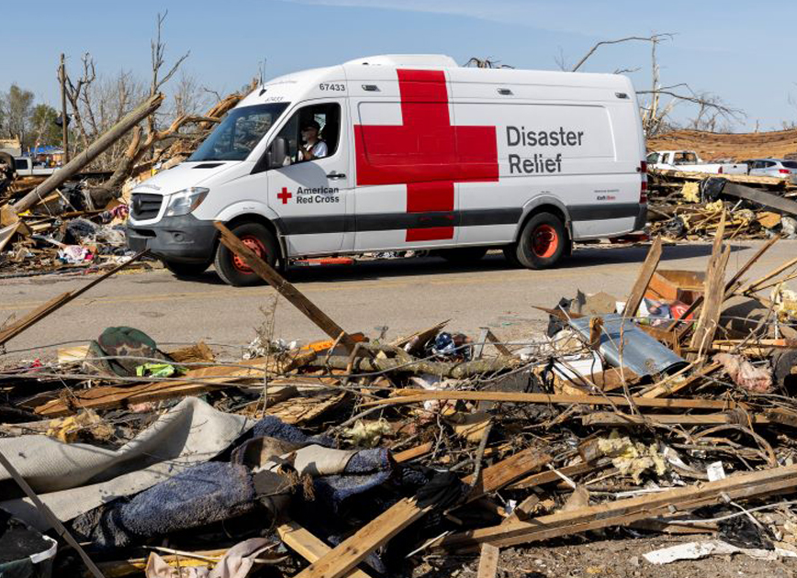
BPG Transfusion in Trauma – New Content
Transfusion Support for Surge Capacity
  Disaster preparedness planning
  Low-resource and remote settings
Future Directions for Transfusion Care

Slide 27

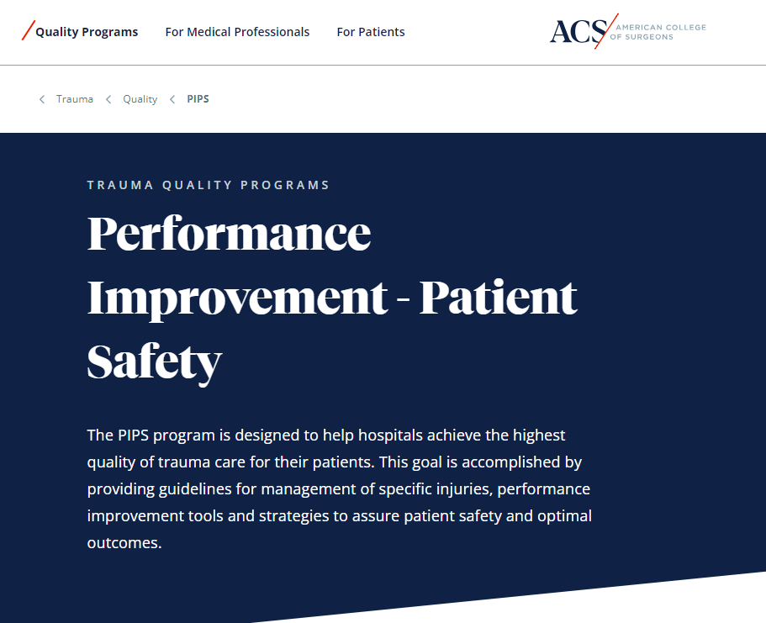



Reminder: ACS PIPS Webpage
Notes:
Note to drive folks to our stand-alone website within the bigger ACS web universe. It’s under the “Performance Improvement - Patient Safety” section of the COT sub-site. All of the content discussed today, BPGs, mortality reporting system publications, and trauma protocols in publication, can be found there.

Slide 28
Thank You
All the BPG panelist, especially the leads
Babak Sarani, MD, FACS, FCCM, PIPS Vice Chair
Avery Nathens, MD, PhD, FRCS, FACS
Tammy Morgan
Audrey Phillips, MS, OTR/L

Slide 29
EMS and Prehospital Blood
Gamunu Wijetunge
Director
Office of EMS, NHTSA

Slide 30







OFFICE OF EMS’ MISSION
Reduce death & disability
Provide leadership & coordination to the EMS community
Assess, plan, develop & promote comprehensive, evidence-based emergency medical services & 911 systems
®
3

Slide 31
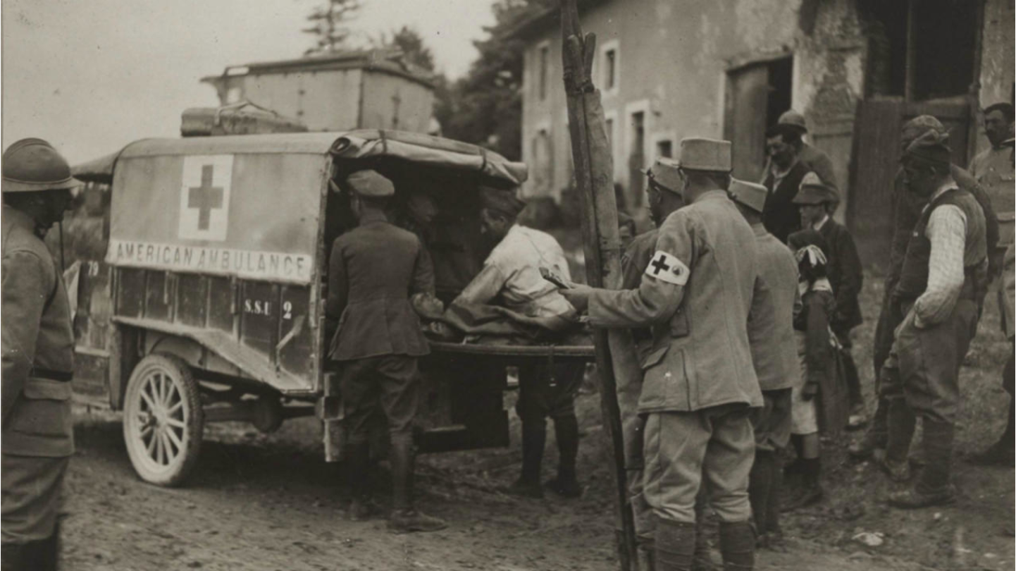

Slide 32

“Accidental Death and Disability: The Neglected Disease of Modern Society”
Published in 1966
By the National Academy of Sciences

Slide 33
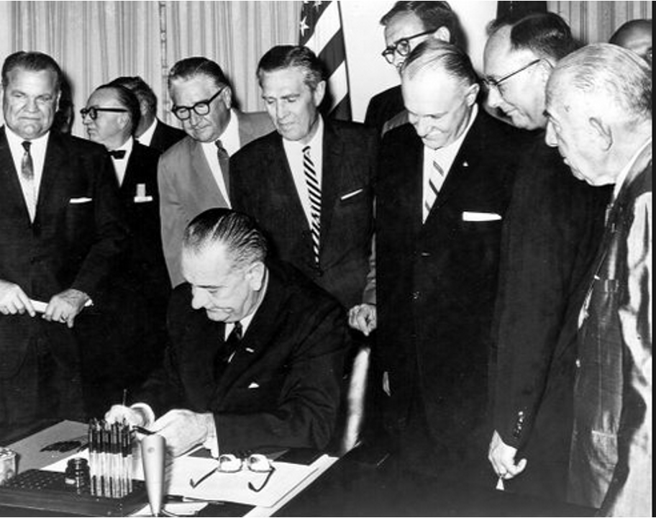
THE HIGHWAY SAFETY ACT OF 1966
Highway Safety Program Standard 4.4.11
Emergency Medical Services
June 27, 1967
“Each State, in cooperation with its local
political subdivisions, shall have a program to ensure that persons involved in highway
accidents receive prompt emergency medical care under the range of emergency
conditions encountered.”

Slide 34
Expert consultants returning from both Korea and Vietnam have publicly asserted that, if seriously wounded, their chances of survival would be better in the zone of combat than on the average city street.
National Academy of Sciences, Accidental Death and Disability: The Neglected Disease of Modern Society, 1967.
Today, a severely wounded service member in Afghanistan is more likely to survive his or her injuries than an equally injured trauma victim in many parts of the United States.
Stephen L. Jones, MD, and Clinton K. Murray, MD. “The Health Challenges of Operation Enduring Freedom and Operation Iraqi Freedom”, 2017.

Slide 35


Slide 36

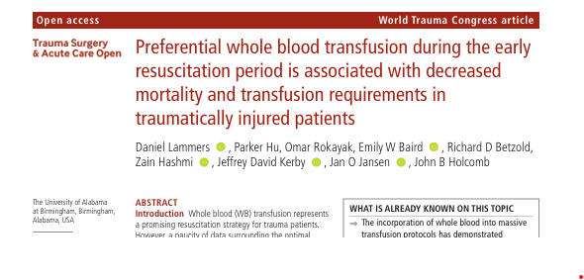
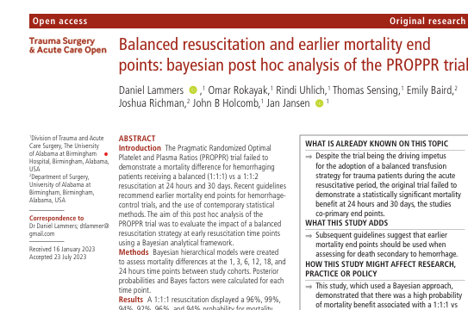
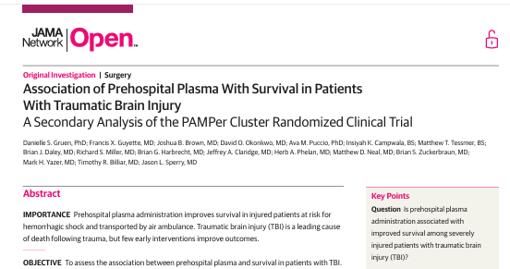
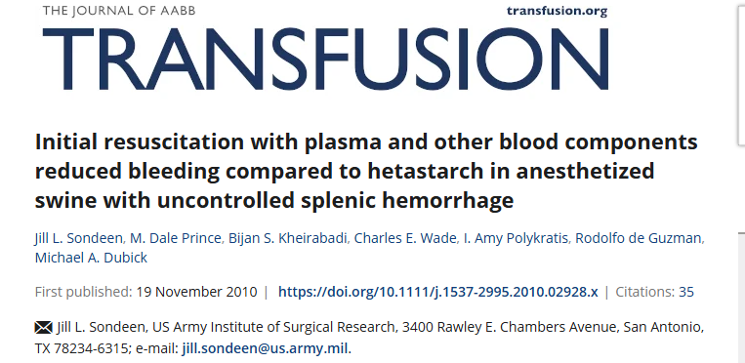


PREHOSPITAL BLOOD TRANSFUSION DATA & RESEARCH

Slide 37
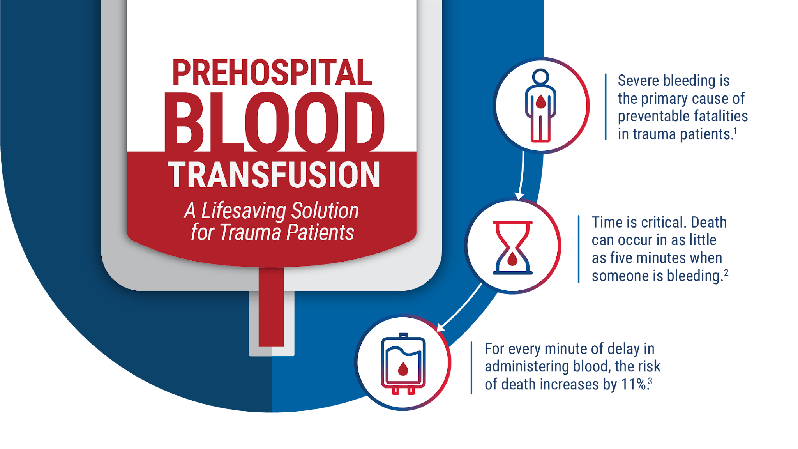

Slide 38
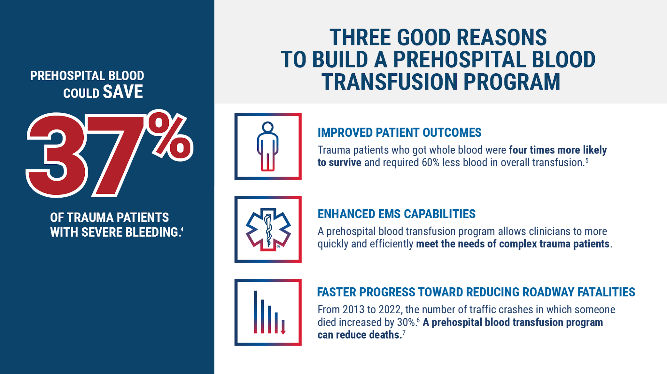

Slide 39

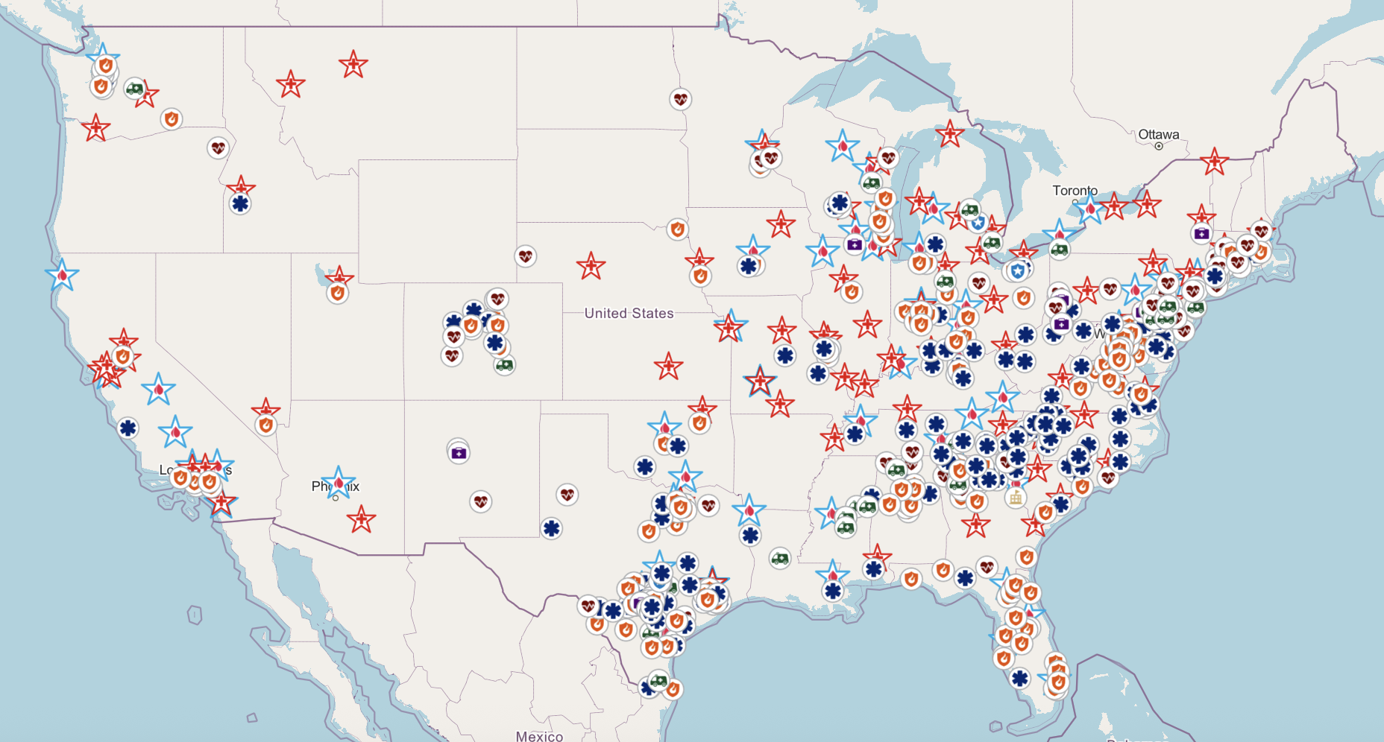


TRACKING PREHOSPITAL BLOOD TRANSFUSION PROGRAMS
More than 450 prehospital blood programs to-date
Prehospital Blood Transfusion Coalition tracks programs nationally
Visit prehospitaltransfusion.org
to learn more
Prehospital Blood Coalition Map, July 2026

Slide 40
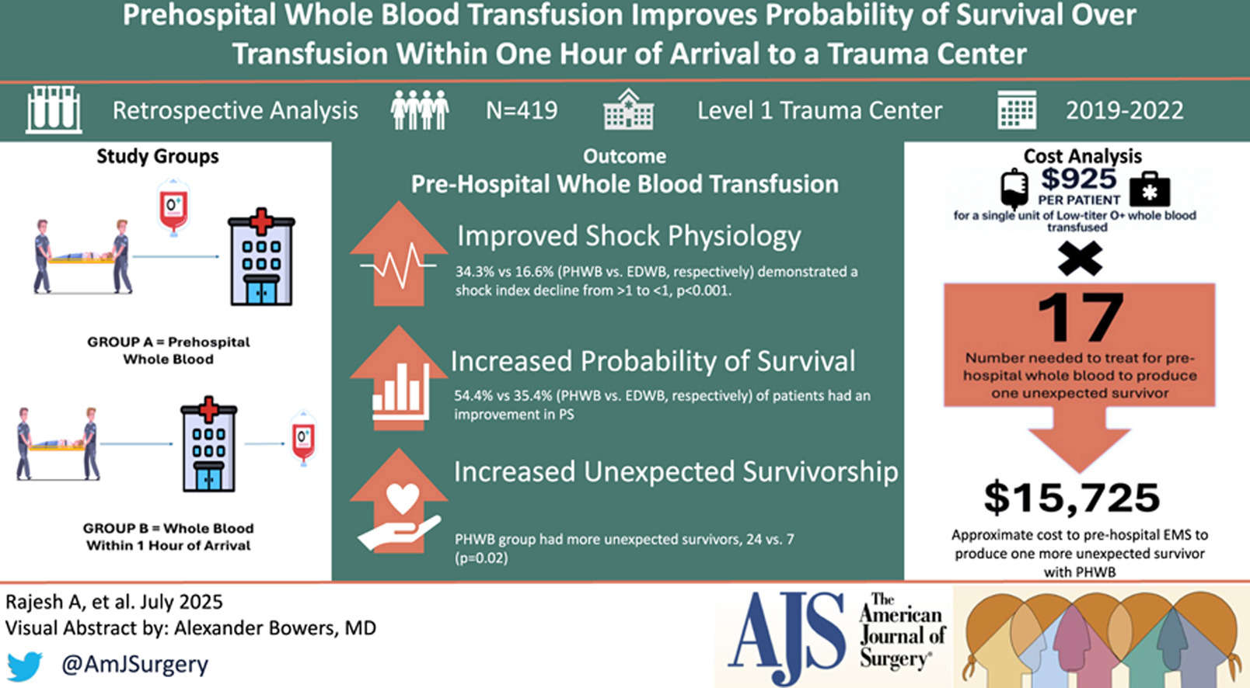
Source: American Journal of Surgery

Slide 41
~$15,725 invested in
prehospital transfusion
produces one more
unexpected survivor.
- American Journal of Surgery

Slide 42



NATIONAL ROADWAY SAFETY STRATEGY 2026
“Prehospital blood transfusion programs coupled with 911 call-taking protocols are promising tools that support faster, more informed responses….DOT will improve public safety infrastructure and expand post-crash care to save lives.”
National Roadway Safety Strategy (NRSS)
®

Slide 43
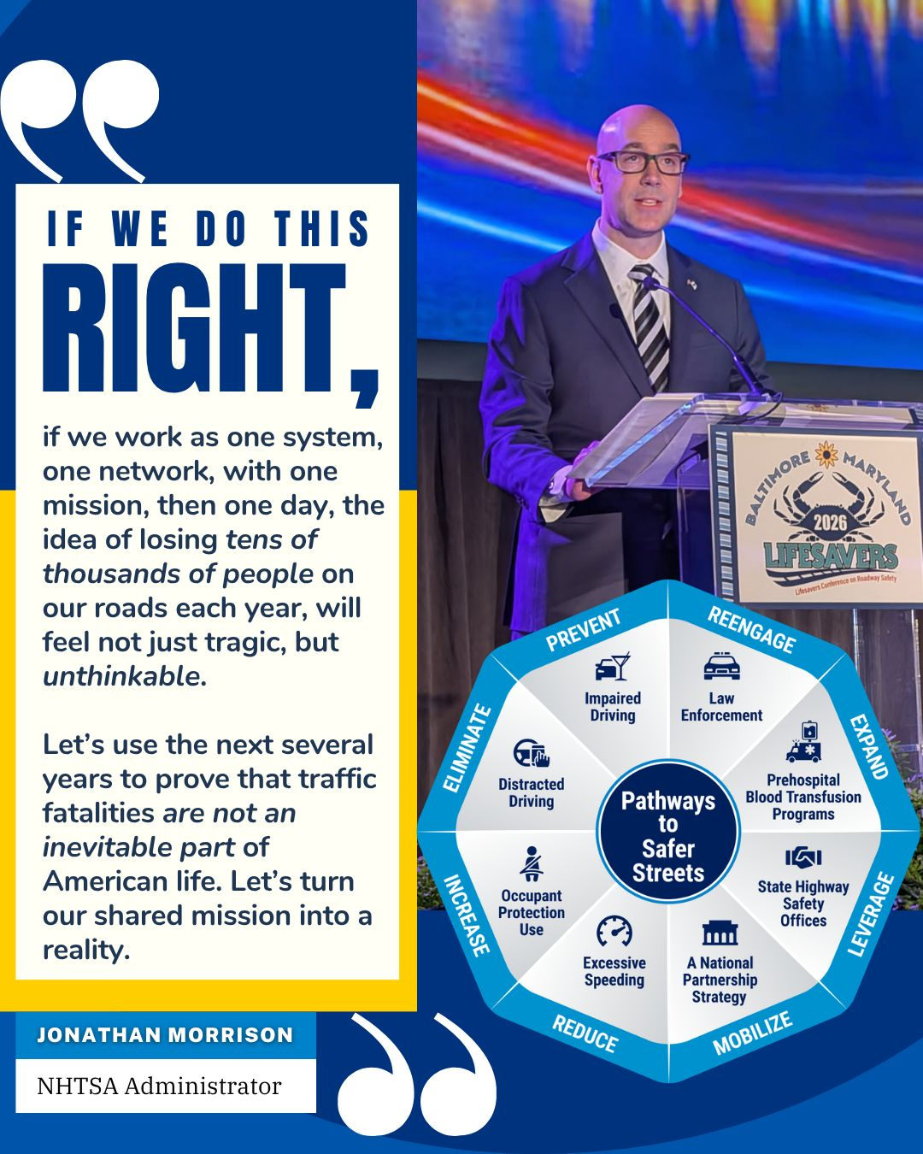
POST-CRASH CARE: A NATIONAL SAFETY PRIORITY IN ACTION
Pathways to Safer Streets (P2SS): Prehospital blood is named one of eight federal priorities in the Administrator’s action plan —with new tools and resources to strengthen SHSO partnerships

Slide 44
HOW NHTSA IS SUPPORTING PREHOSPITAL BLOOD
Increasing national visibility of prehospital blood transfusion with public safety, highway safety and elected officials
Releasing resources (infographics, informational videos, use cases, etc.) communicating impact and best practices
Advancing education, collaboration and best practice sharing across EMS and 911
Providing federal funding to support scalable programs
Partnering with national and regional stakeholders across the care continuum
Accelerating adoption over the next 3 years to advance one of the most transformative EMS interventions in a generation

Slide 45
WHAT YOU CAN DO
LOOK AT your local data. How many trauma patients could potentially have benefited from earlier access to blood?
ASK about prehospital blood. What are the opportunities and barriers to a program in your EMS systems?
ENGAGE with stakeholders. Bring EMS, trauma, blood banks and medical leadership together.
AMPLIFY the message. Visit EMS.gov and share the available prehospital blood resources.

Slide 46
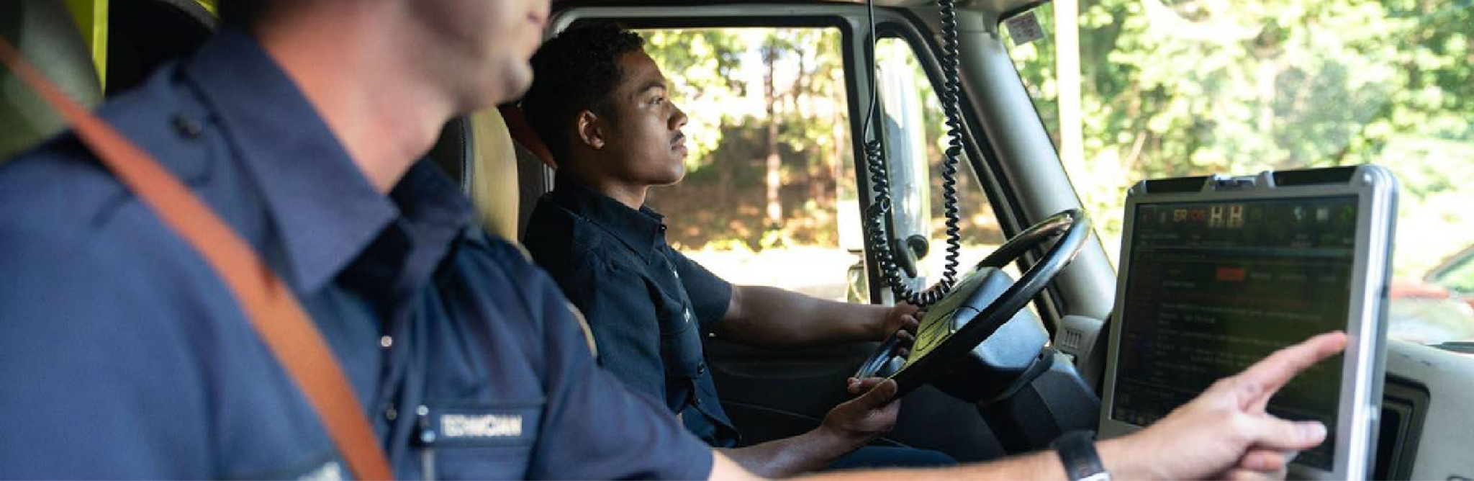



Contact:
Gamunu Wijetunge, NRP
Director
Office of EMS, NHTSA
Gamunu.Wijetunge@dot.gov
THANK YOU!

Slide 47

Strengthening the Supply Chain for Collection/Mfg of Whole Blood & Platelets
Bill Block, President and CEO
Blood Centers of America

Slide 48
Disclosure
Fair Use Notice and Disclaimer
This presentation may contain copyrighted material the use of which has not been specifically authorized by the copyright owner. This presentation operates under the assumption that this not-for-profit use constitutes a “fair use” of the copyrighted material as provided for in Title 17, Chapter 1, Section 107 US Copyright Law.
Bill Block has no financial or commercial conflicts of interest to disclose.

Slide 49

Blood Centers of America
Mission: To strengthen and enhance members’ operations through innovative, cooperative, interdependent activities. A network of 60+, not-for-profit, Independent Community Blood Centers representing over 60% of the American blood supply.
Annualized commercial business ~$1B Plus
Approximately 150+ key industry supply chain contracts
National contracts for national blood contracting
Involved with co-development for driving operational efficiencies
Key Preparedness Events:
Implemented Third Party Logistics (3PL) for critical supplies (30-45 DIOH); Visibility to all independent blood center critical inventory
Disaster Task Force member
Coordinating the transport of blood products during any disruption (weather, mass casualty, cyber, etc.)
During COVID-19 served as national operational center of collaboration, communication and coordination for all independent CCP collectors
Resource Sharing and accounting/inventory management

Slide 50
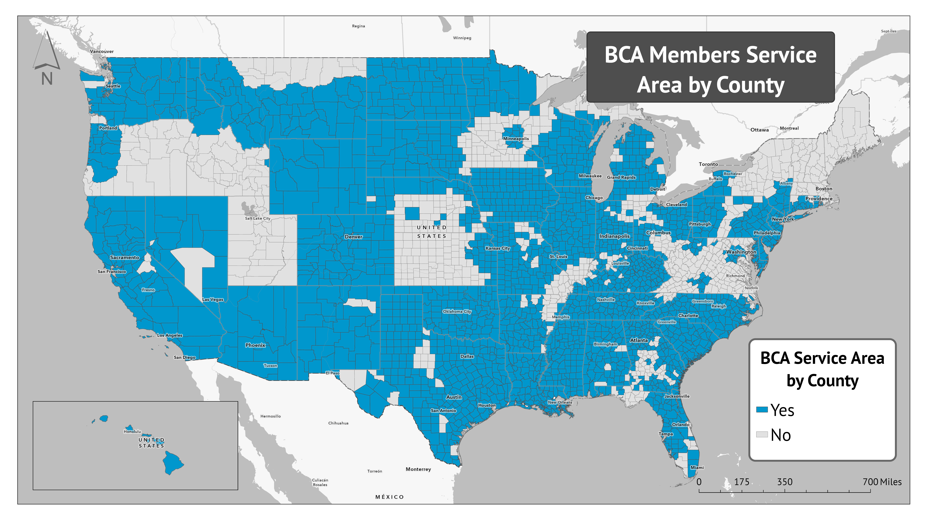

Slide 51
BCA: The Donor Base Is Aging
Key Takeaway
Under-30 Donors Have Declined While 60+ Donors Have Grown
Ages < 30
Ages 60+
Pandemic period
Donors 60+
▲ 46%
since 2015
Pandemic disruption accelerated youth decline
Donors Age 60+: Up ~46%
Older donors are carrying more
Donors < 30
2015 Baseline
▼ 39%
since 2015
The donor base is aging faster than it is being renewed
Age Under 30: down ~39%
No post-pandemic rebound
Source: BCA GOLD

Slide 52

EMS Ground Entity Growth
458 EMS agencies through 9/2026

Slide 53
2026 Supply Chain Disruptors
GVS product hold
  GVS product allocation
FK product hold
Glycerolyte discontinuation notification
  COBE-2991 cell washer discontinuation target date 2030 (De-glysing)
FK 35 day CPDA-1 bag discontinuation (LTOWB impact to military and Pre-Hospital)
FDA Recall BD-ChloraPrep (preferred industry arm scrub)
ARC Blood Shortage (Jan 2026) & Blood Crisis declared (June 2026) 4 year summer low on type O
  Emergency shortage declared after inventory fell over 35% from winter weather & flu
  Blood Crisis declared - Donations fell to a four-year summer low, worsening the shortage and threatening care
Nitrile material ingredient shortage due to Middle East conflict product shortages/price increase over 30%

Slide 54
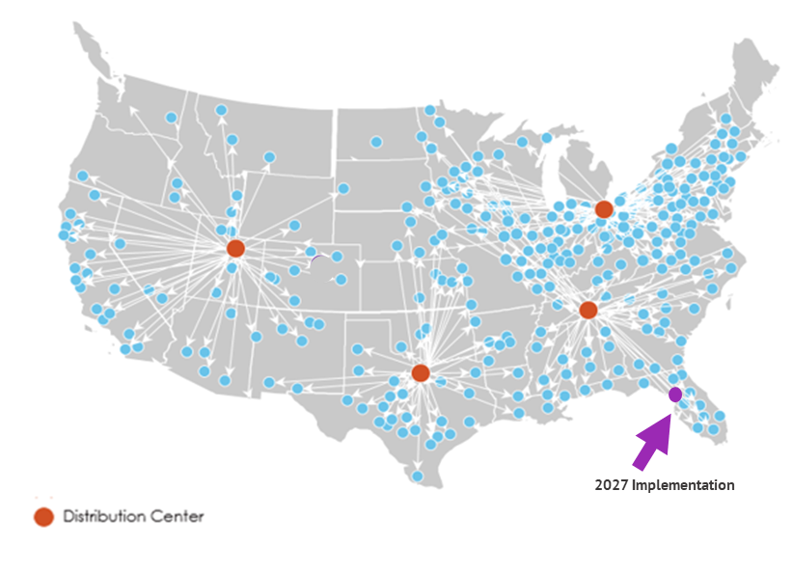
BCA 3PL: Supply Chain Risk Mitigation of Critical Supplies
HemaSource continually maintains 30-45 days of critical medical plastics for BCA centers
BCA has visibility to on hand inventory at blood centers

Slide 55
Supply Chain Alert: LTOWB - Blood Bags
Current Landscape:
Fresenius-Kabi: CPDA-1 non-LRS WB BPU- FK will discontinue all production of CPDA-1 BPU's by mid CY’27 due to shutting down of the Maricao PR plant
Short Term Solution:
TerumoBCT: TeruFlex CPDA-1 non-LRS is a short-term alternative solution ONLY
Long Term Solution:
BCA is currently working with a 3rd manufacturer; actual production timeline TBD
  CPDA-1 non-LRS WB BPU with 35-day WB shelf life.
    35-day, critical to support rural EMS programs due to logistics complexity

Slide 56
Future Preparedness Recommendations
Blood Supply Preparedness Recommendations (including cybersecurity, natural disasters, mass tragedies)
Goal:
Investment in longer-shelf-life technologies, stronger donor pipelines, and scalable systems to rapidly boost and distribute blood during emergencies (cryo-preserves/lyophilization/spray dried blood products (RBC, platelet and plasma))
FDA and Industry Collaborate with Key Suppliers to Accelerate the development/licensing:
Focus should be on making it lower cost/streamlined development and approval/and more attractive of an ROI for these identified suppliers for the blood/plasma industry. (e.g. Move TerumoBCT Reveos from 8 hour hold to 20-24 hours= more efficient/wider use)
Donor Sustainability Focus:
Continue to focus on recruiting younger donors to address the aging gap. Consider public/private partnerships (e.g. Sporting Event Competition; Possible tax incentives; Technology support like mixed reality; Other)

Slide 57

Thank you!
Bill Block, President and CEO
Blood Centers of America
bblock@bca.coop

Slide 58
Discussion and Questions

