Slide 1

Drug shortages
By Mario Motta, MD

Slide 2
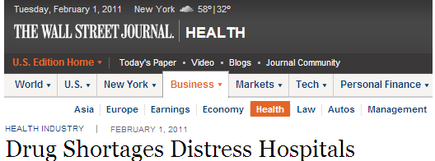
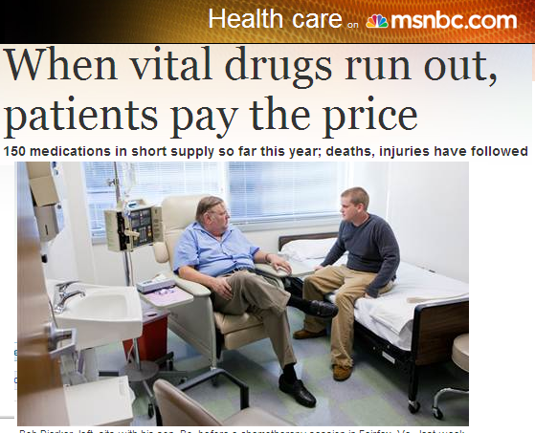
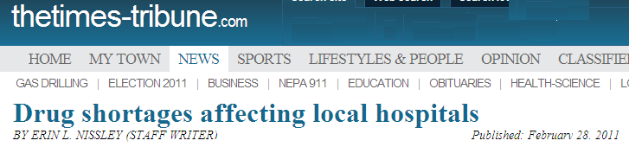

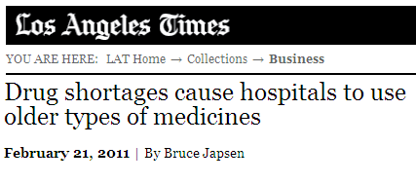
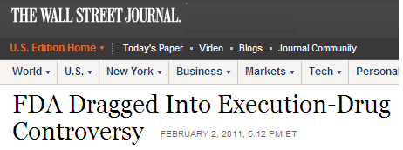
Drug Shortages: a Serious and Widespread Problem

Slide 3
National Drug Shortages—Quarterly
Note: Each column represents the # of active shortages at the end of each quarter. Q2-13 are data through 5/31/13.
University of Utah Drug Information Service

Slide 4
Active Shortages
Top 5 Drug Classes
University of Utah Drug Information Service

Slide 5
NSMC Sept, 2016:
CURRENT MEDICATION SHORTAGES
Attached is the link to current drug shortage list for NSMC. The pharmacy updates the posted list on the pharmacy web page weekly and notification will be e-mailed to nurse managers, supervisors, and medical staff. Please share this information with affected staffs in your clinical area. Its purpose is to describe the current drug shortages and how the shortages are affecting NSMC.
http://nsmcconnect.partners.org/Subwebs/Pharmacy/Default/Back%20Ordered%20Medication%20NSMC%2009092016.pdf

Slide 6
Percent of Hospitals Reporting the Impact on Patient Care as a Result of a Drug Shortage
Source: AHA analysis of survey data from 820 non-federal, short-term acute care hospitals.
Survey completed in June 2011

Slide 7
International Perspective on Drug Shortages
Drug shortages is a global issue!
Globalization of the pharmaceutical supply chain:¹
  40 percent of finished drug products are manufactured abroad
  80 percent of drug components (e.g., active pharmaceutical ingredients) are from foreign countries
Quality issues in the global supply chain contribute to drug shortages
1. www.prescriptionproject.org/assets/pdfs/Pew_Heparin_Round4b_SinglePgs_b.pdf

Slide 8
Critical Drug Shortages
In the US (and Western Europe) we have been increasingly afflicted with unexpected and prolonged shortages of important drugs.
This can be due to a variety of reasons:
  A business decision
  A manufacturing problem
  A base materials supply problem

Slide 9
Patient Care Impact
Patient care issues
  Delayed or unavailable care
  Safety implications
  Adverse impact on patient outcomes

Slide 10
Practice Impact of Drug Shortages
No advance warning
Limited or no information
Significant increase in resources used to manage shortages
  Personnel: pharmacists, pharmacy technicians, nurses, physicians
  Financial: increased cost of alternative products/off-contract purchasing; gray market
Diverts health care providers from direct patient care activities
  The resulting impact on patient safety and outcomes may be substantial but is difficult to quantify
University of Michigan/ASHP Survey. AJHP. 2011;68:1811-9.

Slide 11
Cause for Concern: Errors that May Be Caused by Drug Shortages
Clinicians may be less familiar with dosing, administration, or monitoring of the alternative therapy
Use of different package sizes can lead to over or under dosing
Compounding of unavailable therapies can lead to errors or sterility issues

Slide 12
Tragic Choices
In late December, 2010, we experienced a critical shortage of cytarabine, a chemotherapy drug that is integrally important in curative therapy for adult and childhood acute myelogenous leukemia (AML) and childhood acute lymphoblastic leukemia (ALL).
We came within 2 days of completely running out.
What to do if we have enough for one person and two people need it?
How do you choose?
Also see PM Rosoff (2011): AJOB (in press)

Slide 13
Do we owe a greater “loyalty” to patients who live in your state than those referred from elsewhere?
What do we do with patients who hear that we may have the drug they need, but are not your patients
Should we privilege the young over the old?
  For instance children with AML have a 60% chance of cure, while adults have a 30% (of course, this is a population-derived statistic). Does that mean we should give the limited supply of cytarabine to children and not adults?
Do patients on therapy have a greater claim to drug than new patients who might have a better chance of cure?
Should we stop treatment of patients receiving a drug for unsupported (by evidence) reasons in order to conserve supplies?
Should “dying” patients have claim to any drugs other than “comfort” drugs during a shortage?

Slide 14
Faced With A Critical Shortage, How Should We Decide Who Gets The Drug When Not All Can?
First come, first served?
A coin toss or lottery?
What should be the role of medical/scientific evidence?
Should there be “special” patients (i.e., VIPs)?
Should some people be a priori excluded?
  For example, undocumented immigrants, prisoners, patients with a prior history of poor compliance?

Slide 15
REPORT OF THE COUNCIL ON SCIENCE AND PUBLIC HEALTH CSAPH Report A-13
Solutions to the drug shortage crisis require understanding the causes. Approximately one-third of the shortages in 2012 were triggered by findings emanating from an FDA inspection, while more than one-half were related to self-reported findings or causes.⁵ In 2012, shortages of medically necessary drugs were evenly divided between “quality” and “delays/capacity” issues accounting for 52% of such shortages. Product discontinuations (13%) and problems with the raw materials for active pharmaceutical ingredients (9%) accounted for 22% of shortages. In some cases, shortages resulted from manufacturing failures for one drug that increased demand for another drug and companies producing the latter were unable to meet demand (3%).

Slide 16
Reasons for Shortages – 2012

Slide 17
CSPH
Data on drug shortages comes from various points across the supply chain.¹ The Food and Drug Administration Safety and Innovation Act of 2012 (FDASIA) requires manufacturers of drugs that are “life-supporting, life-sustaining, and intended for use in the prevention or treatment of a debilitating disease or condition, including those used in emergency medical care or surgery” to notify the FDA 6 months in advance (or as soon as possible) if manufacturing is going to be interrupted or discontinued.²

Slide 18
Drug Shortages Provisions in Public Law No: 112-144, FDA Safety and Innovation Act
On July 9, 2012 President Obama signed into law legislation
Notification Requirements
Expedited Inspections and Reviews
Repackaging guidance
Reports, Strategic Plan and Study

Slide 19
Shortages – Dosage Forms 2012
University of Utah Drug Information Service

Slide 20
CSPH:
Sterile injectables continue to comprise the vast majority of shortages (72%) in 2012.⁵ Intravenous nutrition products, emergency medicine, anesthesia, and cancer drugs have been most affected recently. Shortages of sterile injectables are directly linked with the state of the industry as just seven manufacturers constitute the majority of the market for these products.¹
Most facilities producing generic sterile injectables are based in the United States because of high transportation costs associated with liquids that require climate control. Many are aging with inefficient processing lines and facility layouts prone to mechanical problems requiring manual interventions and thus are at higher risk for contamination. This high market concentration can turn a single production line disruption into a drug shortage.

Slide 21
Fragile Supply Chain -
Generic Injectables
Concentrated market
  Few products with > 3 suppliers
Manufacturing capacity
  At capacity, no resiliency
  Multiple products made on single line
Complex manufacturing process
  No simple fixes for quality problems
  Problems typically affect multiple products
  ISPE survey identifies “Quality systems of manufacturing” as key cause of shortages
http://aspe.hhs.gov/sp/reports/2011/DrugShortages/ib.shtml
http://www.ispe.org/drug-shortages-initiative

Slide 22
Reasons for Injectable Shortages – 2012

Slide 23
CSPH:
Food and Drug Administration (FDA) tracks and focuses on shortages of “medically necessary” drugs.³ A medically necessary drug product is a product that is “used to treat or prevent a serious disease or medical condition for which there is no other alternative drug, available in adequate supply that is judged by medical staff to be an adequate substitute.” The drug shortage resource center maintained by the American Society of Health-System Pharmacists tracks all drug shortages.

Slide 24
CSPH:
The FDA successfully prevented 282 shortages in 2012, a substantial increase from the 195 shortages FDA prevented in 2011.^{4,5} One hundred seventeen new shortages of medically necessary drugs occurred in 2012, significantly fewer that the 251 shortages that were recorded in 2011.⁵ FDA believes that the early notification requirement of FDASIA is one important contributing factor in this trend. As of March 6, 2013, the FDA identified a total of 121 shortages of medically necessary products, a number that is comparable to the situation in August 2012.⁴

Slide 25
Shortages Prevented by FDA 2010 - 2012
Source: CDER Drug Shortages

Slide 26
CSPH
Solutions to the drug shortage crisis require understanding the causes. Approximately one-third of the shortages in 2012 were triggered by findings emanating from an FDA inspection, while more than one-half were related to self-reported findings or causes.⁵ In 2012, shortages of medically necessary drugs were evenly divided between “quality” and “delays/capacity” issues accounting for 52% of such shortages. Product discontinuations (13%) and problems with the raw materials for active pharmaceutical ingredients (9%) accounted for 22% of shortages.

Slide 27
Quality Problems
Drug shortages
Raw Materials
Limited Lines
GMP Violations
Few Plants
Unknown

Slide 28
Business and Market Factors
Lack of transparency or communication about actual or possible product shortages
Lack of business incentives to enter a specific product market
Unpredictable changes in product demand
Reallocation of production lines
Consolidation of companies
  Capacity – most factories running 24/7

Slide 29
Raw Materials and Manufacturing Factors
80% of raw materials used come from outside the United States
Disruption to acquisition can be due:
  Political instability/Government interference
  Natural disasters
  Contamination during production, storage or transport
Problematic if single source Active product ingredients (API) or raw materials multiple manufacturers affected

Slide 30
Raw Materials and Manufacturing Factors
Major manufacturing difficulties identified:
  Inability to comply with current good manufacturing practices (cGMP) and/or voluntary recall
  Limited number of production lines ➔ Increase production of one product results in shortage of another
  Complexity of manufacturing sterile injections
  Loss of experienced personal due to business decisions
  Change in product formulation

Slide 31
Distribution Factors
Inventory practices by healthcare facilities and supply chain entities
Little or no inventory cushion to address short-term shortages or excess inventory due to distribution systems
Variability in inventory procurement capabilities between small and large healthcare facilities
Grey market

Slide 32
Manufacturing Problems
Sources
  Sole source raw materials
  Time to establish new source
Capacity
  Few manufacturers of sterile injections
  Same production lines for multiple items
  Limited lyophilization capacity
Provisional observations on drug product shortages: effects, causes, and potential solutions.
Notes:
1 year is not enough time to establish a new source.

Slide 33
Example – Fragile Supply Chain
Manufacturing plant closes April 2010.
Impacts 49 drugs – 18 are chemotherapy.
Problems occurred at the same time at other facilities.
Manufacturing resumed spring of 2011, but still not up to prior capacity for some agents.

Slide 34
Raw Material Issues
Raw material availability
  20 years ago – 90% from US and Europe
  Currently, 75 – 80% from China and India
Some materials are no longer accessible or only available as single source products
Schweitzer SO. N Engl J Med. 2008;358:1773-1777
Provisional observations on drug product shortages: effects, causes, and potential solutions. AJHP. 2002;59:2173-2182
Fox ER, Tyler LS. AJHP. 2009;66:798-800

Slide 35
Multifactorial Reasons
Multiple reasons can play a role in any particular shortage
  A product may be recalled due to concern for microbial contamination or particulate matter in the vials (propofol)
    3 manufacturers of propofol, 2 had recalls, and the 3rd could not keep up with demand—U.S. imported product from Europe.
  A product may be recalled and the manufacturer may have difficulty accessing raw materials (lipid emulsion)
Notes:
This is what happened with propofol – 3 manufacturers, but 2 had recalls and the 3rd manufacturer could not keep up with supplies. FDA allowed importation of European propofol to help alleviate this shortage.

Slide 36
Imports
12 different agents 2010-2013
  propofol, foscarnet, ethiodol, thiotepa, norepinephrine, capecitabine, leucovorin, levoleucovorin, methotrexate, doxorubicin liposomal, phentolamine, sodium bicarbonate
Limited by quantity available to share with US market
Importation is not a viable long-term solution for U.S. market

Slide 37
FDA’s Role
FDA CAN require:
  Notification
  FDASIA (Supply disruptions, discontinuations)
  Manufacturing changes
  No penalties
FDA CANNOT require manufacturers to:
  Make a drug
  Make more
  Distribute in a particular way
FDA CANNOT fix a manufacturing problem
Patient care is top concern
FDA works to prevent and mitigate shortages

Slide 38
U.S. Food and Drug Administration (FDA)
Policy is to “prevent or alleviate shortages of medically necessary products”
Shortages of “medically necessary” drugs are listed on FDA’s website
Jensen V, Kimzey LM, Goldberger MJ. AJHP. 2002;59:1423-1425.
Notes:
FDA focuses action on these drugs

Slide 39
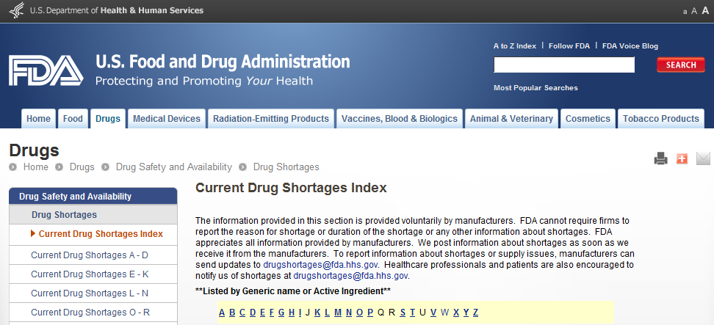

Slide 40
122 Drugs in short supply
Drug Shortages
Current Drug Shortages Index
Current Drug Shortages A - D
Current Drug Shortages E - K
Current Drug Shortages L - N
Current Drug Shortages O - R
Current Drug Shortages S - Z
Resolved Drug Shortages
Drugs to be Discontinued
How to Report a Shortage or Supply Issue
Frequently Asked Questions About Drug Shortages

Slide 41
A
Acetylcysteine Inhalation Solution1 10/15/2012
Alfentanil Injection2 (initial posting 1/23/2012)
Amikacin Injection3
Amino Acid Products4 (initial posting 2/14/2012) 10/15/2012
Ammonium Chloride Injection5
Ammonul (sodium phenylacetate and sodium benzoate) Injection 10%/10%6 (initial posting 9/18/2008)
Amphetamine Mixed Salts, ER Capsules7 (initial posting 10/31/2011)
Amphetamine Mixed Salts Immediate-Release Tablets8 (initial posting 1/12/2012)
Aquasol A9
Atracurium besylate10 (initial posting 2/27/2012)
Atropine Sulfate Injection11

Slide 42
FDA Can Only Do So Much…
FDA CAN require *notification of supply disruptions (FDASIA)
FDA CANNOT require
*continued production
*increased production
*disclosure of distribution

Slide 43
FDA’s Approach
Prioritize based on medical necessity
Review risks / benefits of medication
Minimize risk to patients while maintaining availability
Work with manufacturers to address problems
Toolkit
  Regulatory discretion
  Request increased production
  Expedite reviews
  Temporary importation

Slide 44
How Does FDA Prevent Shortages?
Regulatory discretion
  Require filters (products with particulates, glass fragments)
  Ask clinicians to double check volume (overfill)
Ask others to increase production
Expedite reviews (new product, longer expiration, new raw material, new manufacturing sites
A Review of FDA’s Approach to Medical Product Shortages. October, 2011. http://www.fda.gov/AboutFDA/ReportsManualsForms/Reports/ucm275051.htm

Slide 45
The FDA’s “toolbox” includes:
the use of regulatory discretion that allows for the continued manufacture of a medically necessary product when minor, low risk issues are identified, or the application of additional safety controls (i.e., filters with product; extra testing at plant; 3rd party oversight of production; special instructions for safe use);
requesting other manufacturers to increase production;
expedited review of company proposals; and,
allowance for temporary importation from unapproved sources (rarely)

Slide 46
Regulatory and Legislative Factors
Limited FDA resources for timely inspection of manufacturing sites and review of NDA/ANDA
Lack of FDA authority to:
  Require notification from manufacturers of anticipated market withdrawal
  Enforce notification requirements for medically necessary products

Slide 47
FDA Efforts
Prevention doesn’t work for every shortage
  Unforeseen breakdowns, API shortage
  Longstanding quality problems
Fixes can take a long time

Slide 48
FDA’s Strategy
Prioritize medically necessary agents (determined on a case by case basis)
Evaluate risks and benefits for patients
Offer assistance and advice, but up to the manufacturer to fix
Success hinges on early notification
Jensen V, Kimzey L M, and Goldberger MJ. FDA’s role in responding to drug shortages. AJHP. 2002; 59:1423-5

Slide 49
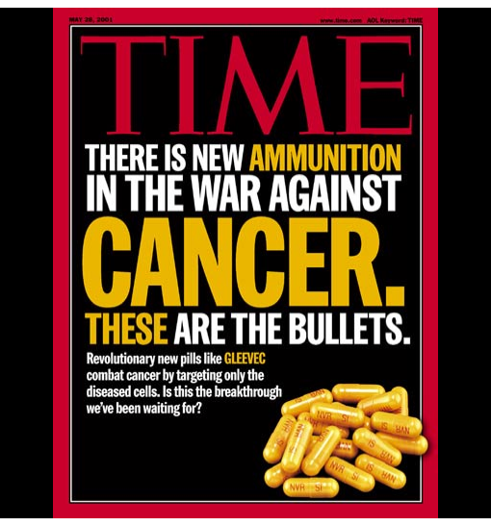
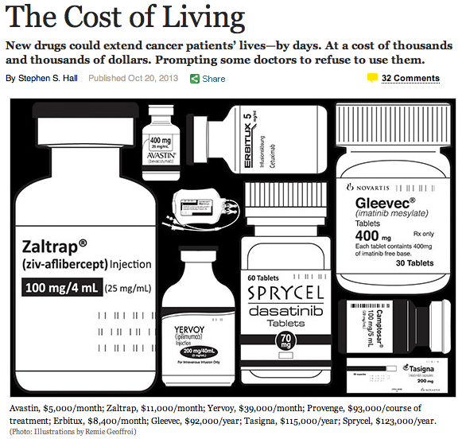
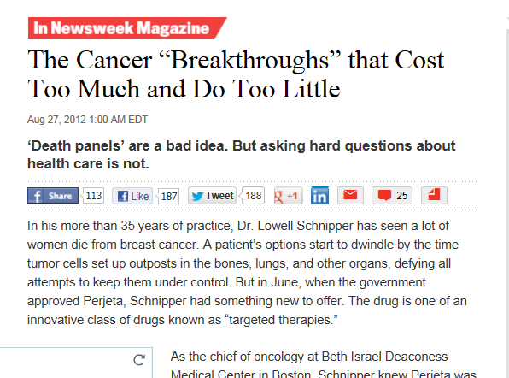

Slide 50
Most Americans favor action to keep drug prices down
Percent who say they favor each of the following in keeping prescription drug costs down:
Source: Kaiser Family Foundation Health Tracking Poll (conducted August 6-11, 2015)
Notes:
When asked about policy options for keeping prescription drugs cost down, 86% of Americans favored requiring drug companies to report on how drug prices are set. Eight-three percent favored allowing Medicare to negotiate with drug companies for lower drug prices, 76% favored limiting prices for high-cost drugs, and 72% favored allowing the purchase of drugs imported from Canada.

Slide 51
Pricing in the market for anticancer drugs
2004: bevacizumab (Avastin), colorectal cancer, $50,000, 5 months
2009: sipuleucel-T (Provenge), prostate cancer, $93,000, 3 months
2011: ipilimumab (Yervoy), skin cancer, $120,000, 3 months

Slide 52
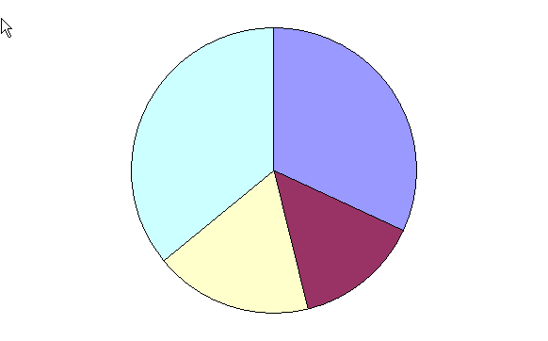
2004 Revenue Allocation for Top 7 US Pharmaceutical Cos
Other, including production cost
Marketing, Advertising
and Administration
32%
36%
18%
14%
Research & Development
Profits (net income)
Source: PhARMA

Slide 53
Truthfulness in Drug Ads: Data
57% little of no educational value
40% not balanced
33% misleading headline
30% incorrectly called drug the “agent of choice”
44% could lead to improper prescribing

Slide 54
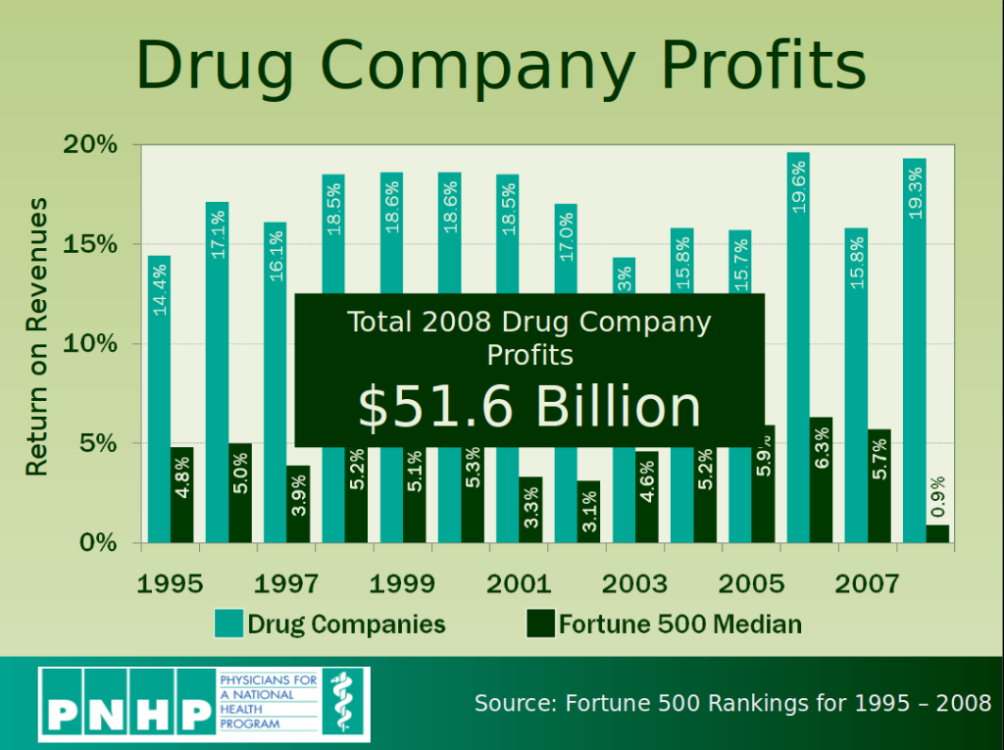

Slide 55
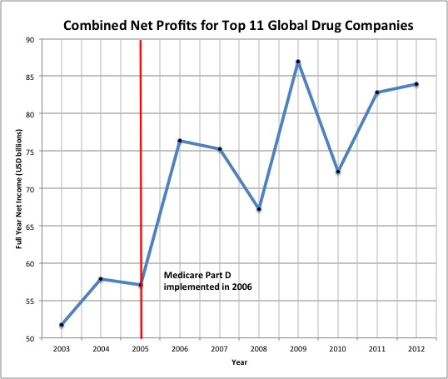

Slide 56
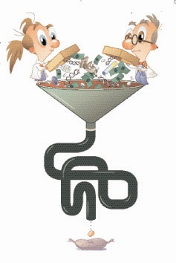
A BREAKTHROUGH drug is a unique
therapeutic entity that opens a new
approach to the treatment of
a given pathophysiology. The
discovery of breakthrough drugs
presents the greatest financial risk.
A ME TOO drug is a structural
analogue, an existing therapeutic
entity. Because me too
drugs are derived from established
drugs the risk associated with their
development is not as great as for
breakthrough drugs.

Slide 57
Where Prescription Dollars Go
Research and development - 12%
-preclinical testing - 6%
-clinical testing - 6%
Manufacturing and distribution - 24%
Sales and marketing - 26%
Administrative / miscellaneous expenses - 12%
Taxes - 9%
Net profit - 17%

Slide 58
R&D, Prices, and Profits
“The conventional fallacy is that the cost of R&D drives prices. In reality, it’s the other way round: prices drive cost.”
Frederic Scherer, Emeritus Professor of Economics, Harvard.
The more a company can charge for its drugs, the more it will spend on development and marketing.
Econ 101: Cost never justifies price.

Slide 59
High Prices in the USA
Why do companies charge such high prices in the USA? Because they can!
Monopoly price discrimination and price increases across patent life, with discounts
  Consumers, especially the uninsured, face a wide disparity in reimbursement, rates, and co-payments.
The demand for prescriptions is a “derived demand”- decision-maker is doctor acting as patient’s clinical and financial agent.
  Prescribers are not price-conscious
Access to drugs is limited by insurance.

Slide 60
Generics
Drug Price Competition and Patent Term Restoration Act (1984)
-requires bioequivalence, rather than therapeutic equivalence
Pharmaceutical companies purchasing generic divisions (e.g., Merck - Medco)
Large drug firms account for 70% of generic market

Slide 61
Conclusions
Drug Shortages Remain a Major International Problem
There is No Single Cause of Shortages
The Reasons for Shortages May Differ From Country-to-Country, But there are also Likely Similarities
Communication is key between stakeholders (providers, government, manufacturers, and patients)
Consolidation exacerbates the problem

Slide 62
Conclusions, cont.
Drug shortages impact patients daily and are not resolving.
New suppliers are needed to manufacture generic drugs with both high quality and high reliability.
Hospitals need unit of use products – may be an opportunity for suppliers to enter the generic injectables market.

Slide 63
From the Q and & A -- What do you think about Group Purchasing Organizations
It's is a mixed response. GPOs were a good idea at first to negotiate with pharma companies, and saved money for institutions signed up, but then they also became very large and create their own problems with buying in such bull that alone created shortages. They sometimes hoard meds as well as a hedge. Finally many of them were bought outright by pharma companies, and no surprise they favored the meds of the parent pharma company over potentially less expensive alternative or generic meds. So.. A mixed track record. Real answer is to reform the entire pharma production and distribution and oppose any more mergers. It's either foster competition, or force regulation.

