Slide 1
Education, Injury Prevention, STB Updates
Jeffrey D. Kerby, MD, PhD, FACS
Medical Director, Trauma Education Programs

Slide 2
Education Updates

Slide 3
None

Slide 4

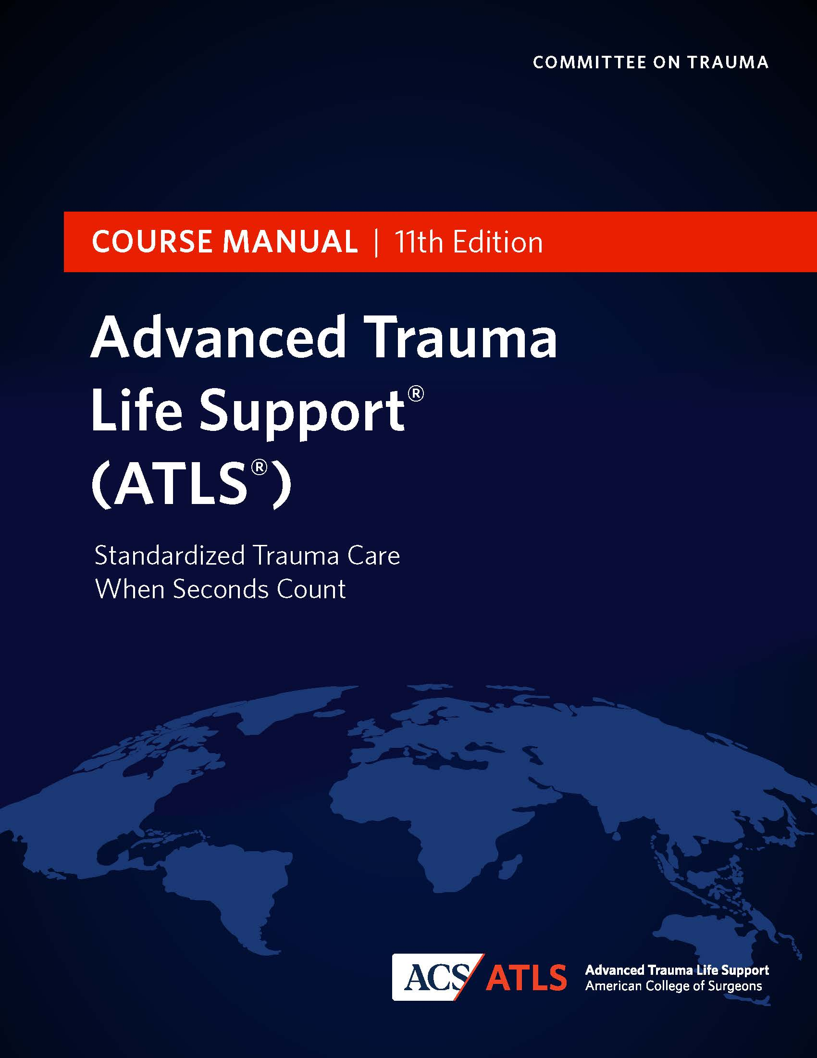
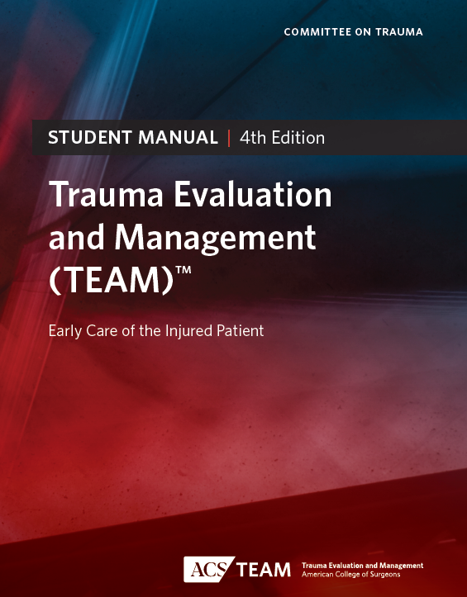
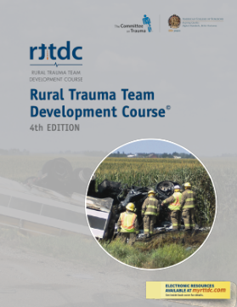
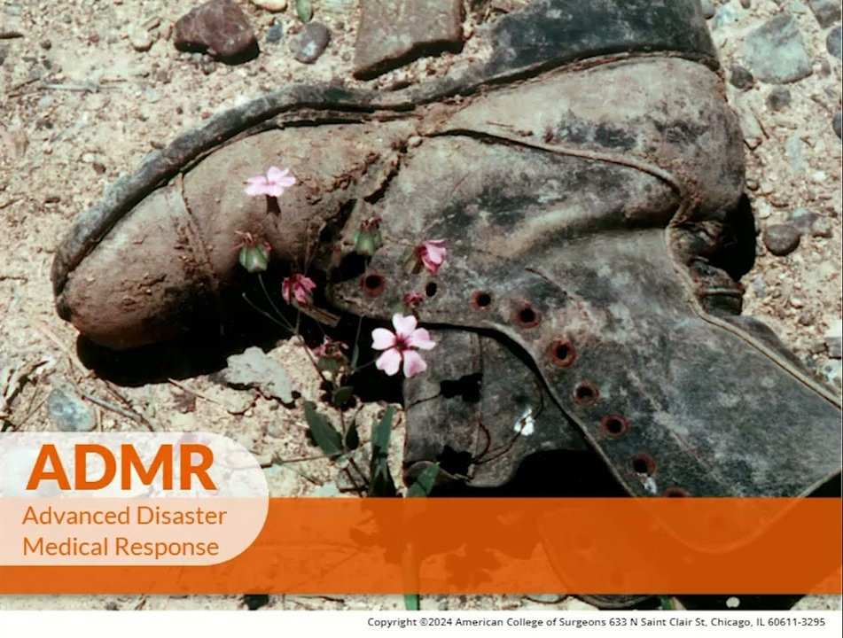
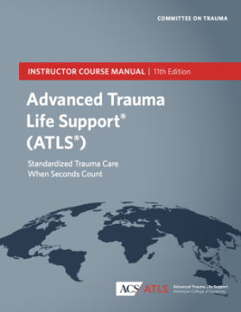
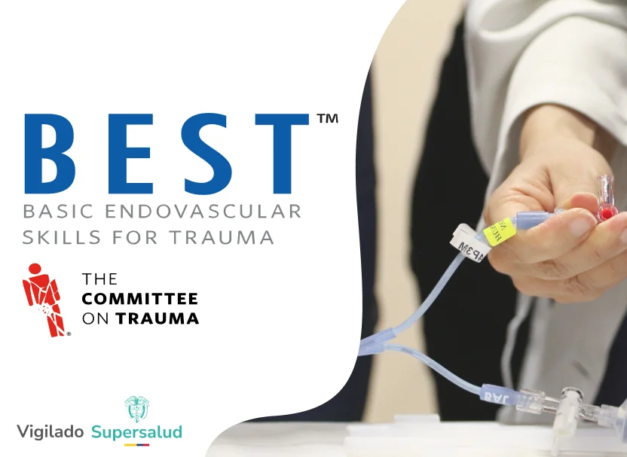
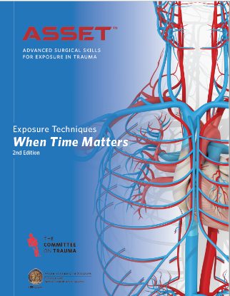


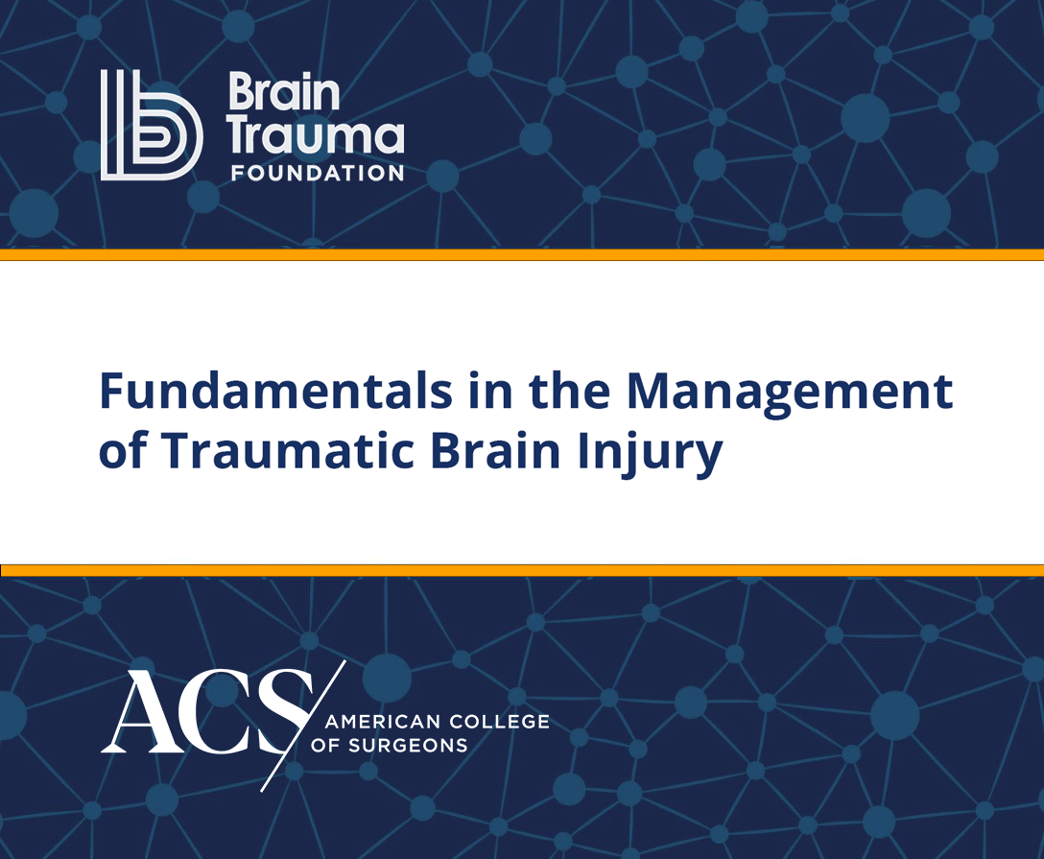
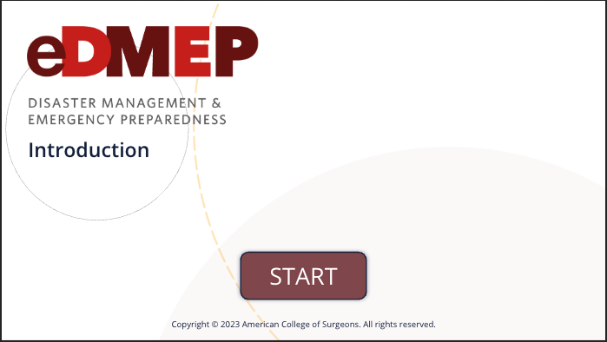

Trauma Education
Our Suite of Program Offerings
COMMITTEE ON TRAUMA
ATLS 11th Edition Instructor Course
BTF / ACS Brain Trauma Foundation
TBI Guidelines Course
v
Learn more at
facs.org/
traumaeducation

Slide 5

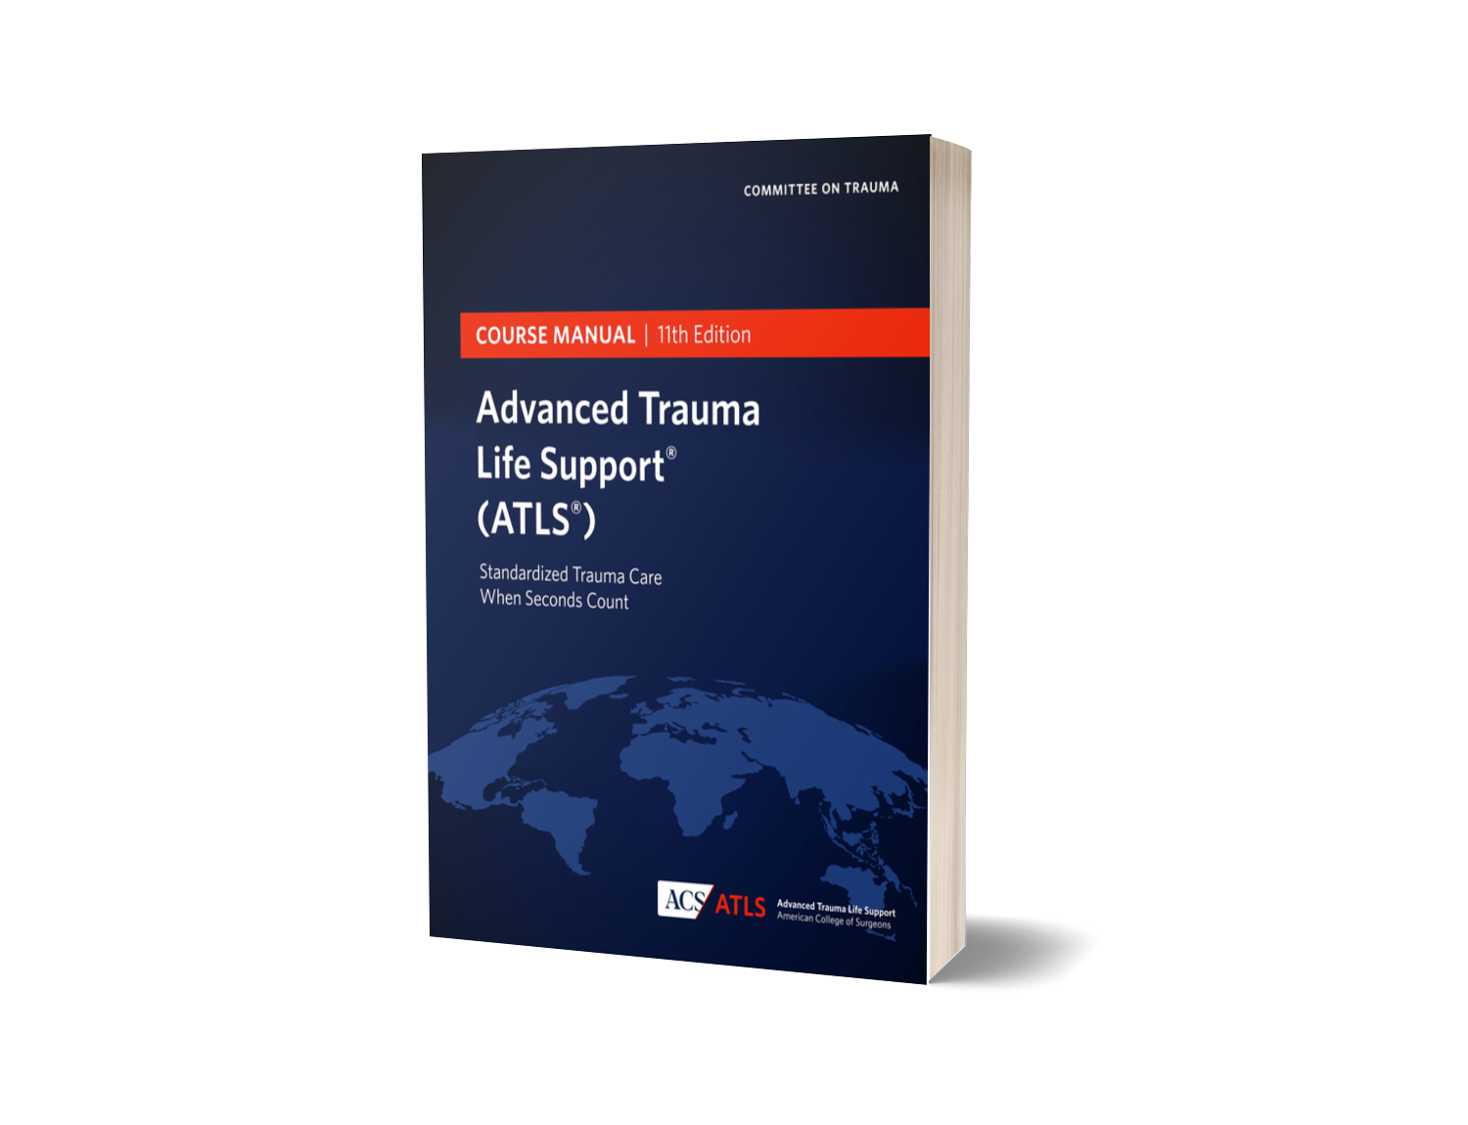



Expert-Driven Updates
Refined Clinical Guidelines
Enhanced Hands-On Training
Expanded Learning Resources
State-of-the-Art Digital Access

Slide 6
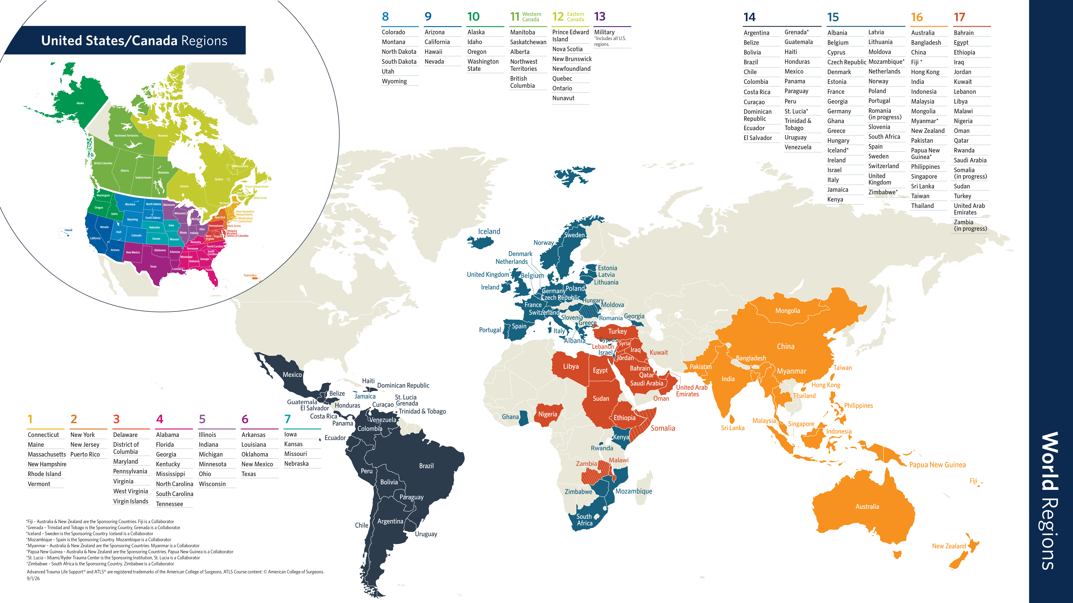
ATLS Expansion

Slide 7
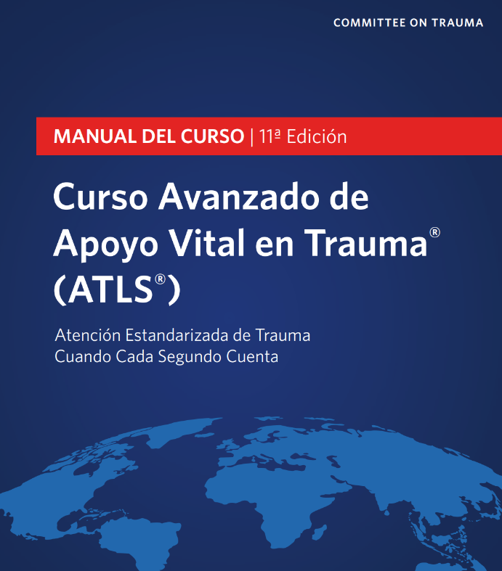
Translations
ATLS 11 is being translated into over 10 different languages:
Spanish
Brazilian Portuguese
Greek
French
German
Indonesian
Mandarin Chinese
Turkish
Ukrainian
COMMITTEE ON TRAUMA

Slide 8
ATLS Expansion – Promulgation Updates
New Countries
  Botswana
  Romania
  Zambia
  Poland
  Bahamas
  Ukraine
  Dominican Republic
  Algeria
  Suriname
Updated ACS ATLS Promulgation Application reviewed by Region Chiefs to be launched in coming months
COMMITTEE ON TRAUMA

Slide 9
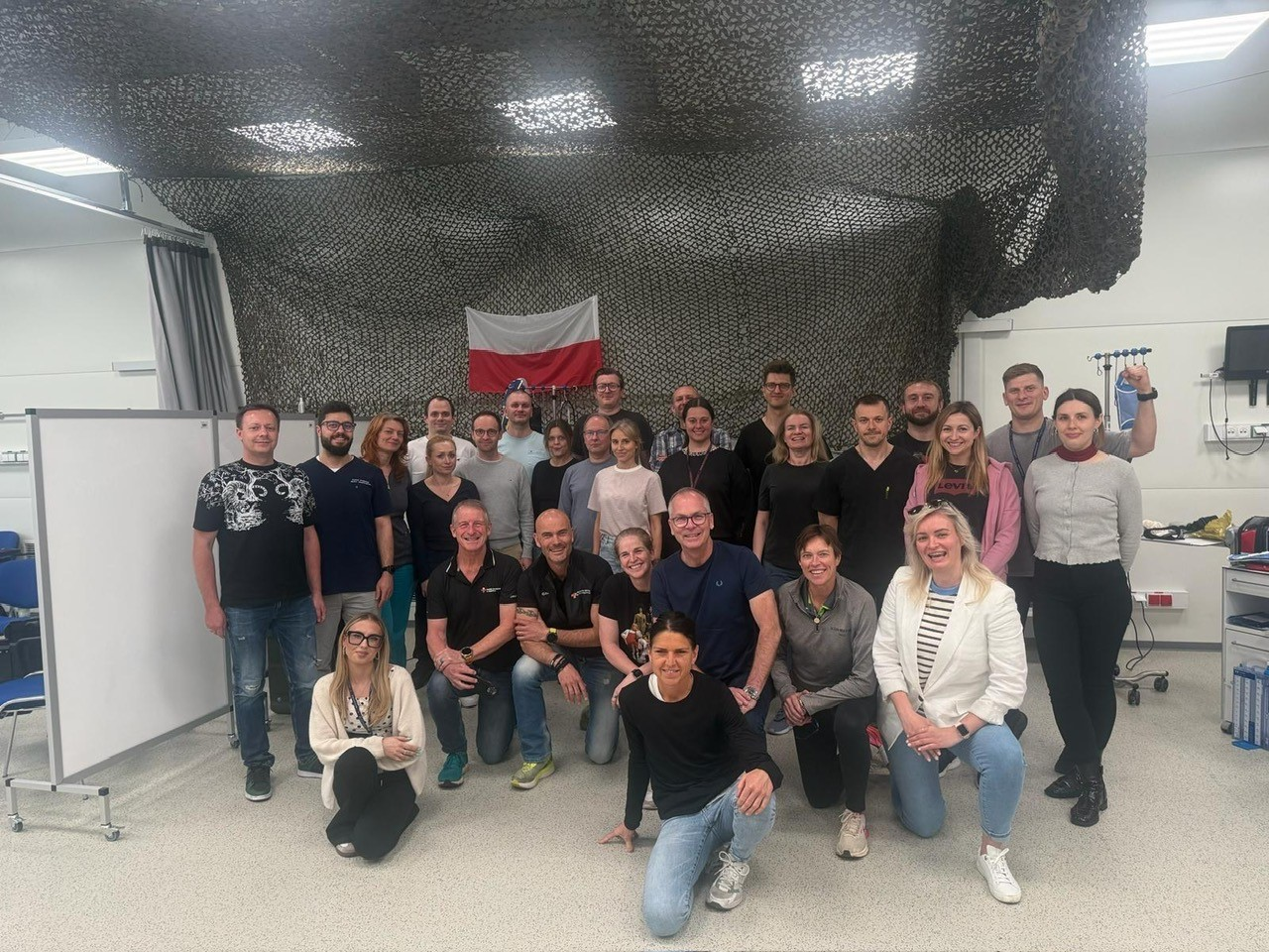
Launch of ATLS in Poland
COMMITTEE ON TRAUMA

Slide 10
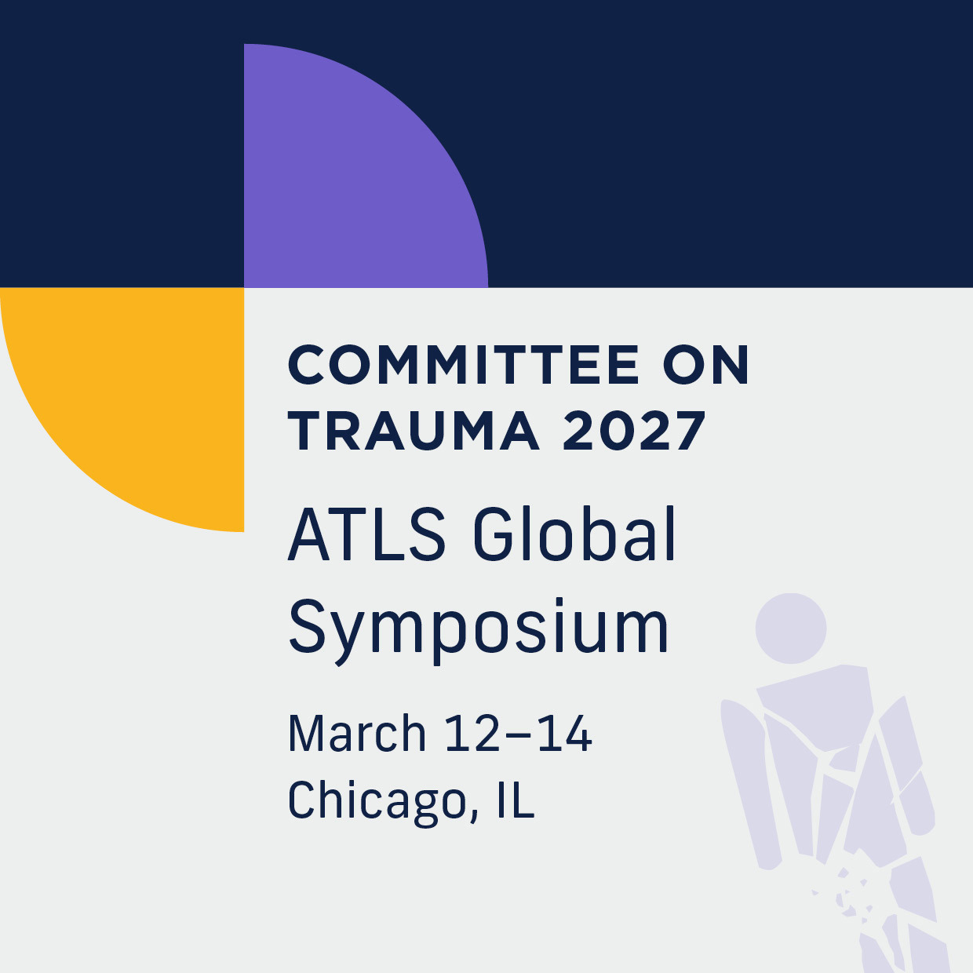
Join us at the 2027 ATLS Global Symposium!
COMMITTEE ON TRAUMA

Slide 11
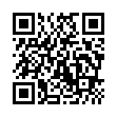
Call for Posters
Poster Session Submissions:
  Two tracks for Scientific Research and
  Best Practices
  Winners in each track will be invited to present their posters during the opening session of the ATLS Global Symposium
  Deadline: December 1, 2026
COMMITTEE ON TRAUMA

Slide 12



ATLS
50 Years, Countless Moments
Advanced Trauma Life Support
ATLS turns 50 in 2028!
Help us celebrate a half-century of saving lives around the world.
Share your stories, reflections, and memories with us.
Let’s shine a brighter light on the extraordinary achievements of surgeons, the surgical team, and transformative trauma education.
Use the QR code to submit your ideas!

Slide 13
ACS Workgroup Opportunities
MyATLS Mobile App (Julie Valenzuela & Brian Beldowicz)
Trauma Education Research (Tim Plackett)
ATLS Global Symposium (Jeff Kerby)
Rural Program (Alexandra Briggs)
Clinical Congress (Mayur Patel)
DMEP (Charity Evans)
Contact traumaeducation@facs.org for more information
COMMITTEE ON TRAUMA

Slide 14
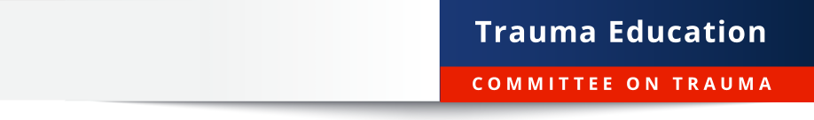

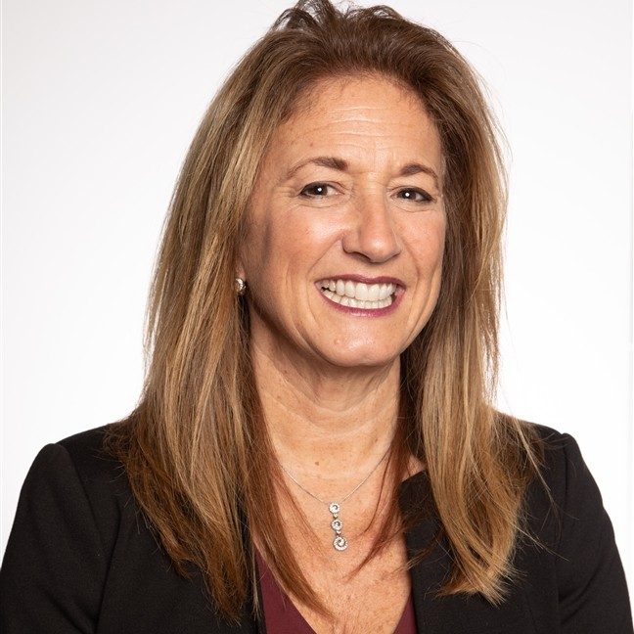

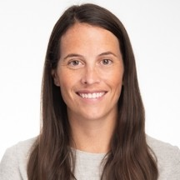
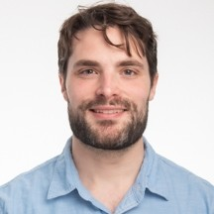

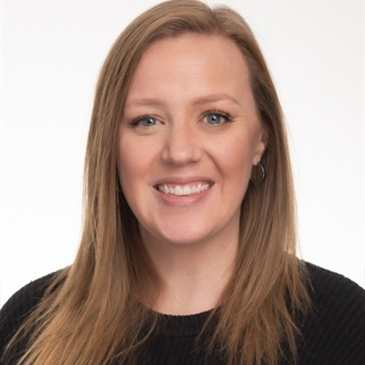
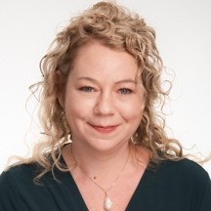

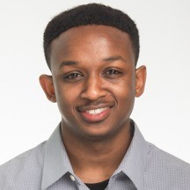
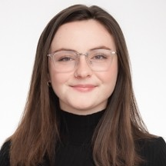
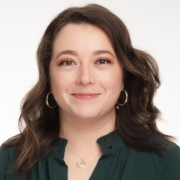
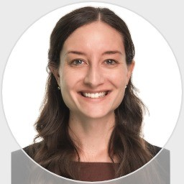
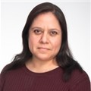
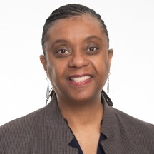
Dr. Jeffrey Kerby
Trauma Education
Medical Director
Alisa Nagler
Assistant Director
Trauma Education Programs
Julie Cwik
Manager
Instructional Design
Meghan Hogan
Project Manager
Jack Daly
Manager
Business Operations
Ryan Francescatti
Manager, Customer & Programs Support
Rebecca Hill
Visual Designer
Meghan Baker
Program Manager
(Technical)
Neil Kato
Program Manager
David Wakaba
Instructional Designer
Olivia Grierson
Program Manager
(Non-tech)
Ana Hernandez
International Program
Coordinator
Kristin Vail
Program Manager
(Global)
Maria Molina
Program Coordinator
Trauma Education Staff
Glenda Hill
Program Coordinator

Slide 15
Injury Prevention Updates

Slide 16
AACN
Theresa Chin
Julie Valenzuela
Thomas Duncan
Peter Fischer
Alexandra Briggs
Alexis Moren
David S Shapiro
Anne Rizzo
Haley Etskovitz
Leah Tatebe
Brendan Campbell
Eileen Bulger
Advanced Automatic Crash Notification Systems: It Is Time to Adopt Potentially Life-Saving Technology
Published in JACS

Slide 17
Position Statements
Statement on | Plan
2006: Managed Care and Trauma Systems | Retire
2006: Disaster and Mass Casualty Management | Retire
2016: General Helmet Use | Retire
2006: Insurance, Alcohol-Related Injuries & Trauma | Full Revise (2026)
2017: Opioids and MVCs | Full Revise (2026)
2014: Older Adult Falls and Prevention | Full Revise (2026)
2018: Intimate Partner Violence | Full Revise (2026)
2009: All Terrain Vehicle Injuries | Full Revise (2027)
2012: Concussion and Brain Injury | Full Revise (2027)
2013: Firearm Injuries | Full Revise
2016: Safety Belt Laws & Enforcement | Full Revise
Statement on | Plan
2018: Cannabis and Risk of Injury | Full Revise
2015: Motorcycle Helmet Laws | Minor Rev
2016: Lithium Batteries | Minor Rev
2016: Elder Burn Prevention | Minor Rev
2016: Prevention of Non-Traffic Vehicular Inj in Kids | Minor Rev
2016: PTSD in Pediatric Trauma | Minor Rev
2018: PTSD in Adult Trauma | Minor Rev
2023: Bicycle Safety & Bicycle Helmet Use | No Change
2024: Automatic Crash Notifications | No Change
2025: eBike Safety and IP | No Change

Slide 18
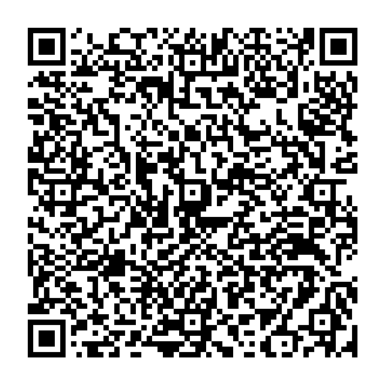
FAST Recommendations Analysis Workgroup
Analysis of the 2018 FAST Recommendations
Sign up here!

Slide 19
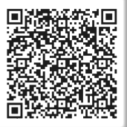
Injury Prevention Forum
Sign up for the IP forums here!
Virtual Platform for regular scheduled communication and information sharing
Engages members, consultants and liaisons on injury prevention related programs including updates and emerging topics
Provides Opportunities to participate in injury prevention initiatives

Slide 20
STB Updates

Slide 21
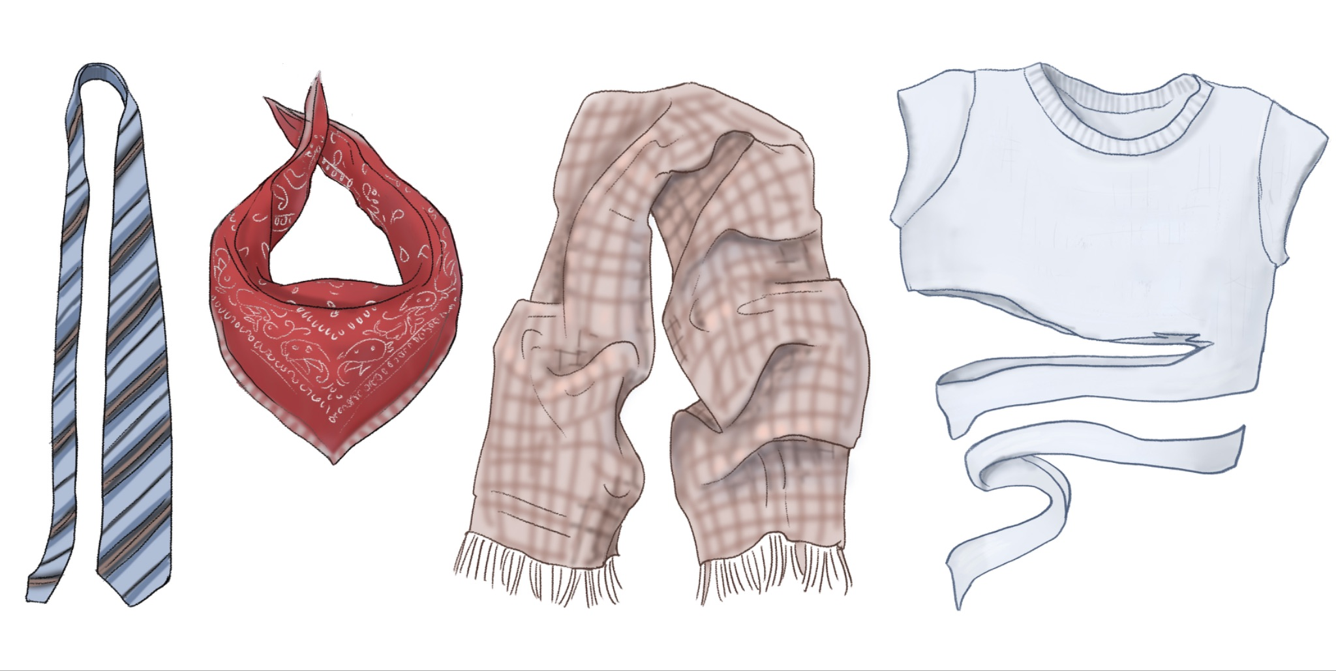

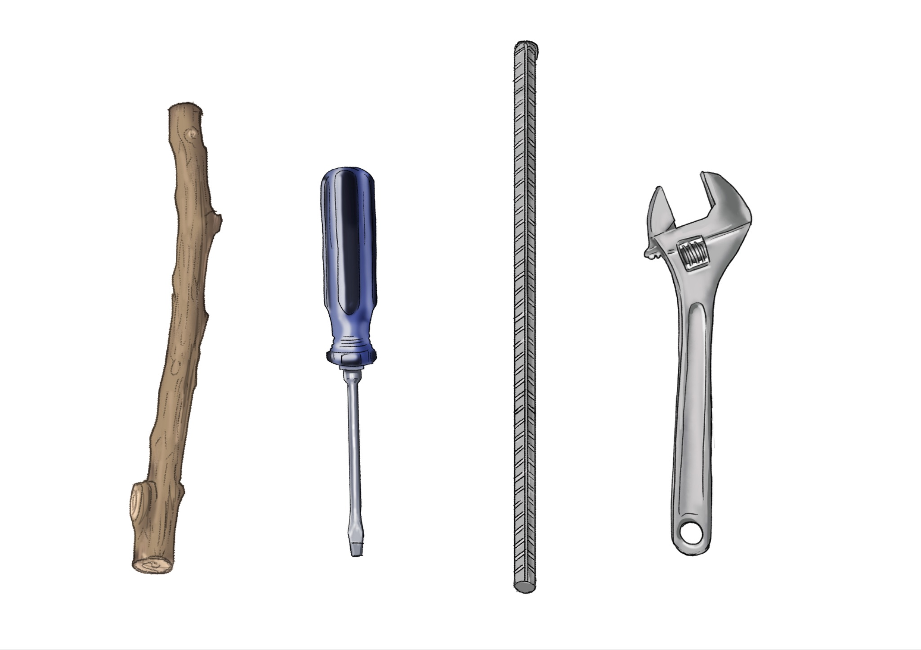
INSTITUTIONAL CONSENSUS & GUIDELINES STATEMENT
ACS Committee on Trauma (Stop the Bleed): Use an improvised tourniquet for life-threatening extremity hemorrhage only when traditional interventions (direct pressure, wound packing, and commercial tourniquets) are not available, feasible, or effective.
CoTCCC / TECC Stance: Treat improvised devices strictly as a last resort, with a rapid transition to a recommended commercial tourniquet or definitive care as soon as possible.
Stop the Bleed v3.1
Notes:
Key Content Elements
Reinforce that CoTCCC-recommended commercially manufactured tourniquets are the preferred standard and should be used whenever available.
Emphasize the importance of obtaining commercial tourniquets from reliable, reputable sources, as lower-quality or counterfeit products may be marketed as equivalent to validated devices.
If a commercial tourniquet is unavailable and an improvised tourniquet is necessary as a last resort, use strong, non-elastic material that is approximately 2 inches wide or wider.
Suitable materials may include a bandana, necktie, scarf, or strip of sturdy cotton fabric, provided the material is strong enough to withstand tightening and does not significantly stretch.
Use a rigid, durable object as a windlass that can withstand substantial force without bending, breaking, or snapping during application.
Potential windlass options may include a sturdy screwdriver, wrench, narrow metal or dense-plastic tool, or strong solid-wood object that cannot easily be broken by hand.
Instructor Considerations
Commercially manufactured tourniquets with established performance and reliability should always be prioritized over improvised devices when available.
Reinforce that not all commercially advertised tourniquets have the same quality, durability, or performance. Instructors should emphasize the importance of knowing the source and quality of the device being used.
When discussing improvised tourniquets, emphasize that the fabric should be strong, relatively broad, and non-elastic so that pressure can be effectively transmitted to the limb.
Materials that are excessively stretchy, loosely woven, very thin, or unable to withstand significant tension may be less effective or prone to failure.
The windlass must be capable of tolerating considerable force. Pens, pencils, small sticks, or other easily breakable objects should be avoided because they may snap during tightening.
A practical consideration is whether the proposed windlass can be easily bent or broken by hand. If so, it may not be strong enough for use as a windlass.
Situational Scenarios for Presenting
A commercial tourniquet is immediately available, and the learner recognizes that it should be selected instead of attempting to construct an improvised device.
A commercially manufactured tourniquet of uncertain quality is encountered, prompting discussion about device reliability, manufacturing quality, and purchasing from trusted sources.
No commercial tourniquet is available, requiring the learner to identify an appropriate broad, strong, non-elastic material for an improvised tourniquet.
Learners compare potential windlass objects and determine which are strong and rigid enough to tolerate the force required for tightening.
Learners identify inappropriate materials or objects, such as stretchy fabric, loosely woven material, pens, pencils, or small breakable sticks, and explain why they should not be used. Some materials loose width when stretched or tightened—these should be avoided.
Guiding Discussion Areas
Why should a CoTCCC-recommended commercially manufactured tourniquet be used whenever one is available?
Why is the source and quality of a commercially manufactured tourniquet important?
What characteristics should fabric have when it must be used to construct an improvised tourniquet?
Why should the material be broad, strong, and non-elastic?
What characteristics make an object appropriate for use as an improvised windlass?
Why are pens, pencils, small sticks, and other breakable objects poor choices for a windlass?
How can a responder quickly evaluate whether a potential windlass is likely to withstand the force required to tighten an improvised tourniquet?
What commonly available materials might be appropriate if a commercial tourniquet is not available?

Slide 22


Slide 23
Thank You!

