Slide 1
COT Rural Initiatives Session
Moderator: Michael A. Person, MD, MPH, MBA, FACS
Chair, Rural Program Area | Chair, RTTDC | RCOT Region 8 Chief
COT Member Meeting at ACS Clinical Congress · Saturday, September 26, 2026 · 9:10 AM
Notes:
Welcome. Session runs ~45 minutes: intro (5), Level IV standards (7), Community of Practice (7), Rural Trauma Education (7), RTTDC (7), Funding/Advocacy (7), Questions (5).

Slide 2
Disclosure
Michael A. Person, MD, MPH, MBA, FACS
No relevant financial relationships to disclose.
Volunteer leadership roles, ACS Committee on Trauma:
Chair, Rural Program Area
Chair, Resource-Variable Trauma Team Development Course (RTTDC)
Regional Committee on Trauma – Region 8 Chief

Slide 3
Session Run of Show
5 min
Session Introduction — Rural Trauma Program
Michael Person, MD, MPH, MBA, FACS
7 min
Level IV Trauma Center Standards
Michael Person, MD, MPH, MBA, FACS
7 min
Community of Practice
Alexis Moren, MD, MPH, FACS
7 min
Rural Trauma Education
Alexandra Briggs, MD, FACS
7 min
RTTDC – 5th Edition
Michael Person, MD, MPH, MBA, FACS
7 min
Funding / Advocacy
Joseph Sakran, MD, MPH, MPA, FACS
5 min
Questions and Discussion
Panel
Notes:
Read the run of show quickly. Note that advocacy is a key part of rural trauma overall and gets its own segment with Dr. Sakran; it is not one of the three Rural Program pillars.

Slide 4
Rural trauma reality
~20%
of Americans live in rural communities — 97% of U.S. land mass
Up to 5×
greater injury-related mortality in rural communities
40%
more likely to die within the first 24 hours after injury
40% vs 90%
rural vs urban patients who receive care in a trauma center
“Where you live determines whether you live or die after injury.”
Delays in care are frequent — 3 hours in a referring facility before transport is common. A rural child is twice as likely to die from injury as an urban child.
Notes:
INTRO (5 min total). 30 seconds here: frame the problem. The Rural Trauma Program exists to close this gap.

Slide 5
How we got here
Jan 2022
Mar 2023
Aug 2024
Jun 2025
2026
Rural Advisory Council (RAC) created
14 members; first rural provider voice at the COT
Rural Special Session at the COT
Rural vs urban perspectives on transfer, staffing, education, mentorship
RAC v2.0 — 36 members
Whole blood, Rural Program design, Level IV standards
Needs Assessment Report
Ascendient: 13 key-informant interviews, 5 focus groups (52 participants, 28 states), survey n=272
Rural Trauma Program approved
Steering Committee in place; program moving from planning into products
Rural Program Steering Committee: M. Person (Chair) · A. Nathens · J. Kerby · A. Nagler · M. Neal · H. Michaels
Notes:
INTRO: 1 minute. Historically the COT lacked rural representation. RAC → special session → RAC 2.0 → a formal needs assessment → an approved Rural Trauma Program with a steering committee. [Confirm the approval date/body you want to cite on this slide.]

Slide 6
ACS COT Rural Trauma Program
OBJECTIVE
DELIVERABLE
Reduce disparities in outcomes between patients injured in rural vs. urban environments through enhancements of current programs and development of new, low-cost and scalable initiatives.
Improve quality of and access to trauma care for 47 million Americans
Support the ~10% of ACS Fellows working in rural communities
A suite of products that, in aggregate, is the “ACS COT Rural Trauma Program.”
Built on what rural stakeholders told us would have the most impact:
Educational and training resources
Care standardization and quality assurance
Community-building infrastructure
Notes:
INTRO: 45 seconds. Objective and deliverable as approved. The needs assessment ranked education and training (100%), care standardization/quality (79%), and community building (64%) as the highest-impact programs.

Slide 7
Three pillars: Education · Quality · Community
EDUCATION
Content and delivery
QUALITY
Care and standards
COMMUNITY
Community of Practice
RTTDC 5th Edition — flexible, team-based, on-site
Just-in-time, microlearning and longitudinal learning
Skills maintenance for critical procedures
Rural content at the TQIP Annual Conference
Level IV Trauma Center Standards (2026)
Standardized transfer criteria and protocols
PI / patient-safety framework for low-volume centers
Rural-specific metrics; structured feedback after transfer
Regional discussions facilitated by Level I/II centers and state partners
Virtual, case-based rural case reviews
Rural trauma champions and leadership development
Best-practice exchange and transfer feedback loops
Advocacy and funding are essential to rural trauma and cut across all three pillars — they are addressed as a dedicated topic later in this session.
Notes:
INTRO: 1.5 minutes. This is the process: three pillars. Quality pillar today = the Level IV standards (next talk). Education = RTTDC and Dr. Briggs. Community = Dr. Moren. Advocacy is not a pillar but is a key part of rural in general — Dr. Sakran.

Slide 8
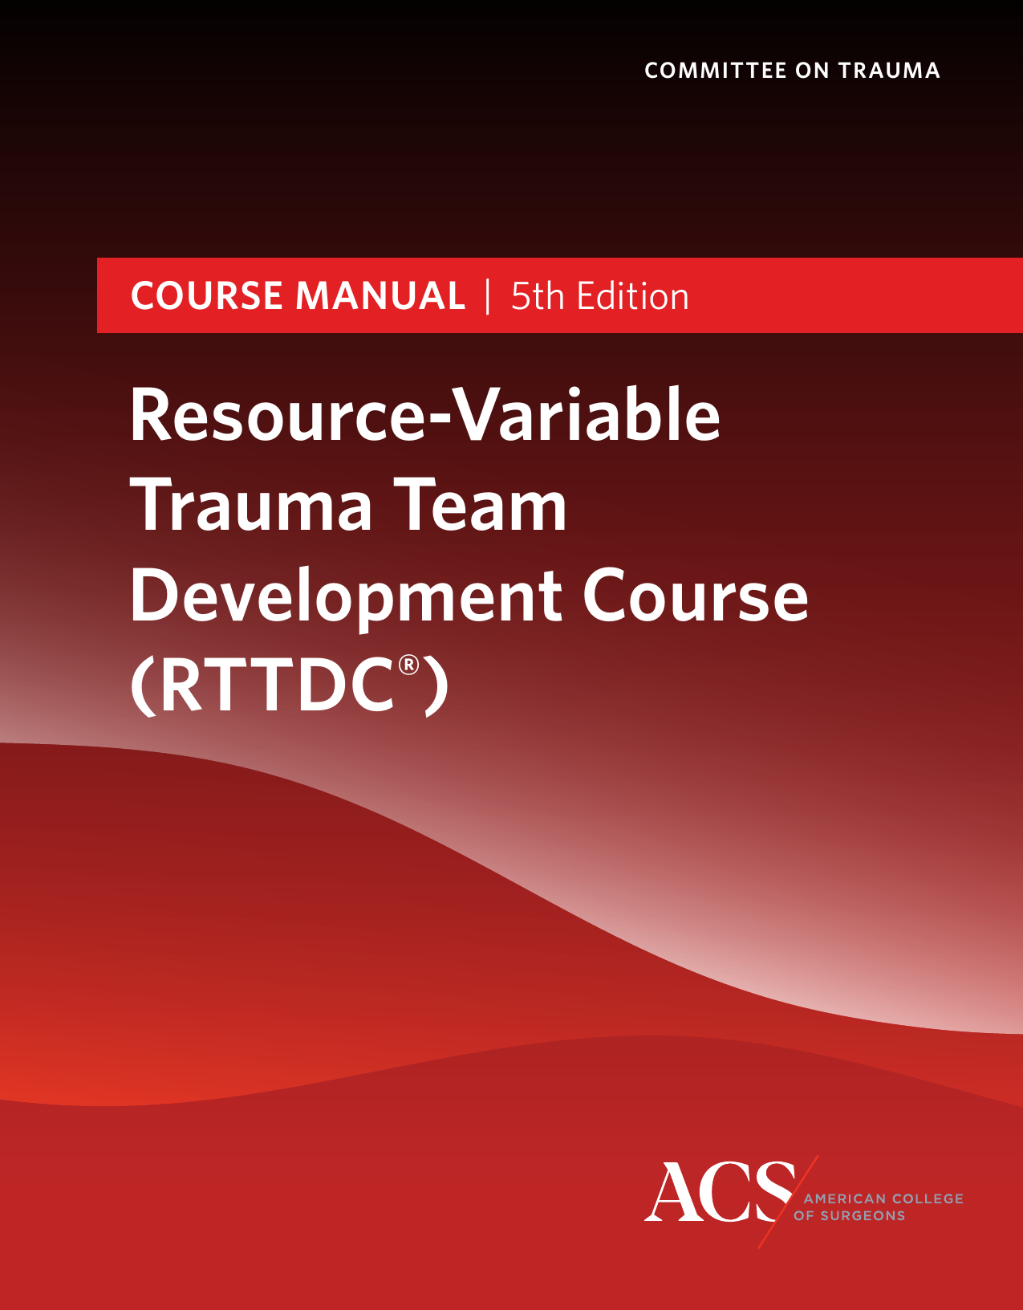
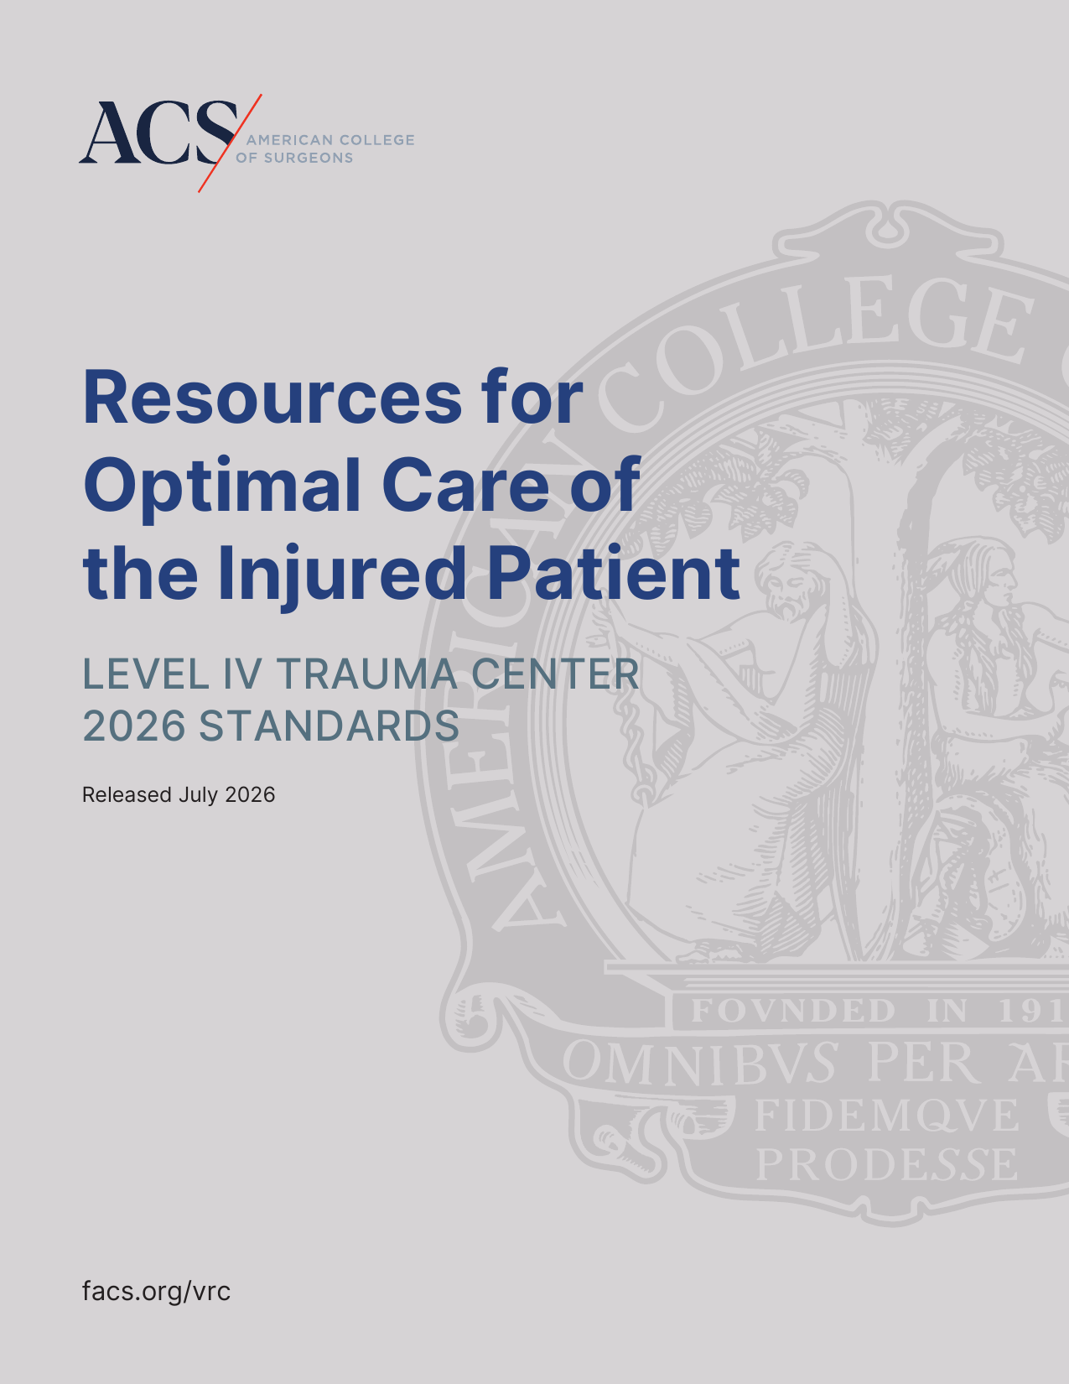
2026: from planning to products
RTTDC 5th Edition — released spring 2026
Level IV Trauma Center Standards — released July 2026
Community of Practice — in development
ACS Rural Definition Project — college-wide rurality tool; to the ACS Board of Regents, September 2026
Rural Trauma Program — approved; started July 1
RTTDC 5th Edition course manual · Level IV Trauma Center 2026 Standards
Notes:
INTRO: 1 minute. The headline — two completed products (RTTDC v5 this spring/summer, the Level IV standards in July), the Community of Practice being built, the Rural Definition Project, and the Rural Trauma Program approved and headed to the Board of Regents this month. Then hand off to the Level IV talk.

Slide 9
Resources for Optimal Care of the Injured Patient
Level IV Trauma Center Standards · 2026 · Released July 2026

Slide 10
Why a stand-alone Level IV document?
Rural practice is different from Level I–III
No ACS verification for Level IV — complements state designation
Framework, not checklist
Guidance for states and a gap-analysis tool for centers
Different resources — the same commitment to quality
Notes:
LEVEL IV (7 min): 1.5 minutes. Level IV centers are often the first — and sometimes only — point of access for seriously injured rural patients. Standards for Level IV have lived inside the Red Book before; this is the first stand-alone document, because (1) the rural environment differs substantially from Level I–III and (2) the VRC does not verify Level IV. Goals: set clear expectations, give designating authorities a basis for criteria, ensure consistent access to high-quality care.

Slide 11
The “revision” process
Oct 2022 – Mar 2023
Mar 2024
2024 – 2025
May 2026
Jul 2026
Stakeholder survey
COT programs and stakeholder groups
Leadership meeting
Workgroup formed
Draft and comment
Multiple feedback periods
Finalized
Released
facs.org/vrc
Workgroup
Avery Nathens (Lead) · Scott Sagraves · John Perlstein · Michael Person · Riordan Azam
Rural Advisory Council and rural stakeholders engaged throughout
Notes:
LEVEL IV: 1 minute. Stakeholder-driven from the start (survey in 2022); rural voices — the RAC — at the table; multiple public comment periods; finalized May, released July 30.

Slide 12
30 standards across 7 chapters
1
1 standard
2
6 standards
3
13 standards
4
4 standards
Institutional Administrative Commitment
Program Scope and Governance
Staffing, Facilities, and Equipment
Patient Care: Expectations and Protocols
5
1 standard
6
4 standards
7
1 standard
Data Surveillance and Systems
Performance Improvement and Patient Safety
Education: Professional and Community Outreach
Same chapter framework and standard format as the Level I–III Resources
Notes:
LEVEL IV: 45 seconds. Same framework and format as the Level I–III standards so the language is familiar to state designating authorities and to higher-level partners. Chapter 3 is the biggest — staffing, facilities, equipment.

Slide 13
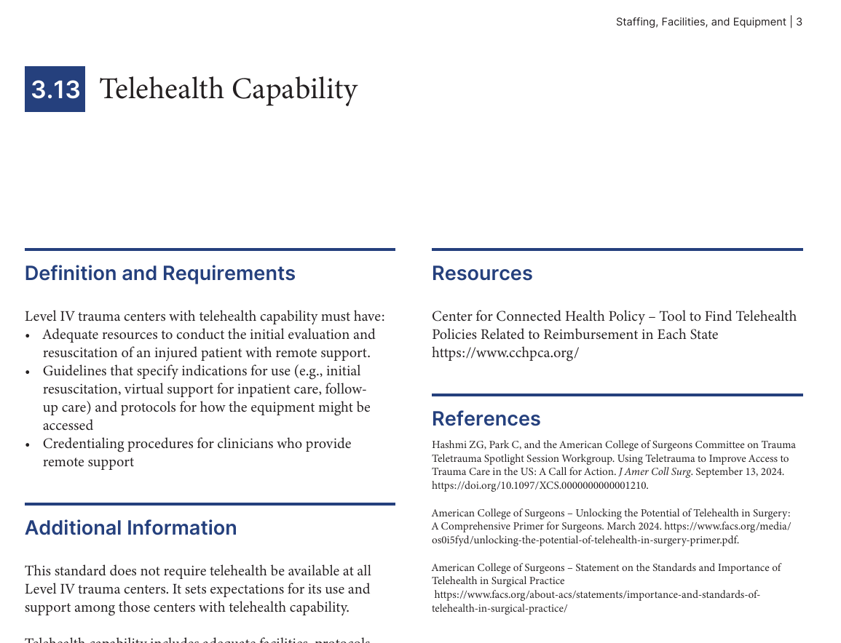
What a standard looks like
Every standard, five parts
1
Definition and Requirements
2
Additional Information
3
Measures of Compliance
4
Resources
5
References
3.13 Telehealth Capability (page excerpt)
Notes:
LEVEL IV: 45 seconds. Show the page. Every standard reads the same way: what is required, context, how a state or a center would measure compliance, and the resources and references behind it. These two pages are the telehealth standard and the transfer-feedback standard — both areas of focus for Level IV centers.

Slide 14
A focus for Level IV centers
FOCUS IN THIS EDITION
3.13 Telehealth Capability — expectations for centers that use remote support
3.5 Pediatric Readiness — assessment each cycle plus seven high-priority elements
6.4 Feedback from higher-level centers — injuries, outcomes and opportunities after transfer
3.9 Blood Products — supply on site, contingency plan where storage is limited
EMPHASIZED
24/7/365 ED physician coverage — EM board-certified or current ATLS
Emergency airway management policy
Transfer protocols and predetermined referral relationships
Activation criteria, clinical practice guidelines, registry
PIPS plan and prehospital feedback
Nursing trauma orientation and continuing education
State/regional system participation, injury prevention
Notes:
LEVEL IV: 2.5 minutes. Spend the most time on telehealth, pediatric readiness and the transfer-feedback loop — these are what rural centers will feel. Telehealth is not required of every Level IV center; it sets expectations for those that have it. Close: a gap-analysis tool for centers and guidance for states — not a verification program.

Slide 15
RURAL TRAUMA
Community of Practice
Creating a low-burden, high-value curriculum for sustainable, collaborative rural trauma learning
Alexis M. Moren, MD, MPH, FACS
Associate Trauma Medical Director, Salem Health · Salem, Oregon · Chair, Oregon Committee on Trauma
Rural Trauma Program | American College of Surgeons
Notes:
Opening: 30 seconds. Introduce the Rural Trauma Community of Practice initiative and set up the problem we're solving for rural trauma engagement.

Slide 16




Why Engagement From Rural Surgeons Is Limited
Professional Isolation
Limited Protected Time
Infrastructure & QI Gaps
Infrequent Critical Skills
Few peers nearby who manage the same infrequent, high-acuity trauma cases.
Workforce shortages leave little room for training outside clinical duty.
Rural sites often lack dedicated quality-improvement support.
Low case volume makes it hard to keep trauma skills sharp.
The barrier isn't interest — it's time, access, and sustainability.
Notes:
45 seconds. This sets the stage: the problem is structural, not motivational.

Slide 17


What Is a Community of Practice — and Why Build One?
A Community of Practice
Our Goals
A collaborative learning network built around shared cases, peer learning, and problem solving
Supports ongoing education, mentorship, and quality improvement
Ongoing interaction and real-world application — reduces isolation while improving trauma care quality
Emphasizes rural ownership with academic support
Educate and support ongoing skills development
Reduce professional isolation
Improve trauma care quality and outcomes
Create collaborative learning and shared problem-solving
Build pathways for local, state, and national engagement
Notes:
45 seconds. Quick definition, then pivot straight into the five goals driving the design.

Slide 18




Opportunities
CLINICIAN
SYSTEM
Case-based discussions & microlearning
ATLS / RTTDC-aligned content
Sessions under 30 minutes, live or async
Centralized templates & QI tools
Shared benchmarks and metrics
Rural-led content development
Sustainable
Engagement
CENTER
ENVIRONMENT
Rural providers drive the content
Tiered participation: passive to active
Real-world clinical relevance
Regional, shared leadership model
COT / quality / education integration
Phased rollout: pilot, build, scale
Notes:
90 seconds — this is the anchor slide. Walk clockwise: clinician, system, environment, center. Each spoke condenses design principles, strategies, and stakeholder roles into one practical opportunity area.

Slide 19



Implementation Strategy
PHASE 1 — PILOT
PHASE 2 — BUILD
PHASE 3 — SCALE
Engage rural sites; begin monthly case discussions
Add procedural skills, simulation, and PI; expand content and participation
Regional and statewide integration
Notes:
30-45 seconds. Emphasize this is a phased rollout, not a single launch.

Slide 20





The End Goal
Increase
Reduce
Support
Enable
Improve
Engagement and collaboration across rural sites
Professional isolation for rural surgeons
Long-term maintenance of critical trauma skills
Meaningful, sustained quality improvement
Rural trauma outcomes through collaborative learning
Rural-led. Academically supported. Built to last.
Notes:
30 seconds. Close on the five outcomes, then the one-line mission statement.

Slide 21
Rural Trauma Education Workgroup
Alexandra Briggs, MD, FACS
Notes:
7 minutes

Slide 22
Disclosures
No relevant financial disclosures

Slide 23
Workgroup Objectives
IDENTIFY PRIORITIES
ADDRESS GAPS
MAINTAIN STANDARDS
Utilize preexisting feedback
Review needs assessment
Obtain rural provider perspectives
Content
Context
Resource informed
Ensure that all content reflects best practice
Acknowledge unique needs of rural providers

Slide 24
Types of Learning
JUST-IN-TIME
MICROLEARNING
LONGITUDINAL LEARNING
TQIP RURAL CONTENT
New content
Diverse formats
In the moment of need
Tailored to learner
‘Bite-size’ learning
Knowledge development
Direct patient care
Continuous development
Tailoring to user / environment
Role for AI to adapt learning
Translation to the TQIP conference

Slide 25
Workgroup Members
John Marc Shellenberger, MD, FACS - Tulsa OK
Jeremy Grushka, MD, MSc, FACS – Montreal, QC
Crystal Perry, MSN, RN, CEN, TCRN – Denton, TX
Anamaria Robles, MD, MAS, FACS – Davis, CA *FTL!*
Joshua Corsa, MD, FACS, NRP – Brewster / Tacoma WA

Slide 26
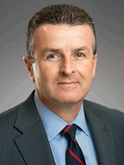
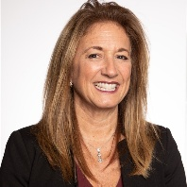

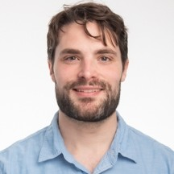
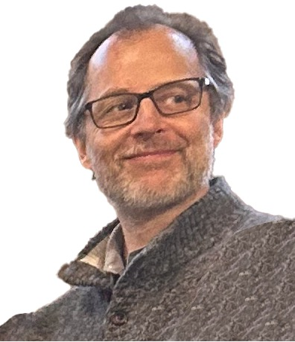






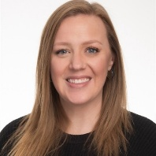
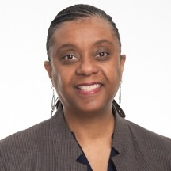



Trauma Education Team
Dr. Jeffrey Kerby
Trauma Education
Medical Director
Alisa Nagler
Assistant Director, Trauma Education Programs
Julie Cwik
Manager
Instructional Design
Jack Daly
Manager
Business Operations
Ryan Francescatti
Manager, Customer & Programs Support
Ana Hernandez
International Program
Coordinator
Meghan Baker
Program Manager
(Technical)
Maria Molina
Program Coordinator
Olivia Grierson
Program Manager
(Non-tech)
Neil Kato
Program Manager
Meghan Hogan
Project Manager
Rebecca Hill
Visual Designer
Glenda Hill
Program Coordinator
Kristin Vail
Program Manager
(Global)
David Wakaba
Instructional Designer

Slide 27
Initial Themes
PROVIDER DIVERSITY
PRACTICE CONTEXT
WHAT WORKS (OR NOT)
  APPs
  Family practice providers
  Low frequency ER providers
  Locums support may increase provider variability
  Nursing staff often can be the continuity for practice
Variety of options
Easy / convenient
NOT too long
NOT narrated lectures

Slide 28
Areas for Opportunity
Supply checklists for equipment
‘How-to’ guides on setup for procedures
Just-in-time procedural refreshers / troubleshooting
Reinforcement of decision making

Slide 29
Specific Topics
BIG criteria and TBI Management
Palliative Care and Family Conversations
Keeping patients locally
Prolonged time to transport

Slide 30
Specific Topics
Tourniquets during prolonged transfer
Details of imaging considerations
Special populations
Clinical deterioration

Slide 31
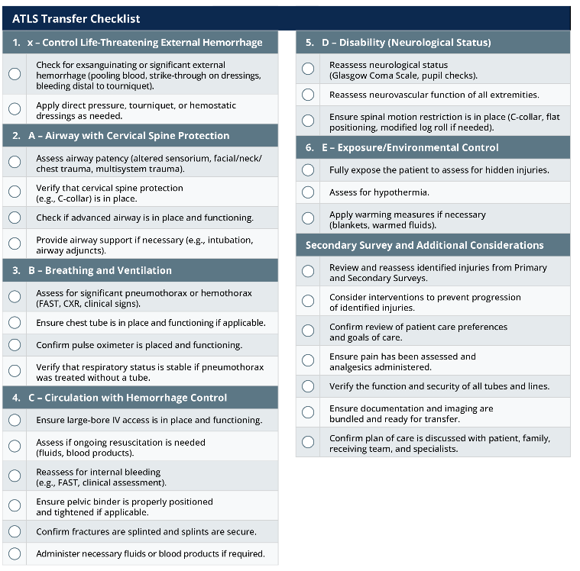
Inspiration: ATLS Transfer Checklist

Slide 32
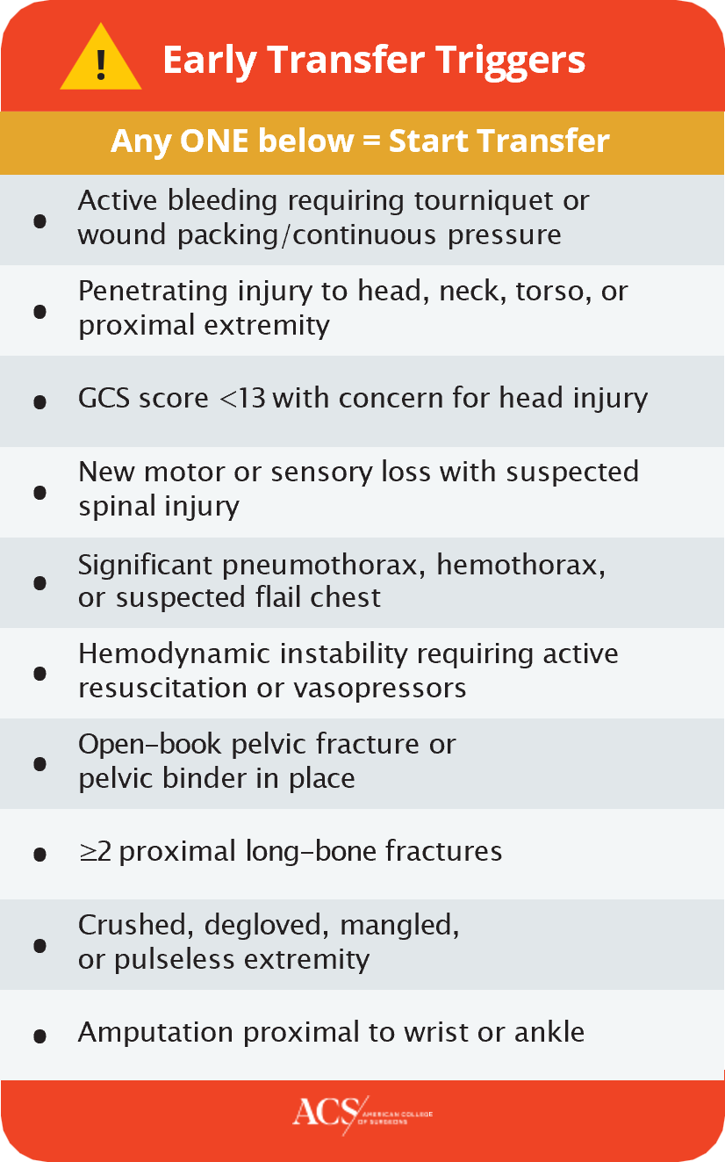
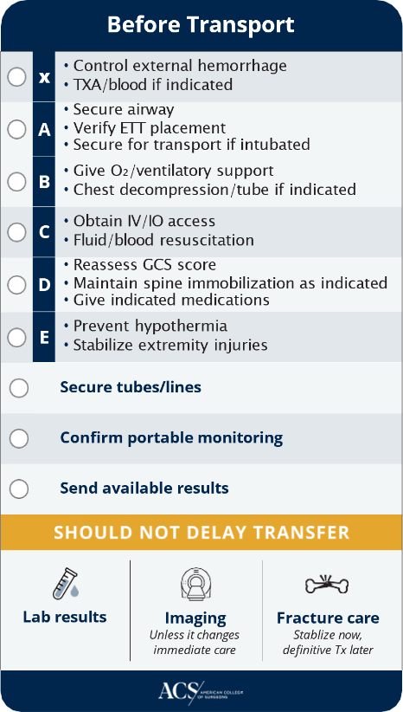
Adaptation: Pocket Guide (Working Draft)

Slide 33
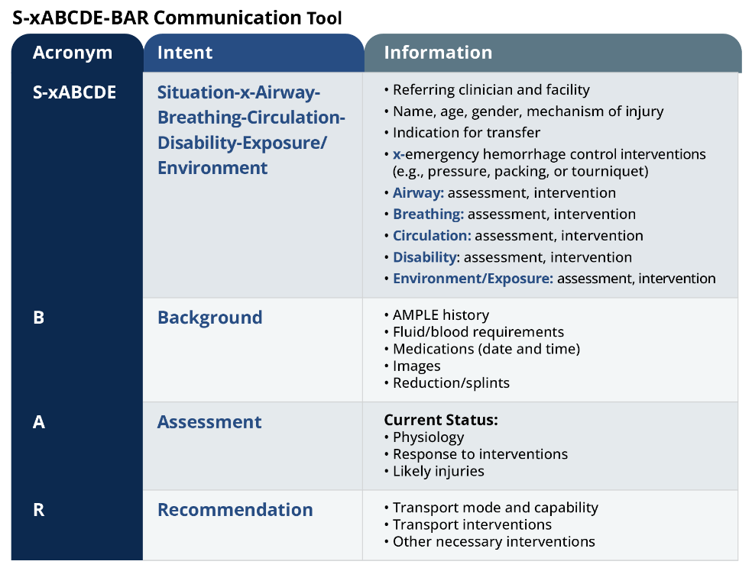
Inspiration: ATLS Communication Tool

Slide 34
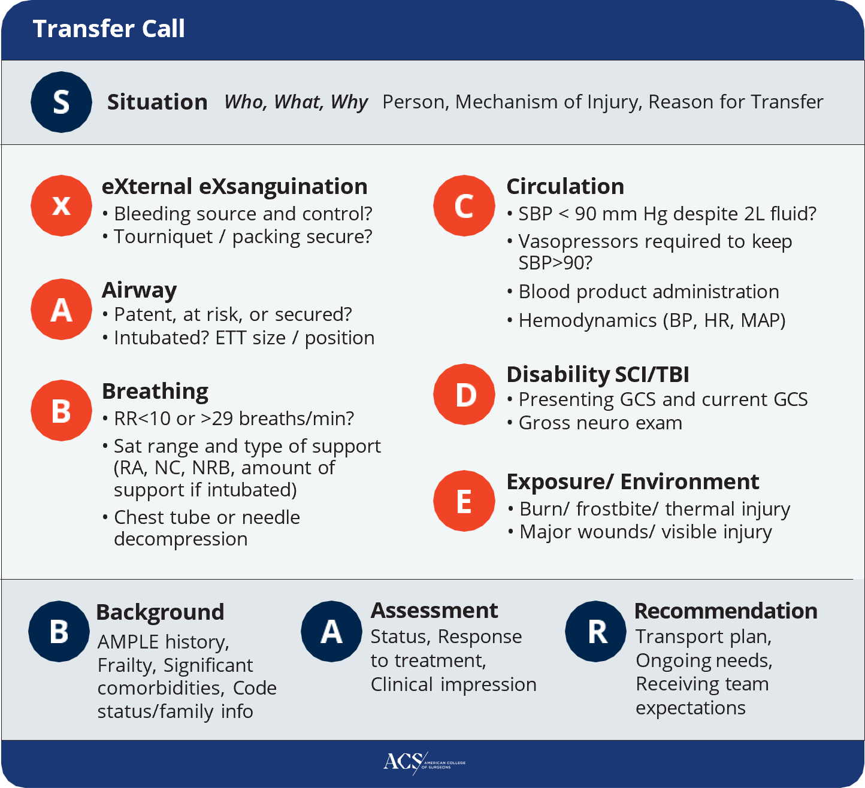
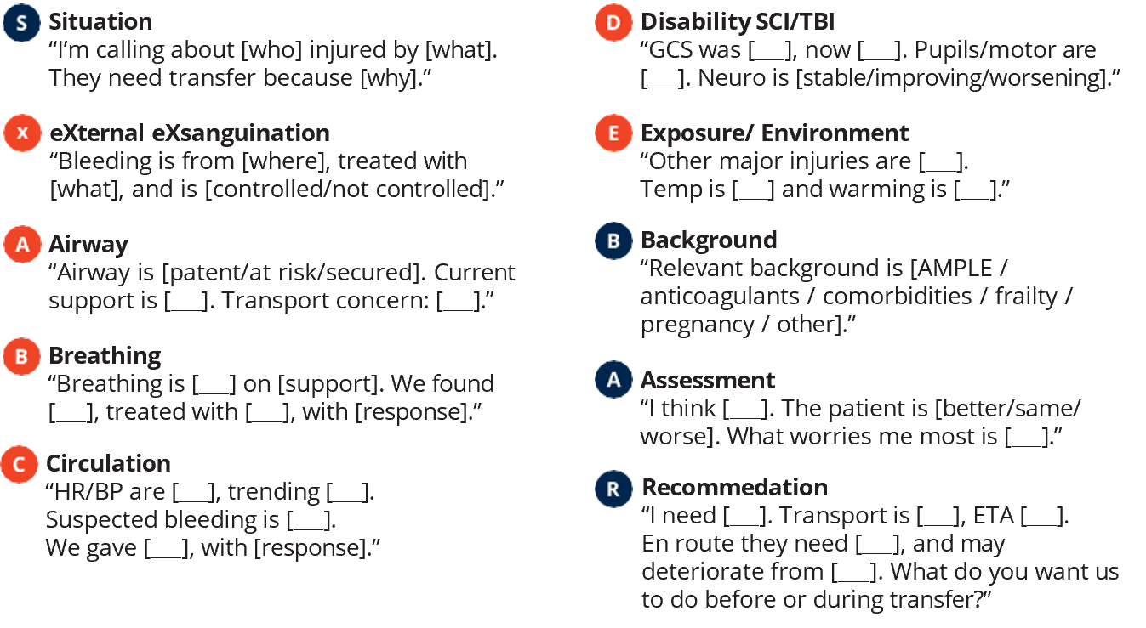
Adaptation: Transfer Guide Tool - Draft

Slide 35
Timeline and Access
Content Development
and Release
Access Considerations
  Meetings every 2-4 weeks
  Ongoing review / comments during development
  Pilot with rural providers
  Content release JANUARY 2027!
  Addition to existing program registration
    RTTDC
    ATLS
  Standalone access

Slide 36

Engagement – Throughout the Congress
What Does Rural Trauma Care Need?
Help us understand what resources, tools, and formats would be most valuable to support trauma care in rural communities.

Slide 37
RTTDC — 5th Edition
Resource-Variable Trauma Team Development Course · Same acronym, new name · Released spring 2026

Slide 38
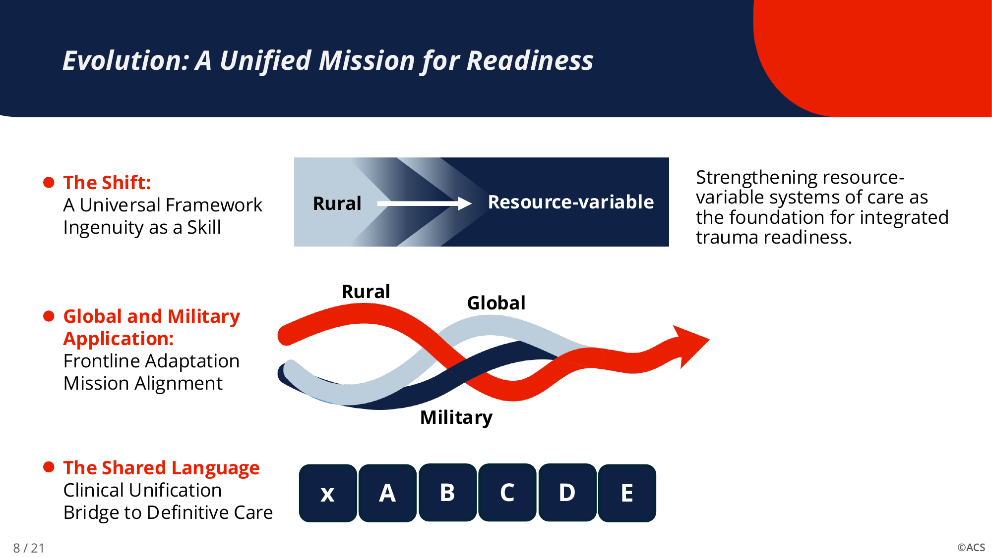
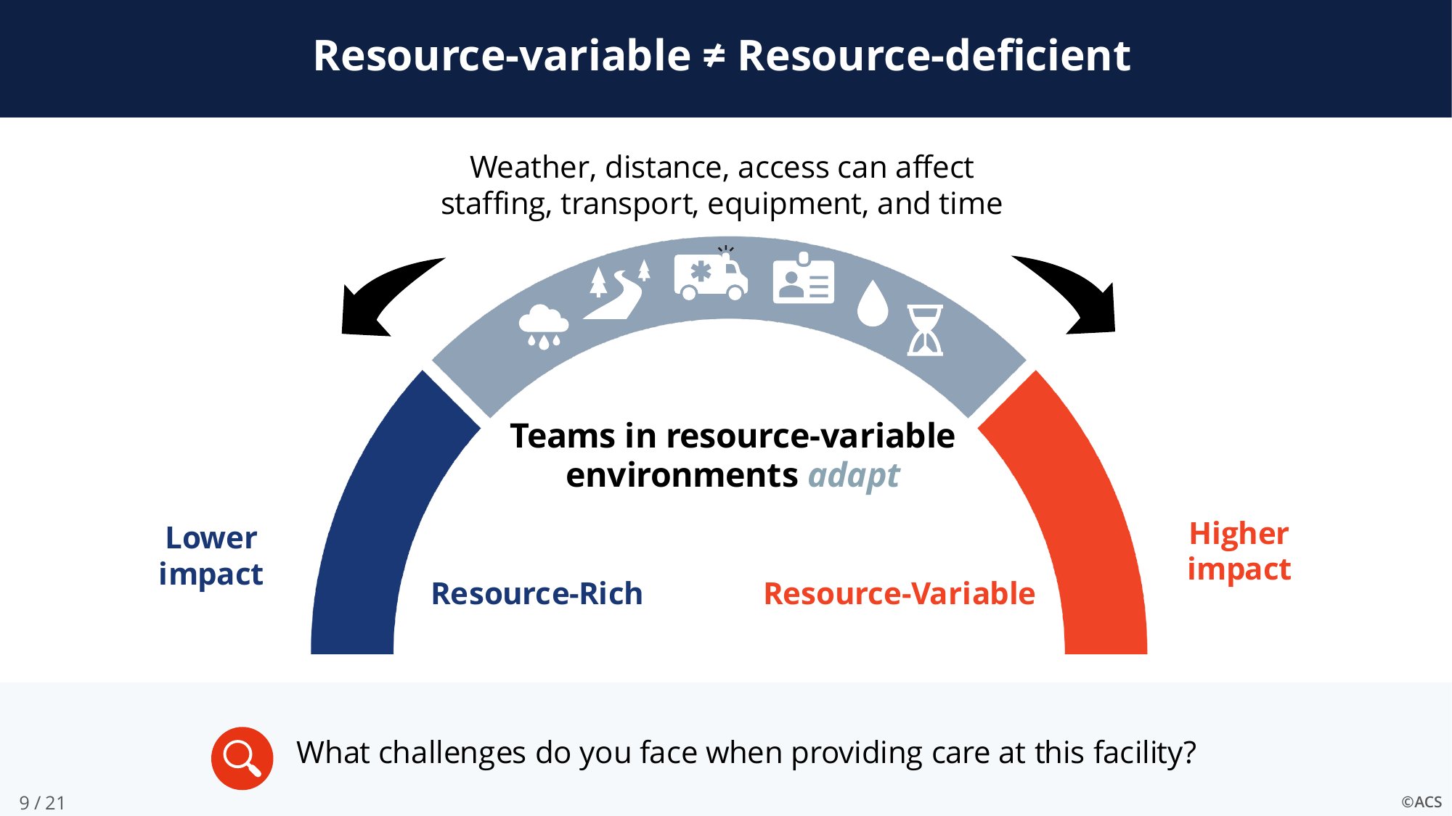
From Rural to Resource-Variable
A unified mission: rural · global · military
Resource-variable ≠ resource-deficient
Same acronym. Same founders’ principles. A broader set of teams.
Notes:
RTTDC (7 min): 1 minute. Why rename? The course was built for rural America, but the same challenges — staff, transport, equipment, time — define austere, global and military settings. Resource-variable acknowledges limitations are situational, not a deficit. The MHSSPACS partnership and Global Collaboration Chair sat on the steering committee.

Slide 39
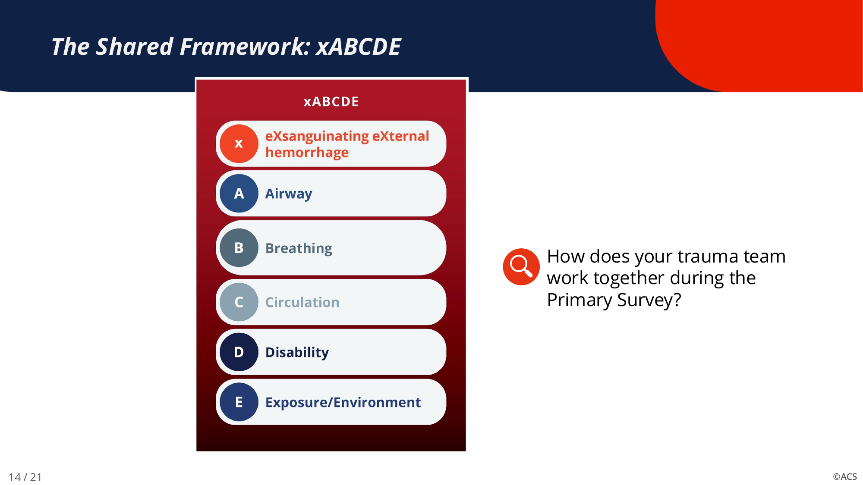
Foundation: ATLS 11 and xABCDE
Every course must include
Telehealth
Transfers and delays
Communication
Process improvement
The shared framework — early hemorrhage control first
Team development and skills
…and the ability to FLEX
Notes:
RTTDC: 1 minute. Educational foundation is ATLS 11 — xABCDE with exsanguinating hemorrhage first. All other chapters revised to align with ATLS and COT educational standards. Five things every course must include, and then flexibility to fit the site.

Slide 40
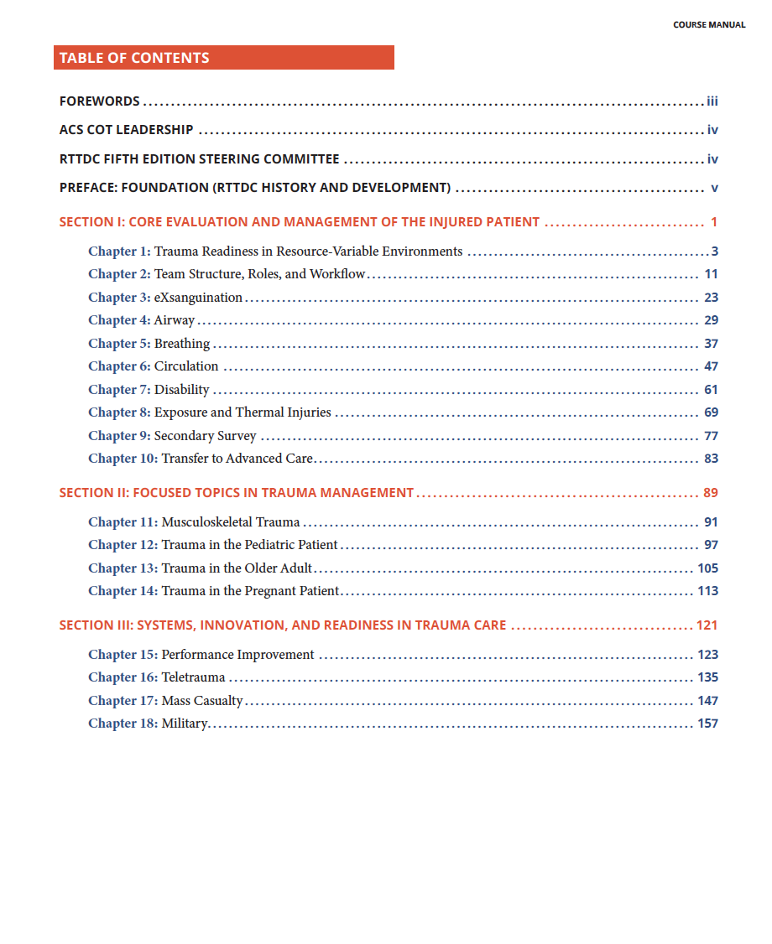
New content: five new chapters, 18 in all
New in the 5th Edition
3
eXsanguination
11
Musculoskeletal Trauma
16
Teletrauma
17
Mass Casualty
18
Military
Three sections: core evaluation · focused topics · systems, innovation and readiness
Course manual table of contents
Notes:
RTTDC: 1 minute. The manual grew to 18 chapters in three sections. Five are new — eXsanguination up front, musculoskeletal, and a systems section with teletrauma, mass casualty and military. Every other chapter revised.

Slide 41
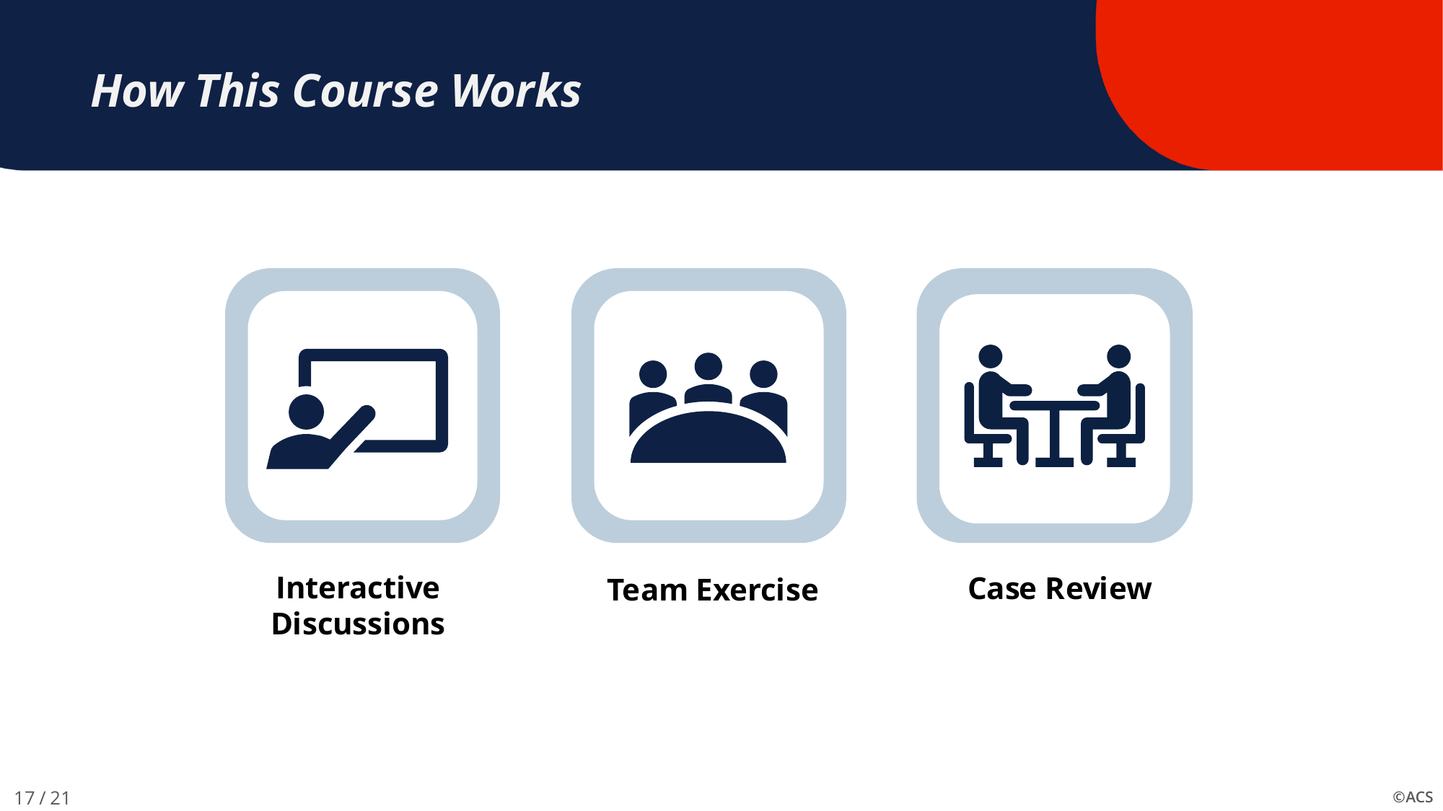
FLEX: one course, variable length
Half day
~5 hours
Full day
~7.5 hours
Half-day modules (minutes)
20
20
15
20
20
20
20
15
15
15
PI + summary
60
Readiness · Team structure · X · A · B · C · D · E · Secondary survey · Transfer · PI
Skills stations chosen by the team’s pre-course survey; Stop the Bleed can be embedded
Didactics · team exercise · case review and skills stations
Notes:
RTTDC: 1 minute. FLEX means the course is adjusted to be relevant to the learners — half day or full day, with skill stations and the PI case review driven by the pre-course survey. Ten core modules of 15–20 minutes, then a 60-minute PI and summary block.

Slide 42
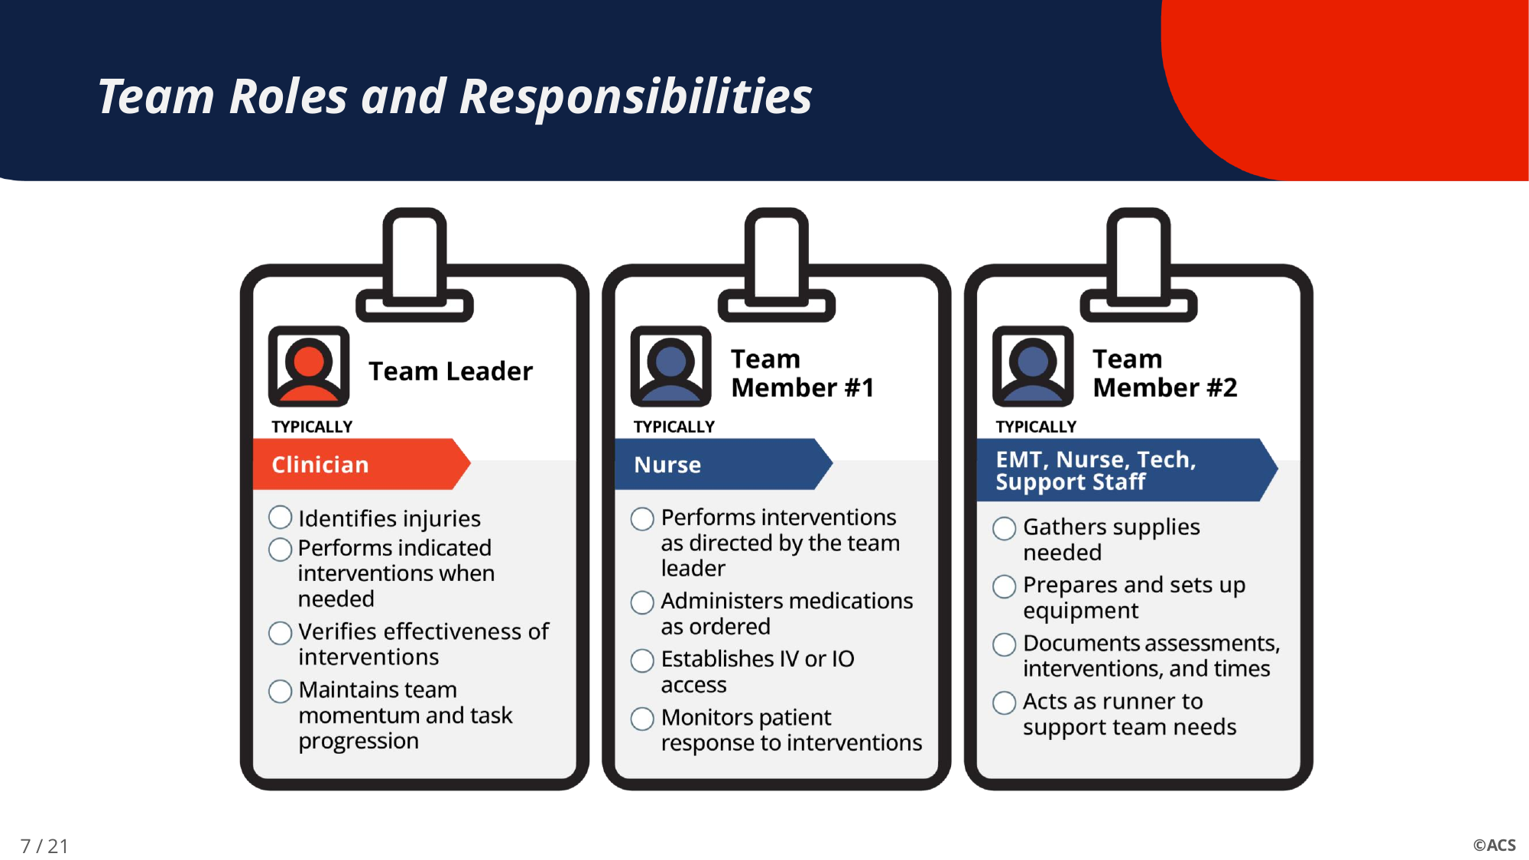
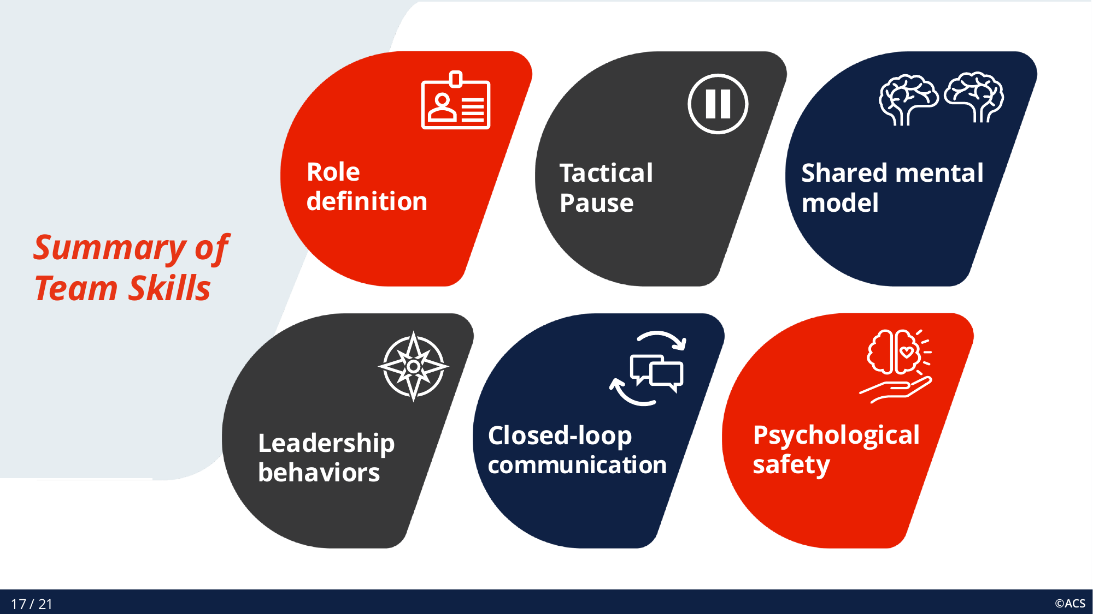
Team tools built into every module
Role badges — Team Leader, Team Member #1, Team Member #2
Team skills — role definition, tactical pause, closed-loop communication, psychological safety
Three-person team concept from the original course, now a visual device on every slide
Notes:
RTTDC: 1 minute. Show the badges. The Iowa/West Virginia three-member team concept — physician/APP, nurse, EMS/tech/support — carried through every phase of the primary survey. Other tools: MIST handover, CUS graded assertiveness, tactical pause, team debrief.

Slide 43
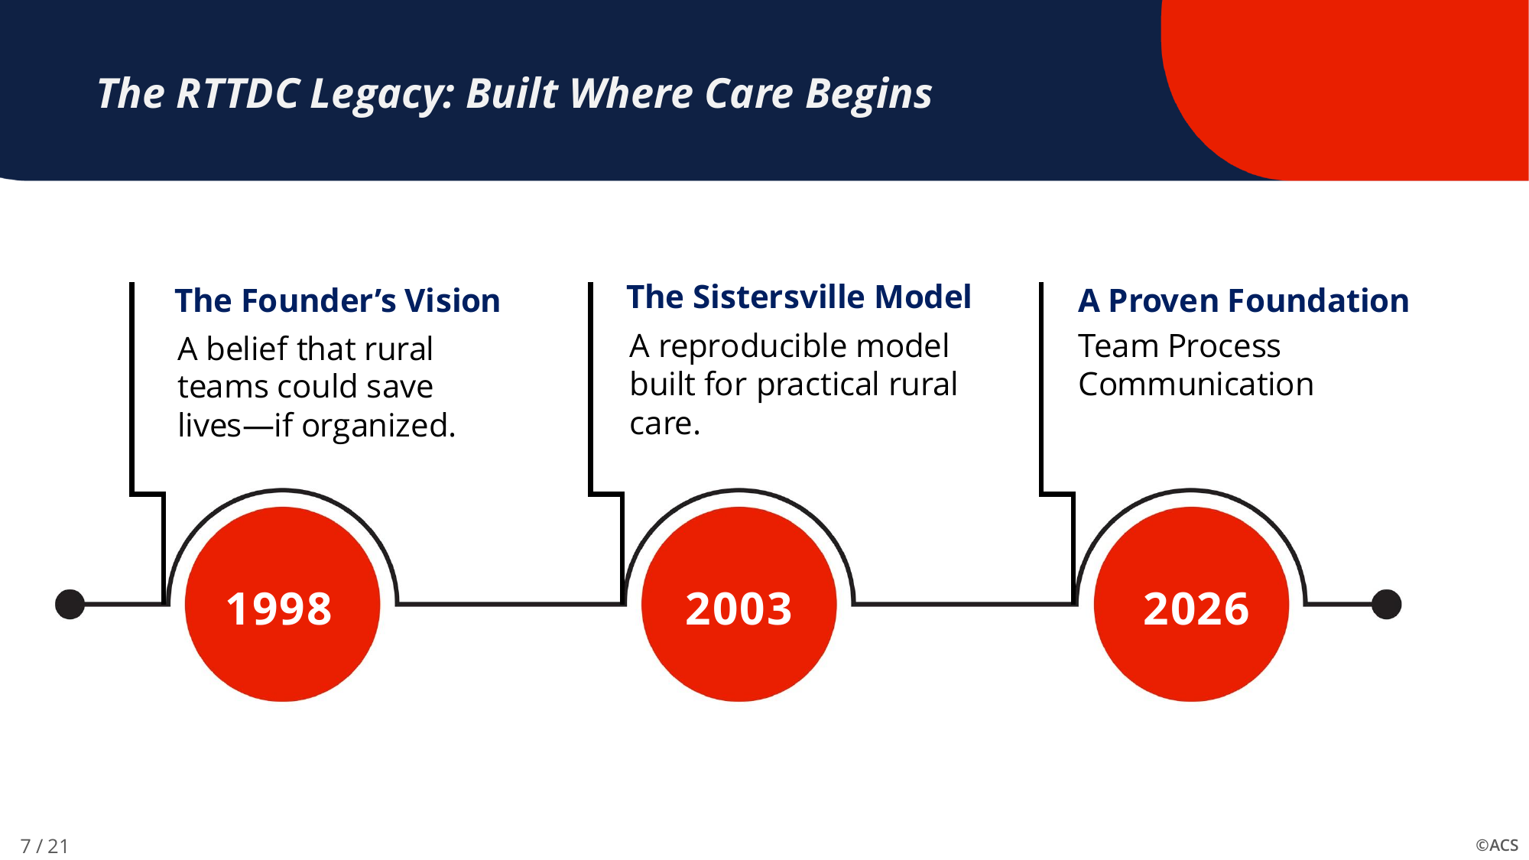
What has not changed
Built for the under-resourced facility
Team concept — everyone in patient flow
Taught on site, with the team’s own equipment
Minimal cost, minimal equipment
Address the delays; transfer early
Relationships across the system
The RTTDC legacy — 1998 · 2003 · 2026 — built where care begins
No test
Notes:
RTTDC: 1 minute. What did not change matters as much as what did. Four rural surgeons, a grassroots course, first taught in Sistersville, West Virginia in 2003; the relational benefit — teams knowing and trusting each other — remains its most enduring contribution.

Slide 44
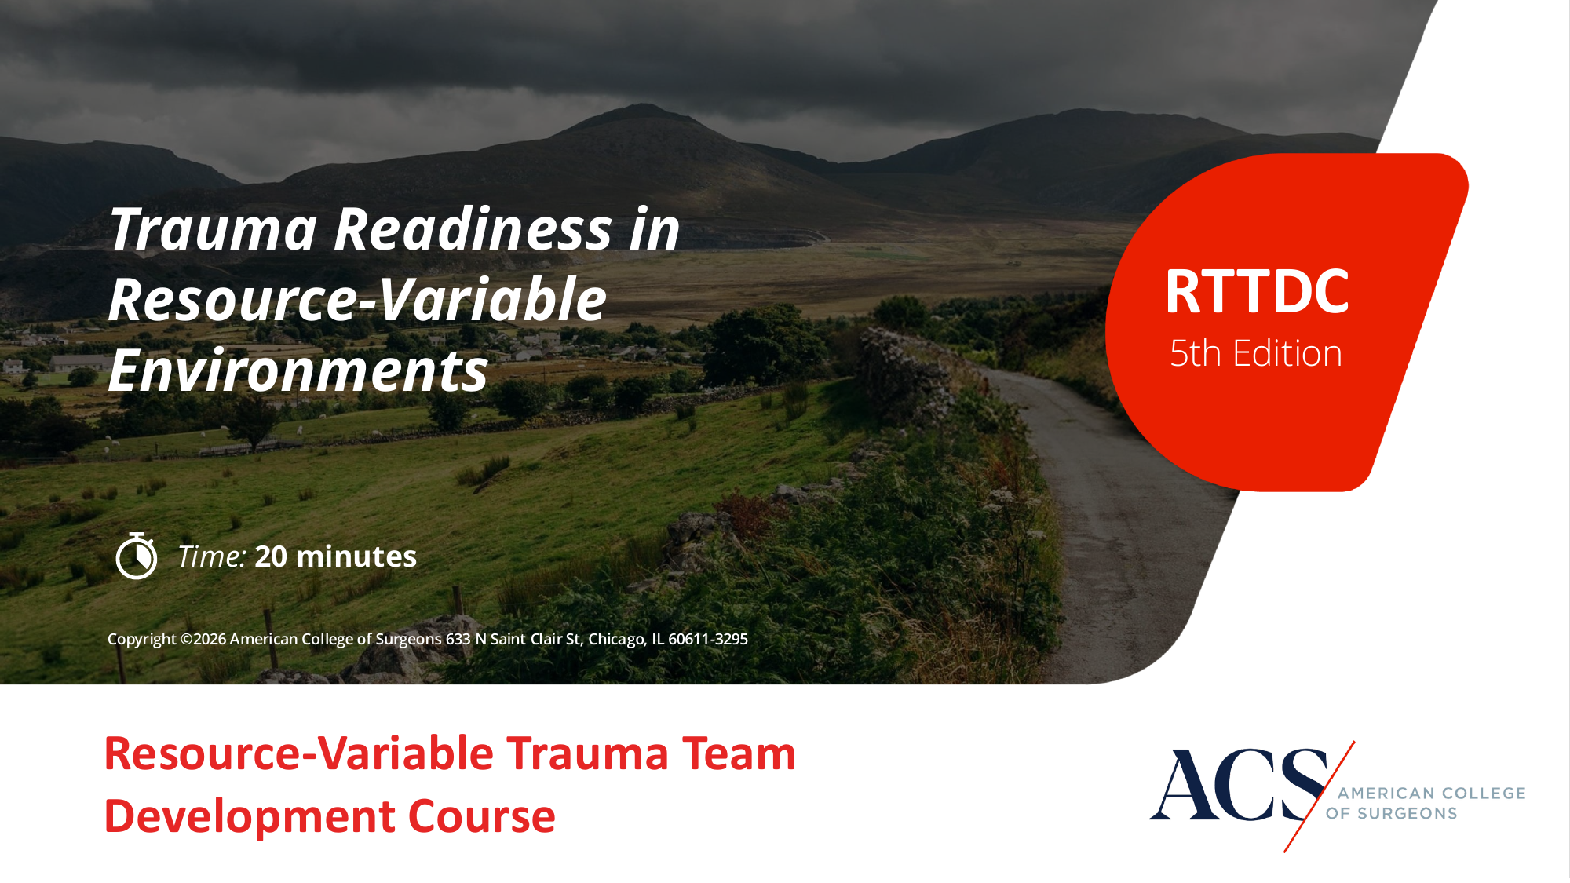
Bringing a course to your facility
Who benefits
Critical access and non-verified hospitals; any team with infrequent, high-acuity trauma
Course Director
An ATLS instructor
Instructors
Surgeons, EM, primary care, nurses, prehospital — online module + Course Director approval
CME
Varies with course length — half day or full day
facs.org → Quality Programs → Trauma → Education → RTTDC
RTTDC participants are the natural seed for a regional Community of Practice
Notes:
RTTDC: 1 minute. The ask: host a course (the Course Director is an ATLS instructor), become an instructor, and use RTTDC teams as the on-ramp to the Community of Practice Dr. Moren described. Hand off to Dr. Sakran.

Slide 45

Rural Health Advocacy
September 26, 2026
Joseph V. Sakran, MD, MPH, MPA, FACs

Slide 46
Quick recap: what is Rural Health Transformation Program?
$50B
50
~$200M
Total Investment
States Approved
Per State Average
Over FY2026–2030, $10 billion per year
All 50 states received first-year awards
First-year award average across all states
A $50 billion, five-year federal investment is now moving into state-level execution.
Administered by CMS through state cooperative agreements. Program is designed to strengthen rural access, workforce, technology, coordination, and innovative care delivery.
Source: CMS Rural Health Transformation Program overview and December 29, 2025 awards announcement.

Slide 47
The part that matters most to trauma
Trauma Care Priority
Regional Collaboration
is one of the eight transformation priorities — a named focus area, not an afterthought.
Developing Regional Collaboration Models is also a named priority, creating the framework for system-level thinking.
Eligible Activities
Strategic Opportunity
Community paramedicine, telehealth, care coordination, regional data-sharing, and workforce training all qualify.
Treat rural trauma as a regional system — not simply a rural-hospital problem.

Slide 48
The program is now in implementation
Now: Execution
December 2025
States moving from statewide plans to project implementation and sub-award processes.
CMS approves RHTP funding for all 50 states simultaneously.
01
02
03
04
FY2026 Awards
Visibility
State allocations range from $147M to $281M per state.
CMS published state project abstracts — trauma, EMS, and regional coordination are visible in the spotlights.
Source: CMS Rural Health Transformation Program awards; CMS state project abstracts/50-state spotlights.

Slide 49
Where trauma and emergency care are showing up
Examples in state plans
Why this matters
EMS and community paramedicine programs
Prehospital and emergency-care capability investments
Telehealth and hub-and-spoke models connecting rural to urban expertise
Transfer, bed tracking, and regional coordination initiatives
Rural patients often depend on EMS as the first clinical contact
Definitive trauma care may be geographically distant
Technology connects rural clinicians to higher-level expertise
Regional coordination can turn isolated resources into a functioning system

Slide 50
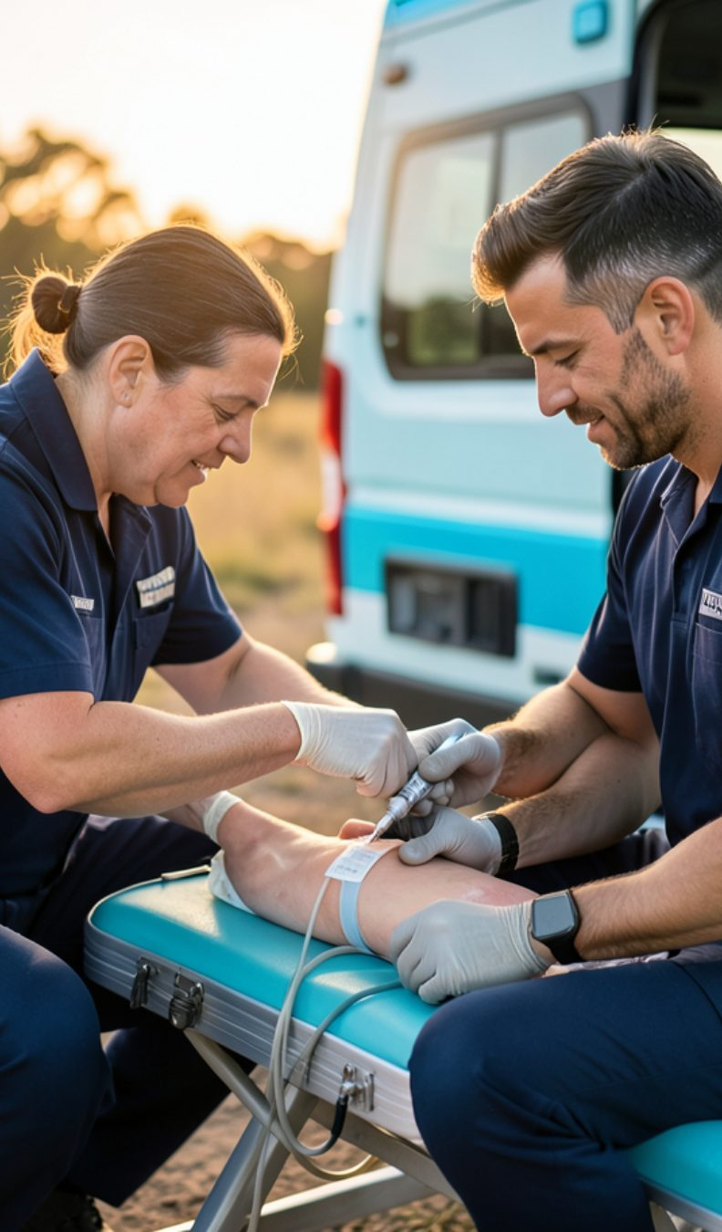
Maryland: a concrete trauma opportunity
Maryland's RHTP plan includes strengthening emergency and trauma response
Key initiative: pilot prehospital blood transfusion program with rural EMS
Directly aligns with COT's 2026 state advocacy priority around prehospital blood
Maryland can become a model for how RHTP dollars strengthen the rural trauma continuum

Slide 51
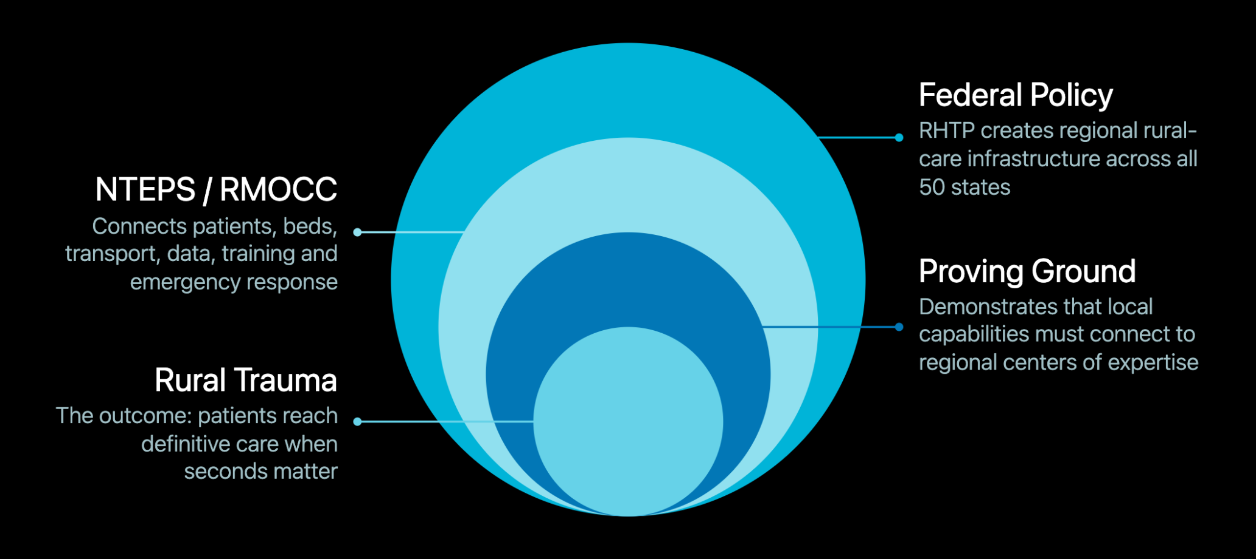
The bigger strategic connection: regionalization

Slide 52
Where Seconds Matter: an advocacy bridge
28
5
15
COT Members
Visits Completed
States Engaged
Participating across 15 states
CA ×3, Colorado ×1, Oklahoma ×1
Active policymaker outreach underway
The Question to Ask
Why It Works
"How is your state using RHTP funding to ensure rural patients can reach definitive trauma care when seconds matter?"
Makes trauma advocacy concrete, state-specific, and tied to an active federal investment — not an abstract policy ask.

Slide 53
Opportunities COT could consider
Map State Plans
Identify Models
Track Opportunities
01
02
03
Analyze all 50 RHTP state plans for trauma-relevant investments
Surface 5–10 model programs that can be replicated across states
EMS, prehospital blood, trauma-system, tele-trauma, and regional-coordination funding
Link to NTEPS/RMOCC
Engage Policymakers
04
05
Connect RHTP implementation directly to ongoing federal policy development
Use Where Seconds Matter to tie measurable rural trauma gaps to active RHTP investments

Slide 54
Bottom line
Policy is now execution
Trauma is in the agenda
RHTP has moved from a policy opportunity toactive implementationin every state.
Emergency and trauma care areexplicitly namedas part of the transformation priorities.
The system opportunity
Our role
Connect EMS, rural hospitals, trauma centers, technology, and regional coordination into one functioning system.
Identify what works, spread it, and keeprural trauma centralto the transformation conversation.

Slide 55
Questions?
COT Rural Initiatives Session · Education, Quality, and Community
Notes:
QUESTIONS (5 min). If the room is quiet, use the appendix prompts on the next slide. Thank the panel and COT staff.

Slide 56
Panel Discussion
How should Level I/II centers use the Level IV standards to support their rural referral partners?
What makes a Community of Practice sustainable for clinicians with little protected time?
Where does RTTDC fit with longitudinal and just-in-time education?
What funding and advocacy priorities would move rural trauma readiness the furthest?

