Slide 1
Case-Based
Triage Scenarios
Target Audience: New EMS Clinicians

Slide 2
These case-based scenarios have been developed as an educational training tool to illustrate application of the National Guideline for the Field Triage of Injured Patients.
EMS and trauma systems vary significantly across the US. These cases include hypothetical system resources from a mix of urban, suburban, and rural community scenarios. Attention should be given to how the availability of different resources may influence your decision making.
Notes:
INSTRUCTORS:
Multiple case scenarios have been developed to facilitate education and training to apply the National Field Triage Guideline in practice. Covering all cases is not necessary depending on time constraints; it is recommended to cover at least 3-5 cases. Choose a variety of cases that cover Injury Patterns, Mental Status & Vital Signs, Mechanism of Injury, & EMS Judgment criteria from the Guideline to illustrate how each set of criteria is applied to injured patients.
These patient cases and discussion points include a mix of urban, suburban, and rural settings and resources for you and the trainees to consider when making triage decisions.
It is important to discuss how system resources can impact triage decision making, including bypassing other hospitals, selection of the level of trauma center, and/or use of air medical transport.
The cases contain the MARCH primary survey and secondary survey to clarify if a patient does or does not meet the specific criterion.

Slide 3
In each scenario there will be one patient to assess and make a triage decision.
The Field Triage Guideline was developed using the best available evidence to identify patients that are most likely to benefit from the resources of a trauma center. They are not meant to supersede local trauma triage protocols and are not intended for mass casualty incident (MCI) triage.
Notes:
INSTRUCTORS:
Multiple case scenarios have been developed to facilitate education and training to apply the National Field Triage Guideline in practice. Covering all cases is not necessary depending on time constraints; it is recommended to cover at least 3-5 cases. Choose a variety of cases that cover Injury Patterns, Mental Status & Vital Signs, Mechanism of Injury, & EMS Judgment criteria from the Guideline to illustrate how each set of criteria is applied to injured patients.
These patient cases and discussion points include a mix of urban, suburban, and rural settings and resources for you and the trainees to consider when making triage decisions.
It is important to discuss how system resources can impact triage decision making, including bypassing other hospitals, selection of the level of trauma center, and/or use of air medical transport.
The cases contain the MARCH primary survey and secondary survey to clarify if a patient does or does not meet the specific criterion.

Slide 4
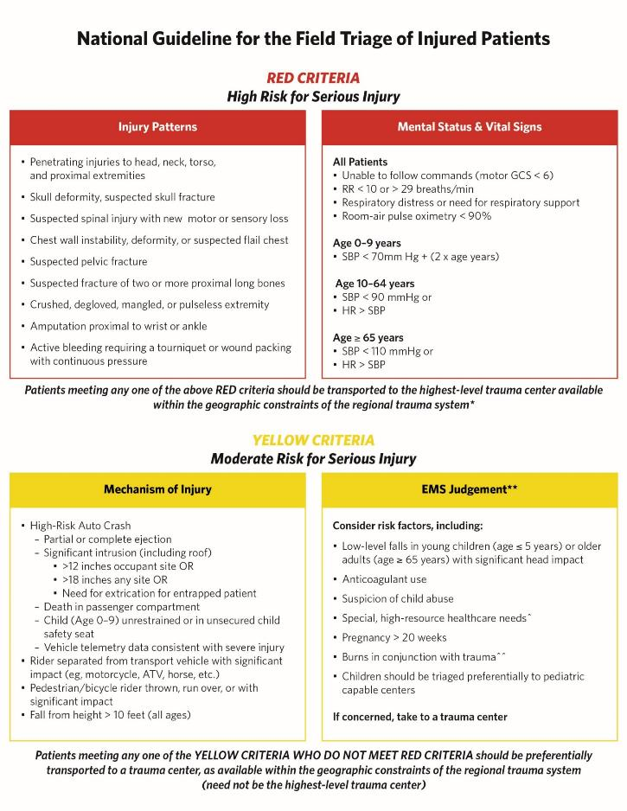
Notes:
INSTRUCTORS:
If you have not already, review the Field Triage Guidelines here.

Slide 5
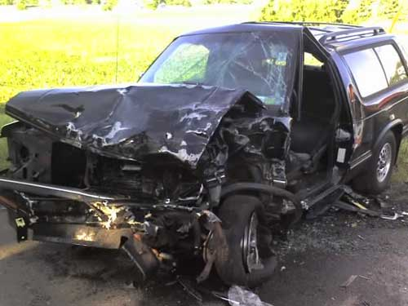
Case 1
System & Resources: Suburban transport ambulance. Level I trauma center 35 min transport, Level III trauma center 20 min transport, community hospital 10 min transport.
Dispatch Info: Passenger vehicle rear-end collision into garbage truck, unknown injuries.
Scene Size Up: SUV with damage as shown. Middle-aged male driver restrained, still in vehicle.
Primary survey:
A – Answering your questions when you approach
B – Regular, non-labored
C – Rapid radial pulse, cool skin
D – Following commands, confused about where he is & what happened
Secondary survey:
Exam – Scattered facial abrasions, abdomen tender lower quadrants, seat-belt sign across lower abdomen, swollen & tender left knee/shinSpO2 97% RA GCS 14 (E4 V4 M6)
Initial Thoughts?
Source: Joshua Brown, MD MSc FACS. Used with permission
Notes:
Discussion Points:
Criterion demonstrated – Shock Index >1 (e.g. HR>SBP): HR 124, SBP 96 → RED criterion, should go to highest level trauma center available
System & resource considerations – Level III trauma center is closest; however, given RED criterion patient will need to go to the Level I trauma center
Bypass other centers – Community hospital and Level III trauma center
Patient destination – Level I trauma center
Transport mode – Ground

Slide 6
Case 1
System & Resources: Suburban transport ambulance. Level I trauma center 35 min transport, Level III trauma center 20 min transport, community hospital 10 min transport.
Dispatch Info: Passenger vehicle rear-end collision into garbage truck, unknown injuries.
Scene Size Up: SUV with damage as shown. Middle-aged male driver restrained, still in vehicle.
Primary Survey:
M – None identified
A – Answering your questions when you approach
R – Regular, non-labored
C – Rapid radial pulse, cool skin
H – Following commands, confused about where he is & what happened
Secondary survey:
Exam – Scattered facial abrasions, abdomen tender lower quadrants, seat-belt sign across lower abdomen, swollen & tender left knee/shin
Initial vital signs – BP 96/52 HR 124 RR
Patient Destination?
Source: Joshua Brown, MD MSc FACS. Used with permission
Notes:
Discussion Points:
Criterion demonstrated – Shock Index >1 (e.g. HR>SBP): HR 124, SBP 96 → RED criterion, should go to highest level trauma center available
System & resource considerations – Level III trauma center is closest; however, given RED criterion patient will need to go to the Level I trauma center
Bypass other centers – Community hospital and Level III trauma center
Patient destination – Level I trauma center
Transport mode – Ground

Slide 7

Case 1
System & Resources: Suburban transport ambulance. Level I trauma center 35 min transport, Level III trauma center 20 min transport, community hospital 10 min transport.
Dispatch Info: Passenger vehicle rear-end collision into garbage truck, unknown injuries.
Scene Size Up: SUV with damage as shown. Middle-aged male driver restrained, still in vehicle.
Primary Survey:
M – None identified
A – Answering your questions when you approach
R – Regular, non-labored
C – Rapid radial pulse, cool skin
H – Following commands, confused about where he is & what happened
Secondary Survey:
Exam – Scattered facial abrasions, abdomen tender lower quadrants, seat-belt sign across lower abdomen, swollen & tender left knee/shin
Initial vital signs – BP 96/52 HR 124 RR 20 SpO2 97% RA GCS M 6
History – HTN, on anti-HTN medication
Changes to Your Plan?
Source: Joshua Brown, MD MSc FACS. Used with permission
Notes:
Discussion Points:
Criterion demonstrated – Shock Index >1 (e.g. HR>SBP): HR 124, SBP 96 → RED criterion, should go to highest level trauma center available
System & resource considerations – Level III trauma center is closest; however, given RED criterion patient will need to go to the Level I trauma center
Bypass other centers – Community hospital and Level III trauma center
Patient destination – Level I trauma center
Transport mode – Ground

Slide 8
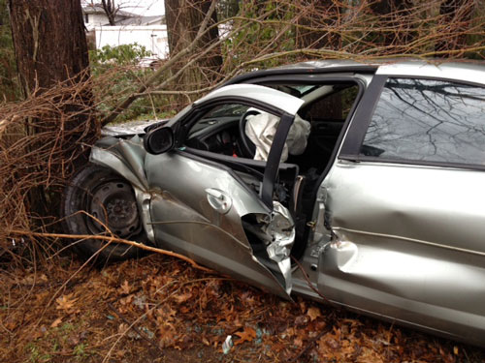
Case 2a
System & Resources: Rural transport ambulance. Level I trauma center 60 min transport, Level IV trauma center 20 min transport, community hospital 12 min transport. Air transport on scene 20 min from request.
Dispatch Info: Two-car MVC, one car over embankment. You and a second unit are dispatched.
Scene Size Up: Sedan over embankment, damage as shown. Young female restrained driver responding but confined by damaged door. Air bags deployed. Door is popped by rescue & patient able to self-extricate.
Primary survey:
A – Yelling for help, answers questions
B – Regular,
agitated about wreck
112/68 HR 96 RR 18 SpO2 99% RA GCS 15
History – None
Initial Thoughts?
Notes:
Discussion Points:
Criterion demonstrated – Need for extrication for entrapped patient → YELLOW criteria, should go to trauma center not necessarily highest level available (if no RED criteria met)
Patient does NOT meet this criterion, does not need a trauma center if no other criteria met. Popping a door does not rise to level of extrication for entrapment.
System & resource considerations – Can transport to closest hospital or hospital of patient’s choice
Bypass other centers – Not applicable, unless per patient choice
Patient destination – Community hospital
Transport mode – Ground

Slide 9

Case 2a
System & Resources: Rural transport ambulance. Level I trauma center 60 min transport, Level IV trauma center 20 min transport, community hospital 12 min transport. Air transport on scene 20 min from request.
Dispatch Info: Two-car MVC, one car over embankment. You and a second unit are dispatched.
Scene Size Up: Sedan over embankment, damage as shown. Young female restrained driver responding but confined by damaged door. Air bags deployed. Door is popped by rescue & patient able to self-extricate.
Primary Survey:
M – None identified
A – Yelling for help, answers questions
R – Regular, non-labored
C – Regular radial pulse, warm skin
H – Following commands, agitated about wreck
Secondary survey:
Exam – Scattered small facial & arm lacs from glass, obviously deformed right shin with bruisin
Patient Destination?
Source: Mark Gestring, MD FACS. Used with permission
Notes:
Discussion Points:
Criterion demonstrated – Need for extrication for entrapped patient → YELLOW criteria, should go to trauma center not necessarily highest level available (if no RED criteria met)
Patient does NOT meet this criterion, does not need a trauma center if no other criteria met. Popping a door does not rise to level of extrication for entrapment.
System & resource considerations – Can transport to closest hospital or hospital of patient’s choice
Bypass other centers – Not applicable, unless per patient choice
Patient destination – Community hospital
Transport mode – Ground

Slide 10
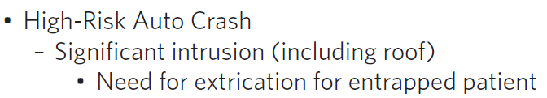
Case 2a
System & Resources: Rural transport ambulance. Level I trauma center 60 min transport, Level IV trauma center 20 min transport, community hospital 12 min transport. Air transport on scene 20 min from request.
Dispatch Info: Two-car MVC, one car over embankment. You and a second unit are dispatched.
Scene Size Up: Sedan over embankment, damage as shown. Young female restrained driver responding but confined by damaged door. Air bags deployed. Door is popped by rescue & patient able to self-extricate.
Primary Survey:
M – None identified
A – Yelling for help, answers questions
R – Regular, non-labored
C – Regular radial pulse, warm skin
H – Following commands, agitated about wreck
Secondary Survey:
Exam – Scattered small facial & arm lacs from glass, bilateral shins with bruising
Initial vital signs – BP 112/68 HR 96 RR 18 SpO2 99% RA GCS M 6
History – None
Changes to Your Plan?
Source: Mark Gestring, MD FACS. Used with permission
Notes:
Discussion Points:
Criterion demonstrated – Need for extrication for entrapped patient → YELLOW criteria, should go to trauma center not necessarily highest level available (if no RED criteria met)
Patient does NOT meet this criterion, does not need a trauma center if no other criteria met. Popping a door does not rise to level of extrication for entrapment.
System & resource considerations – Can transport to closest hospital or hospital of patient’s choice
Bypass other centers – Not applicable, unless per patient choice
Patient destination – Community hospital
Transport mode – Ground

Slide 11
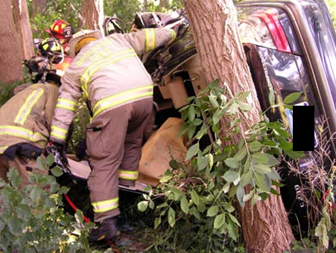
Case 2b
System & Resources: Rural transport ambulance. Level I trauma center 60 min transport, Level IV trauma center 20 min transport, community hospital 12 min transport. Air transport on scene 20 min from request.
Dispatch Info: Two-car MVC, one car over embankment. You and a second unit are dispatched.
Scene Size Up: Sedan over embankment resting on side as shown. Young female restrained driver responding but lower extremities entrapped under dash. Rescue removes the roof and performs dash roll to extricate patient, takes ~25 minutes to get patient out.
Primary survey:
A – Yelling for help, answers questions
B – Regular, non-labored
C – Regular radial pulse, warm skin
D – Following comma
nds, agitated about wreck
99% RA GCS 15
History – None
Initial Thoughts?
Source: Mark Gestring, MD FACS. Used with permission
Notes:
Discussion Points:
Criterion demonstrated – Need for extrication for entrapped patient → YELLOW criteria, should go to trauma center not necessarily highest level available (if no RED criteria met)
This level of extrication does meet the extrication for entrapment criterion and is associated with a high risk of severe injury. The patient should be taken to a trauma center.
System & resource considerations – Patient with YELLOW criterion can go to lower-level trauma center, Level IV trauma center is closest.
Bypass other centers – Community hospital
Patient destination – Level IV trauma center
Transport mode – Ground

Slide 12
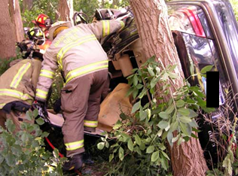
Case 2b
System & Resources: Rural transport ambulance. Level I trauma center 60 min transport, Level IV trauma center 20 min transport, community hospital 12 min transport. Air transport on scene 20 min from request.
Dispatch Info: Two-car MVC, one car over embankment. You and a second unit are dispatched.
Scene Size Up: Sedan over embankment resting on side as shown. Young female restrained driver responding but lower extremities entrapped under dash. Rescue removes the roof and performs dash roll to extricate patient, takes ~25 minutes to get patient out.
Primary Survey:
M – None identified
A – Yelling for help, answers questions
R – Regular, non-labored
C – Regular radial pulse, warm skin
H – Following commands, agitated about wreck right shin with bruising
Initial vital signs – BP 112/68 HR 96 RR 18 SpO2 99% RA GCS 15
History – None
Patient Destination?
Source: Mark Gestring, MD FACS. Used with permission
Notes:
Discussion Points:
Criterion demonstrated – Need for extrication for entrapped patient → YELLOW criteria, should go to trauma center not necessarily highest level available (if no RED criteria met)
This level of extrication does meet the extrication for entrapment criterion and is associated with a high risk of severe injury. The patient should be taken to a trauma center.
System & resource considerations – Patient with YELLOW criterion can go to lower-level trauma center, Level IV trauma center is closest.
Bypass other centers – Community hospital
Patient destination – Level IV trauma center
Transport mode – Ground

Slide 13
Case 2b
System & Resources: Rural transport ambulance. Level I trauma center 60 min transport, Level IV trauma center 20 min transport, community hospital 12 min transport. Air transport on scene 20 min from request.
Dispatch Info: Two-car MVC, one car over embankment. You and a second unit are dispatched.
Scene Size Up: Sedan over embankment resting on side as shown. Young female restrained driver responding but lower extremities entrapped under dash. Rescue removes the roof and performs dash roll to extricate patient, takes ~25 minutes to get patient out.
Primary Survey:
M – None identified
A – Yelling for help, answers questions
R – Regular, non-labored
C – Regular radial pulse, warm skin
H – Following commands, agitated about wreck
Secondary Survey:
Exam – Scattered small facial & arm lacs from glass, bilateral shins with bruising
Initial vital signs – BP 112/68 HR 96 RR 18 SpO2 99% RA GCS M 6
History – None Changes to Your Plan?
Source: Mark Gestring, MD FACS. Used with permission
Notes:
Discussion Points:
Criterion demonstrated – Need for extrication for entrapped patient → YELLOW criteria, should go to trauma center not necessarily highest level available (if no RED criteria met)
This level of extrication does meet the extrication for entrapment criterion and is associated with a high risk of severe injury. The patient should be taken to a trauma center.
System & resource considerations – Patient with YELLOW criterion can go to lower-level trauma center, Level IV trauma center is closest.
Bypass other centers – Community hospital
Patient destination – Level IV trauma center
Transport mode – Ground

Slide 14
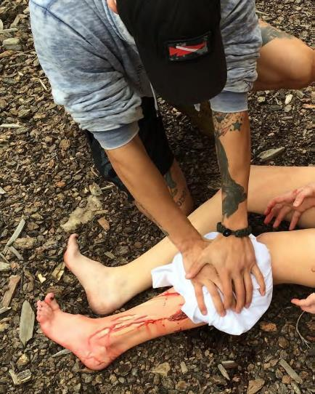
Case 3
System & Resources: Rural transport ambulance. Level I trauma center 40 min transport, Level III trauma center 20 min transport, community hospital 5 min transport. Air transport on scene 25 min from request.
Dispatch Info: Young female fell while standing on a chair, significant bleeding reported from leg wound.
Scene Size Up: Family home, around in back yard you find overturned chair & shattered glass table. There’s a large amount of blood on ground and patient. Family is holding bloody towel on left leg.
Primary survey:
A – Able to answer questions
B – Regular, non-labored
C – Mildly diaphoretic, palpable radial pulse in both arms
D – Following commands, alert and oriented
Secondary survey:
Exam – Multiple deep lacerations to the right upper arm and forearm, down to muscle. One laceration has
bystanders are using for pressure. You place a commercial tourniquet that slows the bleeding.
Initial vital signs – BP 110/72 HR 1ry – CAD, DM, HTN, HLD. No anticoagulant meds, baby aspirin
Initial Thoughts?
Source: American College of Surgeons. Used with permission
Notes:
Discussion Points:
Criterion demonstrated – Active bleeding requiring a tourniquet or wound packing with continuous pressure → RED criterion, should go to highest level trauma center available
System & resource considerations – Patient with RED criterion will need to go to the highest-level trauma center available. If hemorrhage not controlled will need to stop at closest hospital for stabilization/hemorrhage control.
Bypass other centers – Community hospital, should bypass Level III trauma center if bleeding controlled with tourniquet. If active bleeding not controlled by tourniquet, do not bypass and go to Community hospital
Patient destination – Level I trauma center
Transport mode – Ground transport. Air transport will likely only prolong prehospital time by time it arrives, loads and transports the patient in this scenario.

Slide 15

Case 3
System & Resources: Rural transport ambulance. Level I trauma center 40 min transport, Level III trauma center 20 min transport, community hospital 5 min transport. Air transport on scene 25 min from request.
Dispatch Info: Young female fell while standing on a chair, significant bleeding reported from leg wound.
Scene Size Up: Family home, around in back yard you find overturned chair & shattered glass table. There’s a large amount of blood on ground and patient. Family is holding bloody towel on left leg.
Primary Survey:
M – Significant blood loss from left leg
A – Able to answer questions
R – Regular, non-labored
C – Mildly diaphoretic, palpable radial pulse in both arms
H – Following commands, alert and oriented. States she fell off a chair onto a glass table.
the bleeding.
Initial vital signs – BP 110/72 – CAD, DM
, HTN, HLD. No anticoagulant meds, baby aspirin
Patient Destination?
Source: American College of Surgeons. Used with permission
Notes:
Discussion Points:
Criterion demonstrated – Active bleeding requiring a tourniquet or wound packing with continuous pressure → RED criterion, should go to highest level trauma center available
System & resource considerations – Patient with RED criterion will need to go to the highest-level trauma center available. If hemorrhage not controlled will need to stop at closest hospital for stabilization/hemorrhage control.
Bypass other centers – Community hospital, should bypass Level III trauma center if bleeding controlled with tourniquet. If active bleeding not controlled by tourniquet, do not bypass and go to Community hospital
Patient destination – Level I trauma center
Transport mode – Ground transport. Air transport will likely only prolong prehospital time by time it arrives, loads and transports the patient in this scenario.

Slide 16
Case 3
System & Resources: Rural transport ambulance. Level I trauma center 40 min transport, Level III trauma center 20 min transport, community hospital 5 min transport. Air transport on scene 25 min from request.
Dispatch Info: Young female fell while standing on a chair, significant bleeding reported from leg wound.
Scene Size Up: Family home, around in back yard you find overturned chair & shattered glass table. There’s a large amount of blood on ground and patient. Family is holding bloody towel on left leg.
Primary Survey:
M – Significant blood loss from left leg
A – Able to answer questions
R – Regular, non-labored
C – Mildly diaphoretic, palpable radial pulse in both arms
H – Following commands, alert and oriented. States she fell off a chair onto a glass table.
Secondary Survey:
Exam – Long deep laceration lateral left calf, down to muscle. Spurting blood when removing the towel bystanders are using for pressure. You place a commercial tourniquet that stops the bleeding.
Initial vital signs – BP 110/72 HR 102 RR 12 SpO2 98% RA GCS M 6
History – None Changes to Your Plan?
Source: American College of Surgeons. Used with permission
Notes:
Discussion Points:
Criterion demonstrated – Active bleeding requiring a tourniquet or wound packing with continuous pressure → RED criterion, should go to highest level trauma center available
System & resource considerations – Patient with RED criterion will need to go to the highest-level trauma center available. If hemorrhage not controlled will need to stop at closest hospital for stabilization/hemorrhage control.
Bypass other centers – Community hospital, should bypass Level III trauma center if bleeding controlled with tourniquet. If active bleeding not controlled by tourniquet, do not bypass and go to Community hospital
Patient destination – Level I trauma center
Transport mode – Ground transport. Air transport will likely only prolong prehospital time by time it arrives, loads and transports the patient in this scenario.

Slide 17

Case 4a
System & Resources: Suburban transport ambulance. Level I trauma center 35 min transport, Level II trauma center 20 min transport, community hospital 10 min transport.
Dispatch Info: Elderly male ground level fall.
Scene Size Up: Elderly male lying on ground with cane nearby. Lives alone.
Primary survey:
A – Answers questions
B – Regular, non-labored
C – Regular radial pulse, warm skin
D – Following commands, oriented, states he tripped when was not using his walker
Secondary survey:
Exam – Small skin tear on left hand not bleeding, no obvious head trauma, patient unsure if he hit his head
Initial vital signs – BP 168/84 HR 84 RR 12 SpO2 96% RA GCS 15
History – CAD, HTN, OA. No anticoagulants o
Initial Thoughts?
Source: Getty Images. Used with permission
Notes:
Discussion Points:
Criterion demonstrated – EMS Judgment: additional risk factors of lower level fall in older adult with significant head impact → YELLOW criteria, should go to trauma center not necessarily highest level available (if no RED criteria met)
Unclear if significant head impact. In absence of other risk factors or evidence of head trauma, may be reasonable in EMS judgment that patient does not meet this criterion and can go to a non-trauma center.
System & resource considerations – If no other risk factors/triage criteria/concerns, can transport to closest hospital or hospital of patient’s choice
Bypass other centers – Not applicable, unless per patient choice
Patient destination – Community hospital
Transport mode – Ground

Slide 18

Case 4a
System & Resources: Suburban transport ambulance. Level I trauma center 35 min transport, Level II trauma center 20 min transport, community hospital 10 min transport.
Dispatch Info: Elderly male ground level fall.
Scene Size Up: Elderly male lying on ground with cane nearby. Lives alone.
Primary Survey:
M – None identified
A – Answers questions
R – Regular, non-labored
C – Regular radial pulse, warm skin
H – Following commands, oriented, states he tripped
Secondary survey:
Exam – Small skin tear on left hand not bleeding, no obvious head trauma, patient unsure if he hit his head
Initial vital signs – BP 168/84 HR 84 RR 12 SpO2 96% RA GCS 15
History – CAD, HTN, OA. No anticoagulants or antiplatelets
Patient Destination?
Source: Getty Images. Used with permission
Notes:
Discussion Points:
Criterion demonstrated – EMS Judgment: additional risk factors of lower level fall in older adult with significant head impact → YELLOW criteria, should go to trauma center not necessarily highest level available (if no RED criteria met)
Unclear if significant head impact. In absence of other risk factors or evidence of head trauma, may be reasonable in EMS judgment that patient does not meet this criterion and can go to a non-trauma center.
System & resource considerations – If no other risk factors/triage criteria/concerns, can transport to closest hospital or hospital of patient’s choice
Bypass other centers – Not applicable, unless per patient choice
Patient destination – Community hospital
Transport mode – Ground

Slide 19

Case 4a
System & Resources: Suburban transport ambulance. Level I trauma center 35 min transport, Level II trauma center 20 min transport, community hospital 10 min transport.
Dispatch Info: Elderly male ground level fall
Scene Size Up: Elderly male lying on ground with cane nearby. Lives alone.
Primary Survey:
M – None identified
A – Answers questions
R – Regular, non-labored
C – Regular radial pulse, warm skin
H – Following commands, oriented, states he tripped
Secondary Survey:
Exam – Small skin tear on left hand not bleeding, no obvious head trauma, patient unsure if he hit his head
Initial vital signs – BP 168/84 HR 84 RR 12 SpO2 96% RA GCS M 6
History – CAD, HTN, OA. No anticoagulants or antiplatelets
Changes to Your Plan?
Source: Getty Images. Used with permission
Notes:
Discussion Points:
Criterion demonstrated – EMS Judgment: additional risk factors of lower level fall in older adult with significant head impact → YELLOW criteria, should go to trauma center not necessarily highest level available (if no RED criteria met)
Unclear if significant head impact. In absence of other risk factors or evidence of head trauma, may be reasonable in EMS judgment that patient does not meet this criterion and can go to a non-trauma center.
System & resource considerations – If no other risk factors/triage criteria/concerns, can transport to closest hospital or hospital of patient’s choice
Bypass other centers – Not applicable, unless per patient choice
Patient destination – Community hospital
Transport mode – Ground

Slide 20
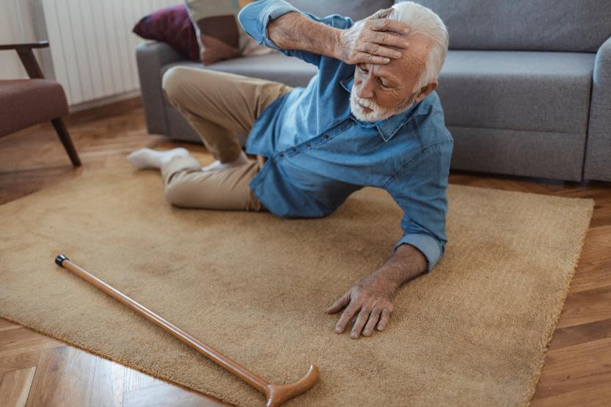
Case 4b
System & Resources: Suburban transport ambulance. Level I trauma center 35 min transport, Level II trauma center 20 min transport, community hospital 10 min transport.
Dispatch Info: Elderly male ground level fall.
Scene Size Up: Elderly male lying on ground near couch. Lives alone.
Primary survey:
A – Answers questions
B – Regular, non-labored
C – Regular radial pulse, warm skin
D – Following commands, oriented to person, place. States he tripped on rug
Secondary survey:
Exam – Large hematoma on left forehead with small overlying skin tear. Multiple bruises on both arms, some appear old.Coumadin)
Initial Thoughts?
Source: Getty Images. Used with permission
Notes:
Discussion Points:
Criterion demonstrated – EMS Judgment: additional risk factors of lower level fall in older adult with significant head impact + Anticoagulation use → YELLOW criteria, should go to trauma center not necessarily highest level available (if no RED criteria met)
Multiple additional risk factors including anticoagulation in setting of evidence of significant head impact. Likely patients should be taken to a trauma center.
System & resource considerations – Level II is closest trauma center, with YELLOW criteria, do not need to transport to farther Level I trauma center.
Bypass other centers – Community hospital
Patient destination – Level II trauma center
Transport mode – Ground

Slide 21

Case 4b
System & Resources: Suburban transport ambulance. Level I trauma center 35 min transport, Level II trauma center 20 min transport, community hospital 10 min transport.
Dispatch Info: Elderly male ground level fall.
Scene Size Up: Elderly male lying on ground near couch. Lives alone.
Primary Survey:
M – None identified
A – Answers questions
R – Regular, non-labored
C – Regular radial pulse, warm skin
H – Following commands, oriented to person, place. States he tripped on rug
Secondary survey:
Patient Destination?
Source: Getty Images. Used with permission
Notes:
Discussion Points:
Criterion demonstrated – EMS Judgment: additional risk factors of lower level fall in older adult with significant head impact + Anticoagulation use → YELLOW criteria, should go to trauma center not necessarily highest level available (if no RED criteria met)
Multiple additional risk factors including anticoagulation in setting of evidence of significant head impact. Likely patients should be taken to a trauma center.
System & resource considerations – Level II is closest trauma center, with YELLOW criteria, do not need to transport to farther Level I trauma center.
Bypass other centers – Community hospital
Patient destination – Level II trauma center
Transport mode – Ground

Slide 22
Case 4b
System & Resources: Suburban transport ambulance. Level I trauma center 35 min transport, Level II trauma center 20 min transport, community hospital 10 min transport.
Dispatch Info: Elderly male ground level fall.
Scene Size Up: Elderly male lying on ground near couch. Lives alone.
Primary Survey:
M – None identified
A – Answers questions
R – Regular, non-labored
C – Regular radial pulse, warm skin
H – Following commands, oriented to person, place. States he tripped on rug
Secondary Survey:
Exam – Large hematoma on left forehead with small overlying skin tear. Multiple bruises on both arms, some appear old.
Initial vital signs – BP 168/84 HR 84 RR 12 SpO2 96% RA GCS M 6
History – CAD, HTN, OA, afib. On warfarin (Coumadin)
Changes to Your Plan?
Source: Getty Images. Used with permission
Notes:
Discussion Points:
Criterion demonstrated – EMS Judgment: additional risk factors of lower level fall in older adult with significant head impact + Anticoagulation use → YELLOW criteria, should go to trauma center not necessarily highest level available (if no RED criteria met)
Multiple additional risk factors including anticoagulation in setting of evidence of significant head impact. Likely patients should be taken to a trauma center.
System & resource considerations – Level II is closest trauma center, with YELLOW criteria, do not need to transport to farther Level I trauma center.
Bypass other centers – Community hospital
Patient destination – Level II trauma center
Transport mode – Ground

Slide 23
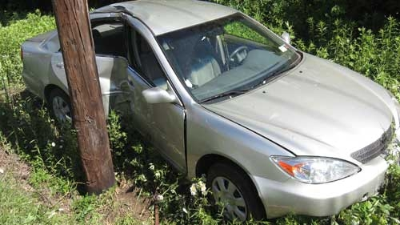
Case 5a
System & Resources: Urban transport ambulance. University medical center (non-trauma center) 5 min transport, community hospital 8 min transport, Level I trauma center 20 min transport.
Dispatch Info: Single car MVC, side impact into telephone pole.
Scene Size Up: Driver still in car. Damage as shown. He was not wearing a seatbelt.
Initial Thoughts?
Source: Mark Gestring, MD FACS. Used with permission
Notes:
Discussion Points:
Criterion demonstrated – Significant intrusion (including roof) >12 inches occupant site OR >18 inches any site → YELLOW criteria, should go to trauma center not necessarily highest level available (if no RED criteria met)
Intrusion is away from occupant site, not >18 inches overall. Patient does NOT meet this criterion, does not need a trauma center if no other criteria met.
System & resource considerations – Can transport to closest hospital or hospital of patient’s choice
Bypass other centers – Not applicable, unless per patient choice
Patient destination – Non trauma center, unless per patient choice
Transport mode – Ground

Slide 24
Case 5a
System & Resources: Urban transport ambulance. University medical center (non-trauma center) 5 min transport, community hospital 8 min transport, Level I trauma center 20 min transport.
Dispatch Info: Single car MVC, side impact into telephone pole.
Scene Size Up: Driver still in car. Damage as shown. He was not wearing a seatbelt.
Primary Survey:
M – None identified
A – Responding to questions
R – Regular, non-labored respirations
C – Radial pulses strong, rapid rate
H – Alert, obeys commands, denies any LOC
Patient Destination?
Source: Mark Gestring, MD FACS. Used with permission
Notes:
Discussion Points:
Criterion demonstrated – Significant intrusion (including roof) >12 inches occupant site OR >18 inches any site → YELLOW criteria, should go to trauma center not necessarily highest level available (if no RED criteria met)
Intrusion is away from occupant site, not >18 inches overall. Patient does NOT meet this criterion, does not need a trauma center if no other criteria met.
System & resource considerations – Can transport to closest hospital or hospital of patient’s choice
Bypass other centers – Not applicable, unless per patient choice
Patient destination – Non trauma center, unless per patient choice
Transport mode – Ground

Slide 25
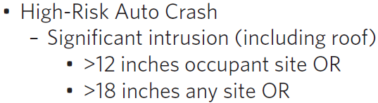
Case 5a
System & Resources: Urban transport ambulance. University medical center (non-trauma center) 5 min transport, community hospital 8 min transport, Level I trauma center 20 min transport.
Dispatch Info: Single car MVC, side impact into telephone pole.
Scene Size Up: Driver still in car. Damage as shown. He was not wearing a seatbelt.
Primary Survey:
M – None identified
A – Responding to questions
R – Regular, non-labored respirations
C – Radial pulses strong, rapid rate
H – Alert, obeys commands, denies any LOC
Secondary Survey:
Exam – Contusion to left parietal area, Denies pain in neck, chest, abdomen, and moving all extremities, except LLE. Deformities noted in left ankle and foot.
Initial vital signs – BP 162/124 HR 114 RR 26 SpO2 95% RA GCS M 6
History – HTN, DM
Changes to Your Plan?
Source: Mark Gestring, MD FACS. Used with permission
Notes:
Discussion Points:
Criterion demonstrated – Significant intrusion (including roof) >12 inches occupant site OR >18 inches any site → YELLOW criteria, should go to trauma center not necessarily highest level available (if no RED criteria met)
Intrusion is away from occupant site, not >18 inches overall. Patient does NOT meet this criterion, does not need a trauma center if no other criteria met.
System & resource considerations – Can transport to closest hospital or hospital of patient’s choice
Bypass other centers – Not applicable, unless per patient choice
Patient destination – Non trauma center, unless per patient choice
Transport mode – Ground

Slide 26
Case 5b
System & Resources: Urban transport ambulance. University medical center (non-trauma center) 5 min transport, community hospital 8 min transport, Level I trauma center 20 min transport.
Dispatch Info: Single car MVC, side impact into telephone pole.
Scene Size Up: Driver out standing by car. Rear right side passenger still in car. Damage as shown. Passenger was not wearing a seatbelt.
Initial Thoughts?
Source: Mark Gestring, MD FACS. Used with permission
Notes:
Discussion Points:
Criterion demonstrated – Significant intrusion (including roof) >12 inches occupant site OR >18 inches any site → YELLOW criteria, should go to trauma center not necessarily highest level available (if no RED criteria met)
Intrusion for passenger is at the occupant site and >12 inches. Passenger does meet this criterion which is associated with a high risk of severe injury. The patient should be taken to a trauma center.
System & resource considerations – While YELLOW criteria could go to a lower-level trauma center, nearest in this urban setting is a Level I so the patient will need to be transported here
Bypass other centers – University Medical Center and Community hospital
Patient destination – Level I trauma center
Transport mode – Ground

Slide 27
Case 5b
System & Resources: Urban transport ambulance. University medical center (non-trauma center) 5 min transport, community hospital 8 min transport, Level I trauma center 20 min transport.
Dispatch Info: Single car MVC, side impact into telephone pole.
Scene Size Up: Driver out standing by car. Rear right side passenger still in car. Damage as shown. Passenger was not wearing a seatbelt.
Primary Survey:
M – None identified
A – Responding to questions
R – Regular, non-labored respirations
C – Radial pulses strong, rapid rate
H – Alert, obeys commands, denies any LOC
Patient Destination?
Source: Mark Gestring, MD FACS. Used with permission
Notes:
Discussion Points:
Criterion demonstrated – Significant intrusion (including roof) >12 inches occupant site OR >18 inches any site → YELLOW criteria, should go to trauma center not necessarily highest level available (if no RED criteria met)
Intrusion for passenger is at the occupant site and >12 inches. Passenger does meet this criterion which is associated with a high risk of severe injury. The patient should be taken to a trauma center.
System & resource considerations – While YELLOW criteria could go to a lower-level trauma center, nearest in this urban setting is a Level I so the patient will need to be transported here
Bypass other centers – University Medical Center and Community hospital
Patient destination – Level I trauma center
Transport mode – Ground

Slide 28
Case 5b
SSystem & Resources: Urban transport ambulance. University medical center (non-trauma center) 5 min transport, community hospital 8 min transport, Level I trauma center 20 min transport.
Dispatch Info: Single car MVC, side impact into telephone pole.
Scene Size Up: Driver out standing by car. Rear right side passenger still in car. Damage as shown. Passenger was not wearing a seatbelt.
Primary Survey:
M – None identified
A – Responding to questions
R – Regular, non-labored respirations
C – Radial pulses strong, rapid rate
H – Alert, obeys commands, denies any LOC
Secondary Survey:
Exam – Contusion to left parietal area, Denies pain in neck, chest, abdomen, and moving all extremities, except LLE. Deformities noted in left ankle and foot.
Initial vital signs – BP 162/124 HR 114 RR 26 SpO2 95% RA GCS M 6
History – HTN, DM Changes to Your Plan?
Source: Mark Gestring, MD FACS. Used with permission
Notes:
Discussion Points:
Criterion demonstrated – Significant intrusion (including roof) >12 inches occupant site OR >18 inches any site → YELLOW criteria, should go to trauma center not necessarily highest level available (if no RED criteria met)
Intrusion for passenger is at the occupant site and >12 inches. Passenger does meet this criterion which is associated with a high risk of severe injury. The patient should be taken to a trauma center.
System & resource considerations – While YELLOW criteria could go to a lower-level trauma center, nearest in this urban setting is a Level I so the patient will need to be transported here
Bypass other centers – University Medical Center and Community hospital
Patient destination – Level I trauma center
Transport mode – Ground

Slide 29
Case 5c
System & Resources: Urban transport ambulance. University medical center (non-trauma center, has OB) 5 min transport, community hospital 8 min transport, Level I trauma center 20 min transport (has OB).
Dispatch Info: Single car MVC, side impact into telephone pole.
Scene Size Up: Pregnant female driver still in car. Damage as shown. She was not wearing a seatbelt.
\
Initial Thoughts?
Source: Mark Gestring, MD FACS. Used with permission
Notes:
Discussion Points:
Criterion demonstrated –
1. EMS Judgement: Pregnancy >20 weeks → YELLOW criteria, should go to trauma center not necessarily highest level available (if no RED criteria met)
2. Significant intrusion (including roof) >12 inches occupant site OR >18 inches any site → YELLOW criteria, should go to trauma center not necessarily highest level available (if no RED criteria met)
As in the first part of the case, the intrusion criteria are not met; however, with pregnancy >20 weeks and abdominal bruising, patient likely should be taken to a trauma center with OB capabilities.
System & resource considerations – While YELLOW criteria could go to a lower-level trauma center, nearest in this urban setting is a Level I so the patient will need to be transported here. Also need to ensure the trauma center has OB capabilities.
Bypass other centers – University Medical Center (despite OB capabilities) and Community hospital
Patient destination – Level I trauma center
Transport mode – Ground

Slide 30
Case 5c
System & Resources: Urban transport ambulance. University medical center (non-trauma center, has OB) 5 min transport, community hospital 8 min transport, Level I trauma center 20 min transport (has OB).
Dispatch Info: Single car MVC, side impact into telephone pole.
Scene Size Up: Pregnant female driver still in car. Damage as shown. She was not wearing a seatbelt.
Primary Survey:
M – None identified
A – Responding to questions
R – Breathing non labored but rapid
C – No signs of bleeding, pulse rapid
H – Alert, obeys commands, denies any LOC
Patient Destination?
Source: Mark Gestring, MD FACS. Used with permission
Notes:
Discussion Points:
Criterion demonstrated –
1. EMS Judgement: Pregnancy >20 weeks → YELLOW criteria, should go to trauma center not necessarily highest level available (if no RED criteria met)
2. Significant intrusion (including roof) >12 inches occupant site OR >18 inches any site → YELLOW criteria, should go to trauma center not necessarily highest level available (if no RED criteria met)
As in the first part of the case, the intrusion criteria are not met; however, with pregnancy >20 weeks and abdominal bruising, patient likely should be taken to a trauma center with OB capabilities.
System & resource considerations – While YELLOW criteria could go to a lower-level trauma center, nearest in this urban setting is a Level I so the patient will need to be transported here. Also need to ensure the trauma center has OB capabilities.
Bypass other centers – University Medical Center (despite OB capabilities) and Community hospital
Patient destination – Level I trauma center
Transport mode – Ground

Slide 31
Case 5c
System & Resources: Urban transport ambulance. University medical center (non-trauma center, has OB) 5 min transport, community hospital 8 min transport, Level I trauma center 20 min transport (has OB).
Dispatch Info: Single car MVC, side impact into telephone pole.
Scene Size Up: Pregnant female driver still in car. Damage as shown. She was not wearing a seatbelt.
Primary Survey:
M – None identified
A – Responding to questions
R – Breathing non labored but rapid
C – No signs of bleeding, pulse rapid
H – Alert, obeys commands, denies any LOC
Secondary Survey:
Exam – Abdomen has large bruise to the left upper quadrant, size of baseball, tender on palpation. Uterus is firm at fundal height.
Initial vital signs – BP 114/52 HR 111 RR 28 SpO2 98% RA GCS M 6
History – She is 29 weeks pregnant, gravida 1, para 0
Changes to Your Plan?
Source: Mark Gestring, MD FACS. Used with permission
Notes:
Discussion Points:
Criterion demonstrated –
1. EMS Judgement: Pregnancy >20 weeks → YELLOW criteria, should go to trauma center not necessarily highest level available (if no RED criteria met)
2. Significant intrusion (including roof) >12 inches occupant site OR >18 inches any site → YELLOW criteria, should go to trauma center not necessarily highest level available (if no RED criteria met)
As in the first part of the case, the intrusion criteria are not met; however, with pregnancy >20 weeks and abdominal bruising, patient likely should be taken to a trauma center with OB capabilities.
System & resource considerations – While YELLOW criteria could go to a lower-level trauma center, nearest in this urban setting is a Level I so the patient will need to be transported here. Also need to ensure the trauma center has OB capabilities.
Bypass other centers – University Medical Center (despite OB capabilities) and Community hospital
Patient destination – Level I trauma center
Transport mode – Ground

Slide 32

Case 6
System & Resources: Rural transport ambulance. Closest additional mutual aid 30 min out; Level I trauma center 70 min transport, community hospital 12 min transport, Level III trauma center 20 min transport opposite direction of Level I. Air transport on scene 25 min from request.
Dispatch Info: Male fell off ladder.
Scene Size Up: Middle aged male lying supine on concrete driveway, ladder lying next to him near 2 story roof.
Initial Thoughts?
Source: Getty Images. Used with permission
Notes:
Discussion Points:
Criterion demonstrated –
1. Fall from height >10 feet (all ages) → YELLOW criteria, should go to trauma center not necessarily highest level available (if no RED criteria met)
2. Suspected spinal injury: New onset motor or sensory loss → RED criterion, should go to highest level trauma center available
System & resource considerations – Patient should go to the highest level of trauma center available because of the suspected spinal injury with inability to move his legs after the fall. He meets both a RED criterion and YELLOW criterion, and the RED criteria supersedes the YELLOW criterion for destination determination. Highest level trauma center relatively far, consider Air transport availability and potential need for mutual aid if transport ground to Level I trauma center
Bypass other centers – Community hospital and Level III trauma center (especially if Air transport available)
Patient destination – Level I trauma center. Patient may need to go to Level III depending on conditions, such as unavailability of Air transport and/or mutual aid EMS coverage.
Transport mode – Air transport to Level I, can Ground transport to Level I if system resources support. Possibly ground to Level III if Air transport unavailable and already using mutual aid for additional 911 call coverage.

Slide 33

Case 6
System & Resources: Rural transport ambulance. Closest additional mutual aid 30 min out; Level I trauma center 70 min transport, community hospital 12 min transport, Level III trauma center 20 min transport opposite direction of Level I. Air transport on scene 25 min from request.
Dispatch Info: Male fell off ladder.
Scene Size Up: Middle aged male lying supine on concrete driveway, ladder lying next to him near 2 story roof.
Primary Survey:
M – None identified
A – Answers questions
R – Regular, non-labored
C – Regular radial pulse, warm skin
H – Following commands. States up working on roof eaves and ladder gave out.
Patient Destination?
Source: Getty Images. Used with permission
Notes:
Discussion Points:
Criterion demonstrated –
1. Fall from height >10 feet (all ages) → YELLOW criteria, should go to trauma center not necessarily highest level available (if no RED criteria met)
2. Suspected spinal injury: New onset motor or sensory loss → RED criterion, should go to highest level trauma center available
System & resource considerations – Patient should go to the highest level of trauma center available because of the suspected spinal injury with inability to move his legs after the fall. He meets both a RED criterion and YELLOW criterion, and the RED criteria supersedes the YELLOW criterion for destination determination. Highest level trauma center relatively far, consider Air transport availability and potential need for mutual aid if transport ground to Level I trauma center
Bypass other centers – Community hospital and Level III trauma center (especially if Air transport available)
Patient destination – Level I trauma center. Patient may need to go to Level III depending on conditions, such as unavailability of Air transport and/or mutual aid EMS coverage.
Transport mode – Air transport to Level I, can Ground transport to Level I if system resources support. Possibly ground to Level III if Air transport unavailable and already using mutual aid for additional 911 call coverage.

Slide 34
Case 6
System & Resources: Rural transport ambulance. Closest additional mutual aid 30 min out; Level I trauma center 70 min transport, community hospital 12 min transport, Level III trauma center 20 min transport opposite direction of Level I. Air transport on scene 25 min from request.
Dispatch Info: Male fell off ladder.
Scene Size Up: Middle aged male lying supine on concrete driveway, ladder lying next to him near 2 story roof.
Primary Survey:
M – None identified
A – Answers questions
R – Regular, non-labored
C – Regular radial pulse, warm skin
H – Following commands. States up working on roof eaves and ladder gave out.
Secondary Survey:
Exam – Hematoma to occiput. Cannot move lower extremities, states they are numb. Full strength in upper extremities. No obvious lower extremity deformities.
Initial vital – BP 152/110 HR 70 RR 22 SpO2 98% RA GCS M 6
History – HTN, CAD, CABGx2
Source: Getty Images. Used with permission
Changes to Your Plan?
Notes:
Discussion Points:
Criterion demonstrated –
1. Fall from height >10 feet (all ages) → YELLOW criteria, should go to trauma center not necessarily highest level available (if no RED criteria met)
2. Suspected spinal injury: New onset motor or sensory loss → RED criterion, should go to highest level trauma center available
System & resource considerations – Patient should go to the highest level of trauma center available because of the suspected spinal injury with inability to move his legs after the fall. He meets both a RED criterion and YELLOW criterion, and the RED criteria supersedes the YELLOW criterion for destination determination. Highest level trauma center relatively far, consider Air transport availability and potential need for mutual aid if transport ground to Level I trauma center
Bypass other centers – Community hospital and Level III trauma center (especially if Air transport available)
Patient destination – Level I trauma center. Patient may need to go to Level III depending on conditions, such as unavailability of Air transport and/or mutual aid EMS coverage.
Transport mode – Air transport to Level I, can Ground transport to Level I if system resources support. Possibly ground to Level III if Air transport unavailable and already using mutual aid for additional 911 call coverage.

Slide 35
You have seen how resource availability can impact triage, patient destination, and transport mode decisions.
It is important to understand the local EMS and trauma system resources where you practice.
Trauma centers of each level and transport time/distance
Local non-trauma center hospitals
Air medical services and time to request & arrive on scene
Other ambulance coverage & need for mutual aid
Geographic constraints or other unique resources and challenges
Notes:
INSTRUCTORS:
Emphasize, particularly for new trainees, that it will be important to understand the system they ultimately practice in. The resources may include trauma centers of different levels, non-trauma center hospitals, air medical transport resources, other EMS coverage, or need for mutual aid. Additionally, it is important to consider geographic constraints or other challenges unique to the EMS and trauma system.

