Slide 1
Membership Program Area Update
Stephanie A. Savage, MD, MS, FACS
Chair, Membership Program Area

Slide 2
None

Slide 3
Membership Program Area Structure
COT Executive Committee oversight → Membership Program Area leadership → staff support
COT Executive Committee
Provides strategic direction, oversight, and approval
for all COT Program areas
Responsible Areas
Membership Program Area Chair:
Stephanie A. Savage, MD, MS, FACS
• Central COT Membership
• METS Program: FTL, RAS, YFA, Clinical Scholars
• Scudder Oration Work Group
• Opportunity Boards
Staff Support to Chair
Jené Hickman
Program Manager
Administrative Programs
Responsible Areas
Membership Program Area Vice Chair:
Lillian F. Liao, MD, MPH, FACS
• Specialty Surgery Advisory Council
• Inclusive Excellence Advisory Council
• Liaisons & Consultants
Staff Support to Vice Chair
Courtney Simmons
Program Manager
Administrative Programs
Notes:
[Sources]
Membership - Savage PowerPoint source content identifies the Membership Program Area Chair, Vice Chair, assigned program areas, and staff support. Specific source lines: 94-107.

Slide 4
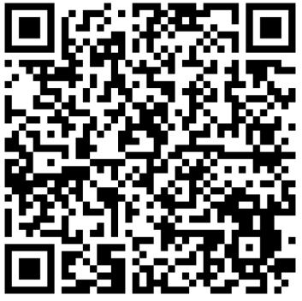
Membership Program Area
Central COT Membership
Inclusive Excellence Advisory Council
Leadership and Participation Opportunity Boards
Specialty Membership Involvement:
  Focus within State Committees
Mentoring for Excellence in Trauma Surgery (METS)
  Future Trauma Leaders (FTL) Program
  RAS/YFA/Clinical Scholars
Scudder Oration on Trauma
Scudder nominations needed!

Slide 5
Membership Program Area
Mentoring for Excellence in Trauma Surgery (METS)
Future Trauma Leaders (FTL)
Resident and Associate Society (RAS)
Young Fellows Association (YFA)
Inclusive Excellence (IE)
Scudder Oration Work Group
(Scudder Selection)
Specialty Surgery Advisory Council
Clinical Scholars
Burn, Neuro, Ortho, Peds, Reconstruct, Vascular, OMS, OB/Gyn, Urology
Liaisons and Consultants
Liaison to/from ACS-COT
Federal Partner
Independent Contactor
Review and Selection of Central COT Membership

Slide 6
RCOT Participation Timeline
FTL RAS YFA
FTL
Transition
SPC
Active
Member
S/P/C
Vice Chair
S/P/C Vice Chair
Region Chief
Central COT
RCOT Leadership & COT Service Timeline
S/P/C
Vice Chair
S/P/C Chair
Region Chief
Central COT
RCOT Leadership & COT Service Timeline
S/P/C Chair
Region Chief
Central COT
COT Service Timeline
Central COT
Pathways of Participation
Notes:
Eligible FTL’s are appointed to an FTL Transition term (one 2-year term) once they complete the FTL term in October.
Continued participation as Active Member in the State COT is encouraged prior to being considered for a State Vice Chair position

Slide 7
Participation and Active Engagement Expectations
Active participation/engagement are essential expectations for continued eligibility and service on the Regional and Central Committees on Trauma, including participation in the Future Trauma Leaders program.
Personally Attend
Actively Engage
Use AI as Support
Members are expected to personally attend scheduled Zoom meetings and remain present for the discussion.
Participation should include being on camera when appropriate and contributing meaningfully to committee or work group dialogue.
AI assistants and automated notetakers may supplement participation, but they do not constitute attendance or engagement.
Committee Chairs and Work Group Leads may remove an AI assistant, automated notetaking application, or other automated participant from a meeting when the associated member is not personally present, or at their discretion when sensitive topics are discussed.

Slide 8
Membership Roles (RCOT and COT)
Central COT Member
Regional Member (Region Chief, SPC Chair, SPC Vice Chair)
METS Participant (FTL, RAS, YFA, Clinical Scholar)
Liaison
Consultant
Federal Partners
Others (including ATLS specific etc.)
To represent the COT in any official capacity, including service as a liaison/consultant, a member must hold an active membership appointment at either the Regional COT (RCOT) or Central COT (cCOT) level.

Slide 9
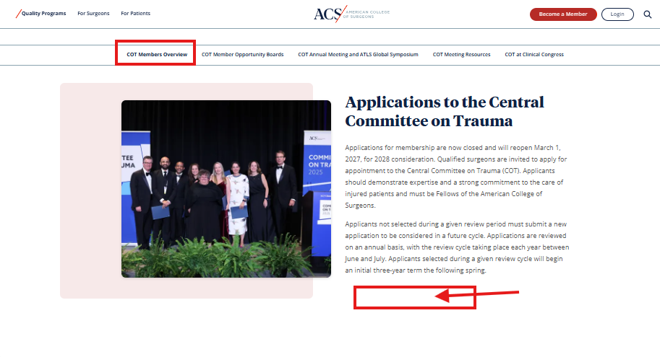
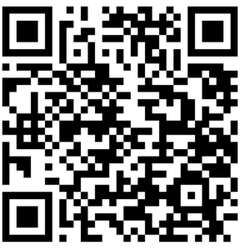
Online Central COT Application – Under Construction
Using feedback to improve current survey
Will be live in early 2027
Will live on the
Members Only Page:
New Link

Slide 10
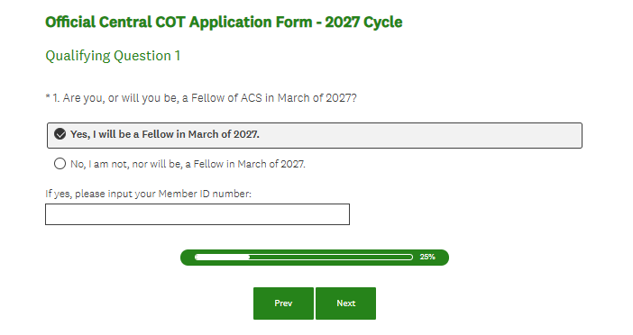
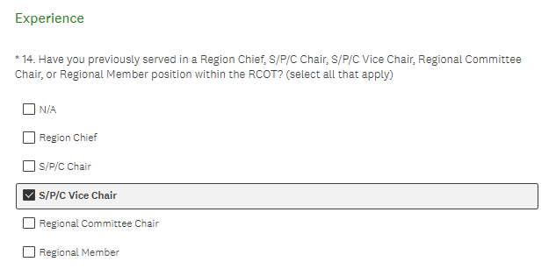
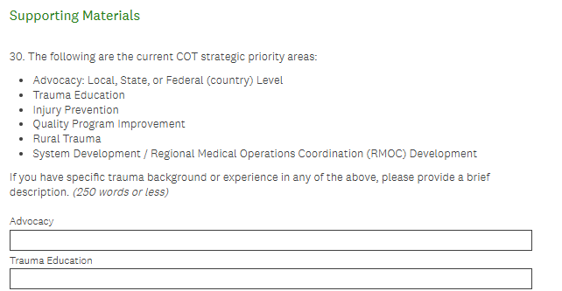
Online Central COT Application
Currently Six Sections
Survey Introduction Page
Qualification Questions
Contact Information
Practice Information
Trauma Experience
Supporting Materials
  Short Answer and Essay
  Headshot Upload
  CV Upload
  Three References

Slide 11
Future Trauma Leaders (FTL) – Program Process
Early career - within five years of completing training
Current or former State Vice Chairs are not eligible for the FTL Program
Benefit from mentorship and engagement with COT members and trauma leaders at regional and national levels
Dedicated Military FTL (every year – JTS and MSHPACS alternate funding)
Dedicated Orthopedic FTL (every other year)
New in 2027!! Dedicated Pediatric Spot (every other year)
  Potential for a dedicated Neuro spot starting in 2028
Goal is long-term engagement through the FTL Program, followed by participation as Active Member in State COT, prior to be considered for Vice Chair position
"Tell me and I forget, teach me and I may remember, involve me and I learn” - Benjamin Franklin

Slide 12
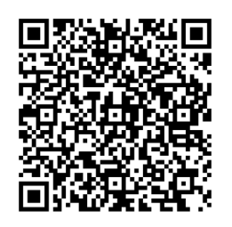
2028 Future Trauma Leader (FTL) Cycle
Applications to the FTL Program open May 1, 2027
Deadline: July 30, 2027 (application, CV, essay, 2 x references)
Goal – online application coming in 2028/2029!
Further develop the FTL Transition term (2027/2028 project)
    FTL Class of 2027 selected!
  Final approval: COT Exec Com/Board of Regents Sept
  Notifications by email by end November 2026
  New FTL participant welcome March 2027!
Apply to FTL Program

Slide 13
Future Trauma Leader (FTL) Transition
FTL Term – March - October of following year (Mar 2026-Oct 2027)
During the FTL term, the expectations are:
  Attend all required meetings
  Actively work on projects
  Build your network, raise your hand, show up, get involved
CHANGE! Transition Term – change in 2026, now one 2-year term
  During the transition term, the expectations are:
    Complete current projects, no new projects on the Central COT
    No leadership role on Work Groups / Committees, on the Central COT
    Get involved in State COT, talk to your State Chair

Slide 14
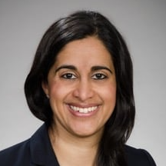
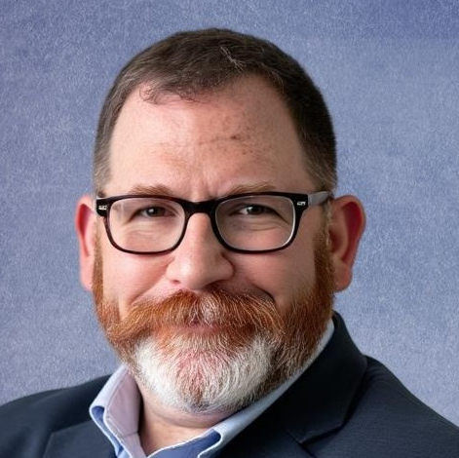
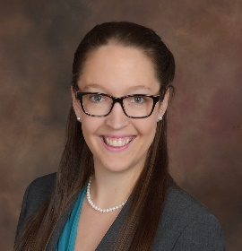
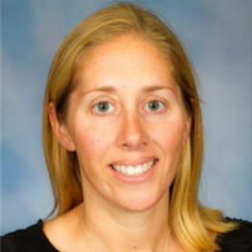
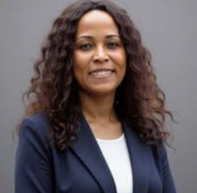
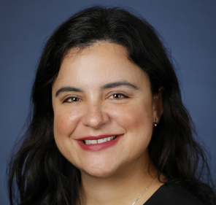
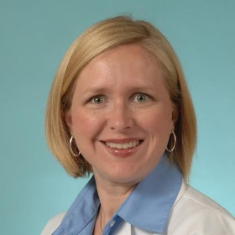
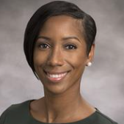
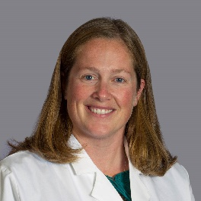
Inclusive Excellence Advisory Council
COT Position Statement on Inclusive Excellence
The Committee on Trauma (COT) is committed to upholding the principles of inclusive excellence, within both the organization and the community that it serves. These principles are essential to ensure the COT’s effectiveness as an organization dedicated to injury prevention and optimal care of the injured patient.
Members:
David Shapiro, MD, MHCM, FCCM, FACS
Julia Coleman, MD, MPH, FACS
Alexis Moren, MD, FACS
Cherisse Berry,
MD, FACS
Meera Kotagal,
MD, MPH, FACS (Lead)
Anamaria Robles, MD, FACS
Stephanie Bonne, MD, FACS
Randi Smith, MD, MPH, FACS
Regan Williams, MD, MS, FAAP, FACS

Slide 15
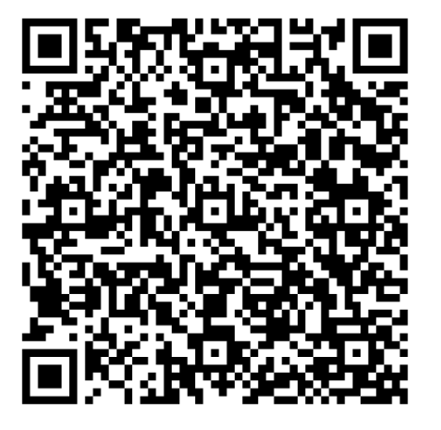
Inclusive Excellence Advisory Council
Activities of IE Council
Inclusive excellence review of educational materials (ATLS, ASSET, etc.)
Resident research competition judging for Achieving Excellence in Surgery and Equity category
Supporting COT efforts to ensure excellent outcomes for all patients
  Achieving Better Outcomes in Trauma Care Summit – proceedings under review
  Participation in Rural Program Area efforts
Partnering with membership to ensure recruitment and retention of diverse members of the COT
  Focus this year on diversity of perspectives (including rural, states with lower representation, among other diversity dimensions)
To liaise with ACS, as a whole, regarding Inclusive Excellence
  If interested, see posting on Opportunities Board to join:

Slide 16


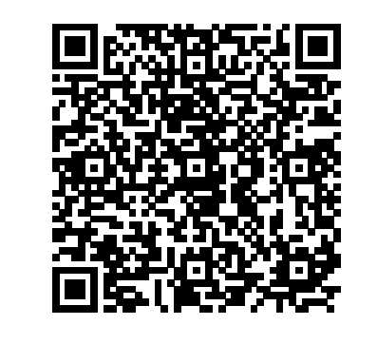
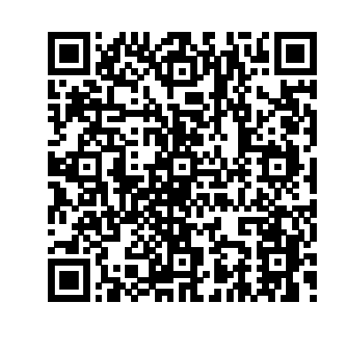
COT Member Opportunity Boards
How do members get involved?
Apply to Current Openings on the
For Central COT and Regional COT Members

Slide 17

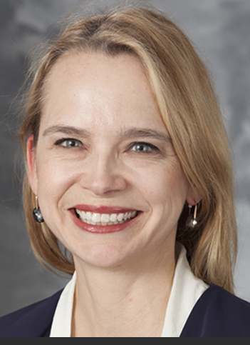
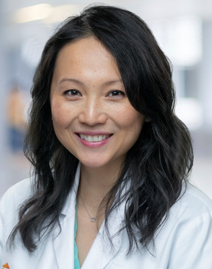
Thank
You!!
Membership Questions
and/or Applications
Stephanie Savage
savage@surgery.wisc.edu
Lillian Liao
liaol@uthscsa.edu
Staff
Jené Hickman jhickman@facs.org
Courtney Simmons csimmons@facs.org

