Slide 1
Trauma Quality Programs Update
Avery Nathens, MD, PhD, FACS

Slide 2
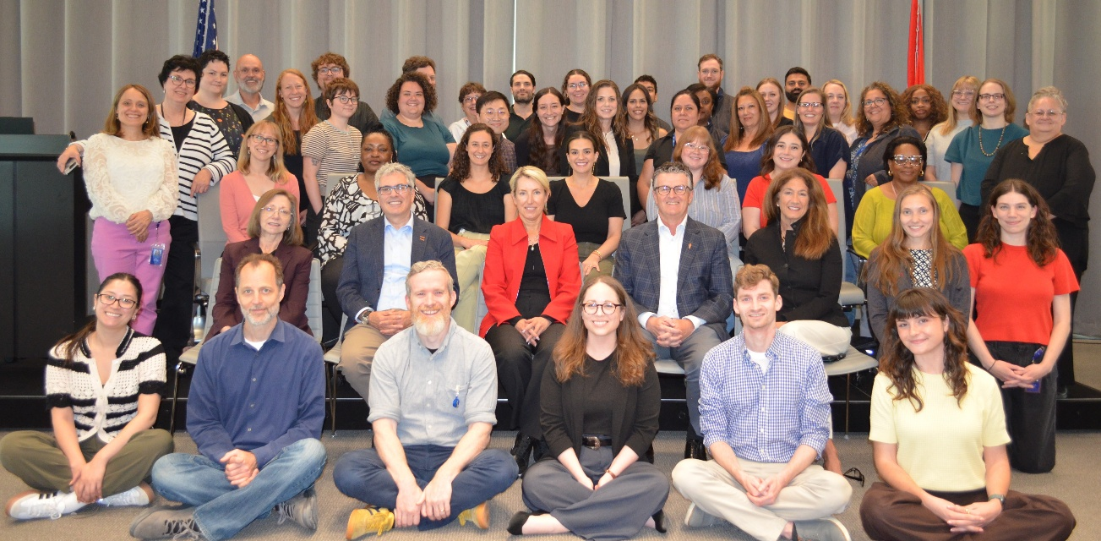
The team
TQIP
Lillian Kao
Aaron Jensen
PIPS
Bryce Robinson
Babak Sarani
Natasha Keric
Shannon Castle
VRC
Jon Perlstein
Andrew Bernard
Systems
Peter Fischer
Jeremy Cannon

Slide 4

Keynote –
Louie Gravance
The man behind the Disney experience
”Last coat of paint gets the glory, but the first few coats tell the story”
The importance of backstage performers and “goal fusion”
Notes:
Avery- encourage COT members to attend the conference

Slide 5
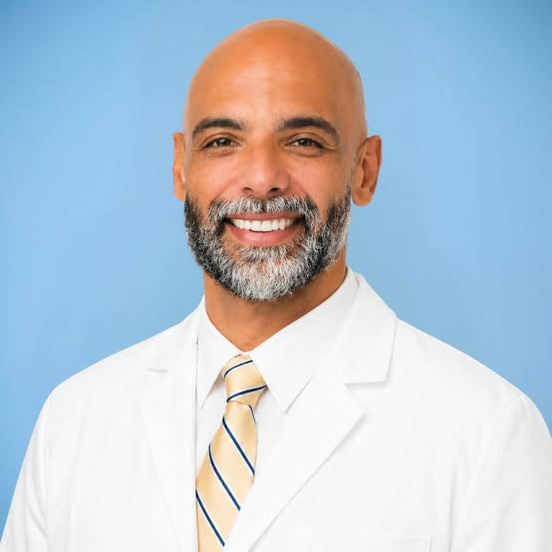
Trauma Survivor –
Dr. Joshua Taylor
Struck by a driver in a hit-and-run in 2024
Challenges post-discharge with both physical health and navigating the return to surgical practice

Slide 6

The Chaplain and the Doctor
Collaborative partnership between palliative care medicine and the hospital chaplain
Film showing on Thursday, November 12 at 4pm
Plenary session on Friday, November 13 at 1pm

Slide 7
Current TQIP Enrollment
TQIP Program | Number of Participants
Adult Level I & II TQIP Centers | 540
Pediatric TQIP Centers | 175
Level III TQIP Centers | 268
Total | 983

Slide 8

TQIP Report

Slide 9
TQIP 2.0
Accelerating PI
Enhancing the value of your time

Slide 10
Consultative input
Content
Functionality
Expansion of TQIP population to better reflect patients served (AIS 3 criterion)
Connect processes to outcomes
Site specific summary scorecard
AI-generated contextual analysis
  With suggested actionable steps
Top level introduction/executive summary
Intuitive charts, pre-set queries
Robust search functionality
Improved data visualization and interactivity
Seamless drill-down capabilities
Filter ability (populations/time intervals)

Slide 11
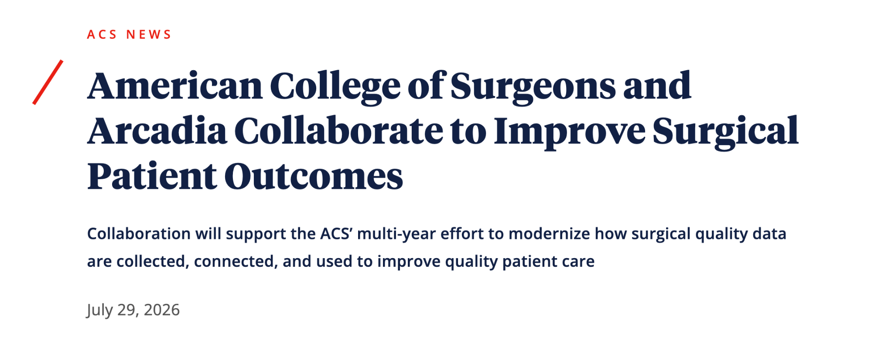

Slide 12
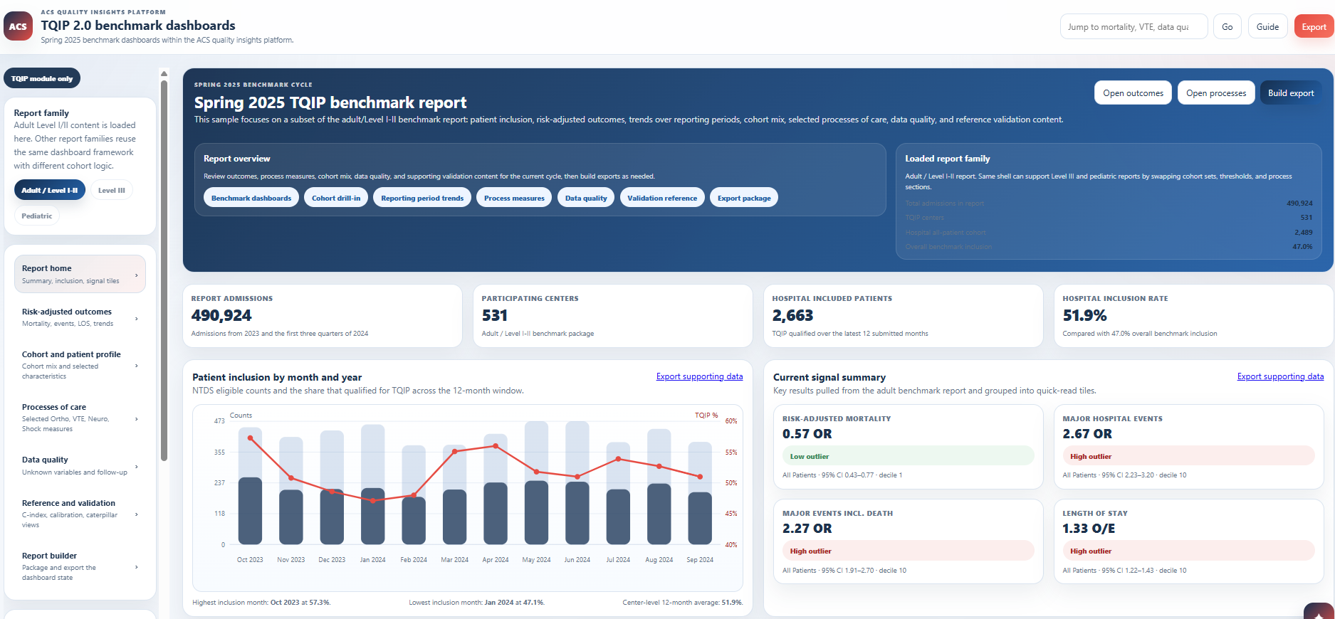

Slide 13
Direct Data Submission
Traditionally – data flowed in batches
Accounted for delays between care as provided and care as reflected in the reports
Real-time data submission is the required next step for real-time reporting
~50%
Are you in?
Ask your registrar
of sites now use a registry product compatible with direct data submission

Slide 14
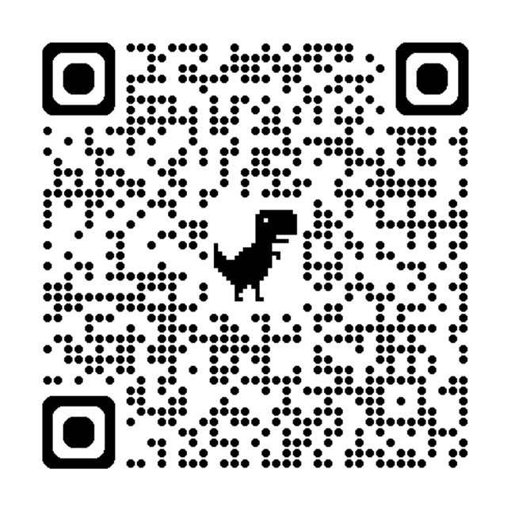
Your Data, Beyond Your Hospital
In 2026…
325 research (PUF) applications
1300 datasets provided to 250 researchers
Impact
~300 publications in 2026
~2000 since 2016

Slide 15

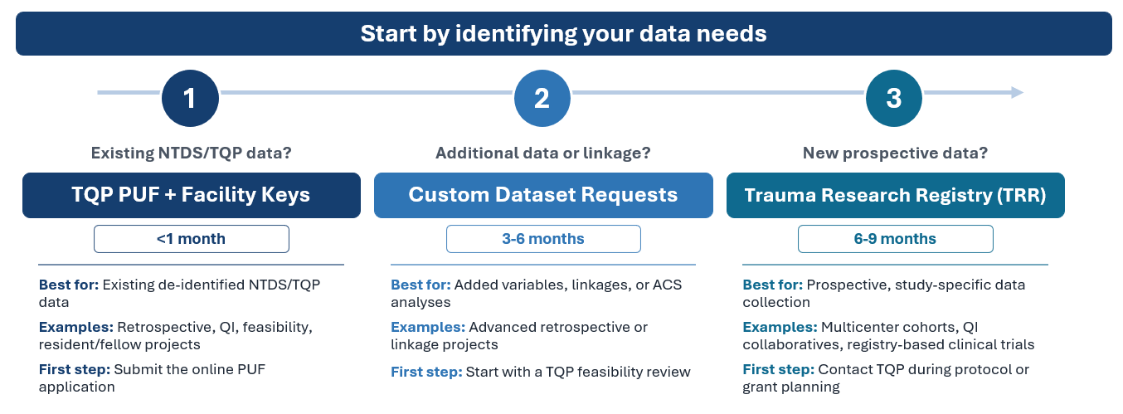
TQP Data Access/Research Options

Slide 16
Performance Improvement and Patient Safety

Slide 17
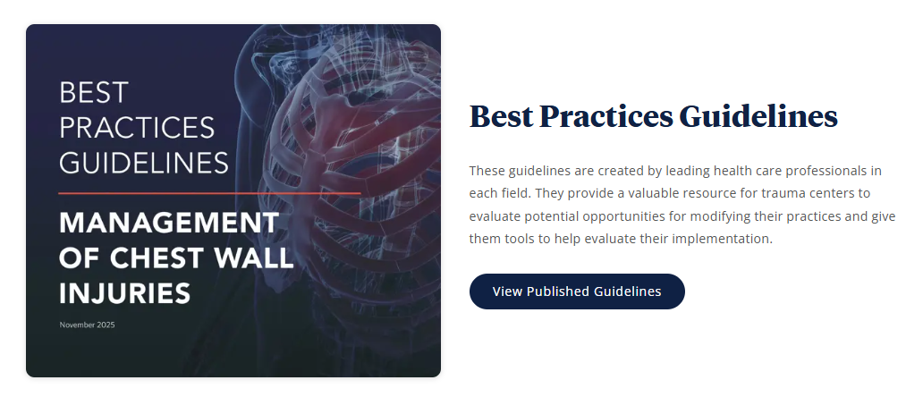
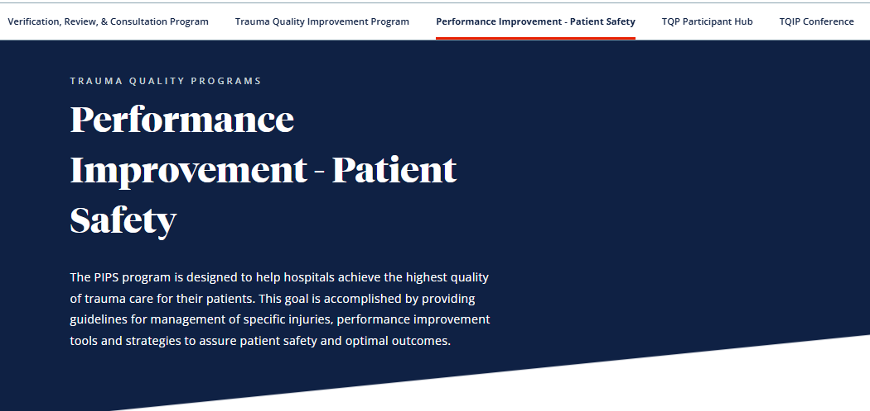



PIPS Webpage

Slide 18

Trauma Protocols Repository
Adult Protocols
Management of Patients with Rib Fractures*
Nutrition Support in Adult Trauma*
Blunt Splenic Injury*
Coming Soon:
  Analgesia & Sedation
  Mangled Extremity
  BCVI
Pediatric Protocols
Coming Soon
  Peds MTP
  Peds Damage Control Resuscitation
  Peds Thoracic Imaging
  Peds VTE Prophylaxis
  Peds Mild TBI Resource Utilization
  Nutrition for Pediatric Trauma Patients

Slide 19
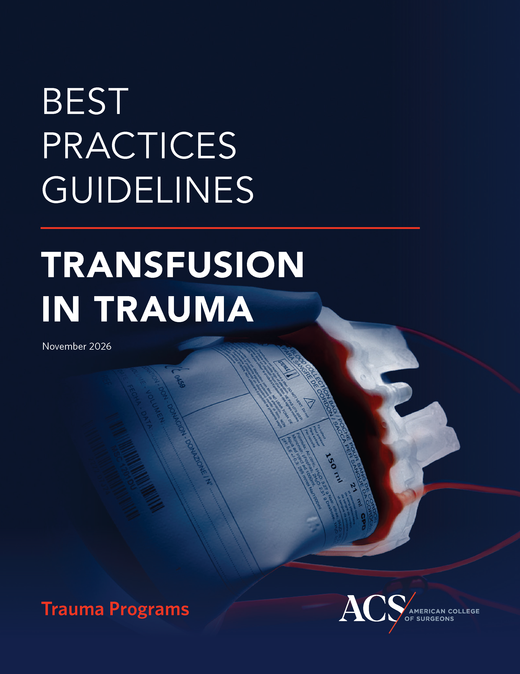
Best Practices Guidelines for
Transfusion in Trauma
Leads
  John Hess, Matthew (Macky) Neal
Highlights
  Prehospital Transfusion
  Transfusion Medicine and Trauma Support Services
  Anticoagulation reversal
  Transfusion Support for Surge Capacity
  Future Directions for Transfusion Care
  PI Implementation & Integration of the Best Practices Guidelines
Notes:
NOTE: As of 9/21/2026, AABB has not executed the MOU. This cover does not display the AABB logo and may be updated closer to TQIP

Slide 20


Best Practices Guidelines for Burn Injuries
In Progress
New guidelines in development
Formal collaboration between
ACS COT and ABA
Leads:
  J. Kevin Bailey, MD, FACS, FABA
  Elisha Brownson, MD, FACS

Slide 21

Mortality Reporting System
Anonymous case reporting from local mortality reviews
Aggregates lessons across trauma centers
Identifies recurring patterns and improvement opportunities
Findings disseminated through case reports to all centers
Enroll once. Submit cases anytime.

Slide 22
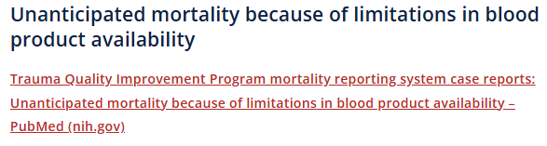
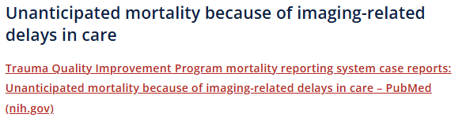
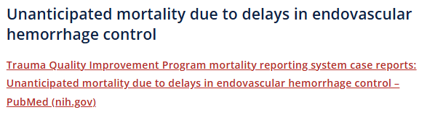
Mortality Reporting System
Shared Learning in Action

Slide 23
How can we move from producing publications to measurably changing trauma care?
Evaluate our current portfolio
How we select our topics
How do we move from publications to impact?

Slide 24
What would a multichannel guideline/PIPS ecosystem look like that moves guidance into practice?
Derivative products from BPGs
Point-of-care / just-in-time resources
EHR and clinical decision-support integration
Practical guidance within TQIP reports
Longitudinal education and implementation support
Podcasts and short-form video
Implementation exemplars

Slide 25
Trauma Systems
ACS is working with Florida and Texas on future Trauma Systems Consultations
  Texas will have an additional Rural focus
  Florida will be an extended engagement with ACS involvement in the PRQ process
A new Trauma System Resource Repository to assist in system development
Growing interest in international consultation

Slide 26

Thank You!

