Slide 2
SUGGESTIONS FOR SURGERY INTEREST GROUPS
Host a session to discuss the “Pre-Clinical” and “Clinical” timelines.
Include a faculty advisor to speak about institution specifics, as many of the events vary with institution, advisor, and applicant.
If no advisor is present, find a faculty mentor to serve as a resource.
Photo Courtesy of U.S. Army, taken by Jim Bryant/NW Guardian

Slide 3
KEY POINTS: Priorities for Medical Students
Do well on all clinical and preclinical experiences. Be engaged and immerse yourself in what you are learning.
Do well on standardized board exams. Study hard and do your best.
Seek out extracurricular clinical activities. Show you are interested.
Become engaged at your school. Volunteer, do research, or join a club. Whatever you do, be passionate.
Find a mentor. Someone who challenges you and helps you become better is important.
Image courtesy of U.S. Army

Slide 4
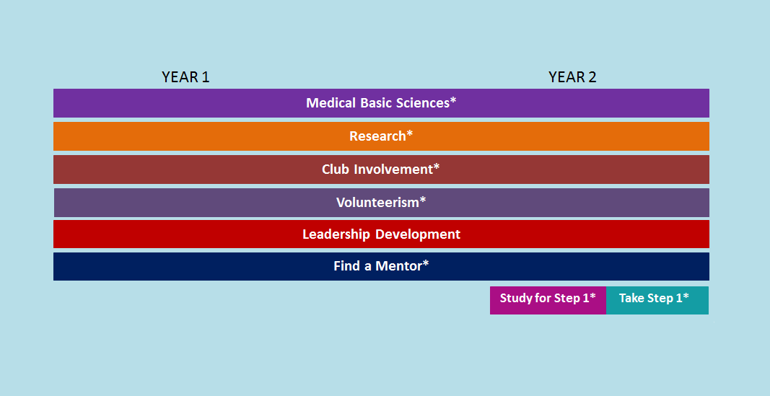
PRE-CLINICAL YEARS

Slide 5
GENERAL ADVICE: Extracurriculars
While research, volunteerism, club involvement, and leadership are encouraged, they should not replace class grades and board scores.
Consider getting involved in extracurricular activities ONLY IF studying/grades can be maintained.
Club involvement includes SIG and others
Leadership development includes acquiring board positions in SIG and/or other clubs

Slide 6
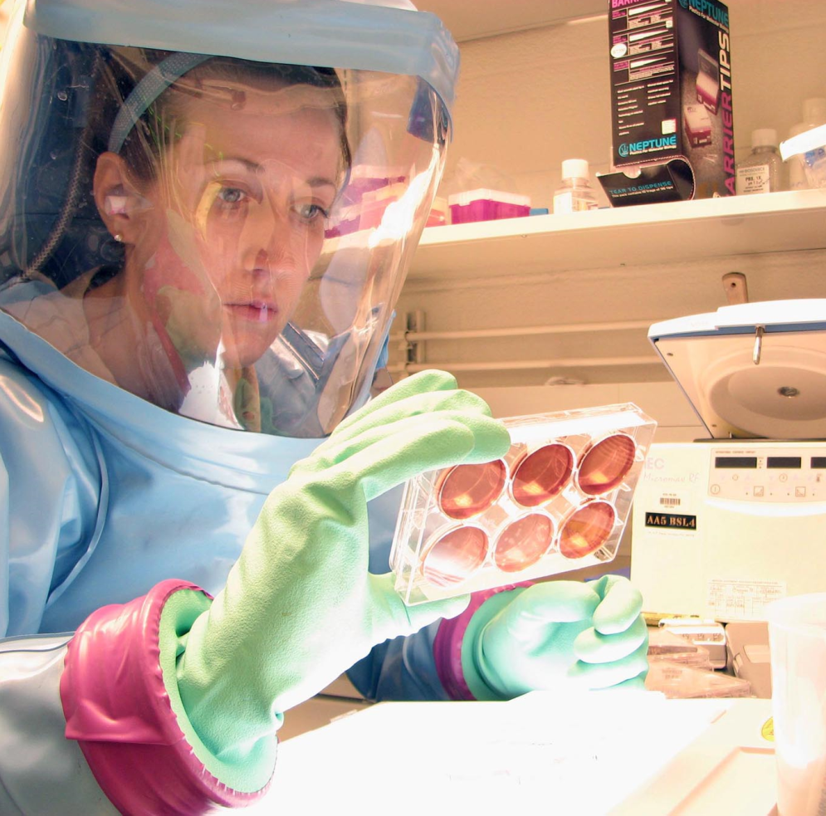
GENERAL ADVICE: Research
Continue research and volunteerism between years 1 and 2. Consider shadowing a surgeon(s).
It does not matter what kind of research you participate in, but consider a project in the department of surgery with publication(s) in surgical journals.
It is important that you are engaged in the process, understand the steps, contribute to designing the process, and participate in some level of presentation.
Image courtesy of U.S. Army

Slide 7
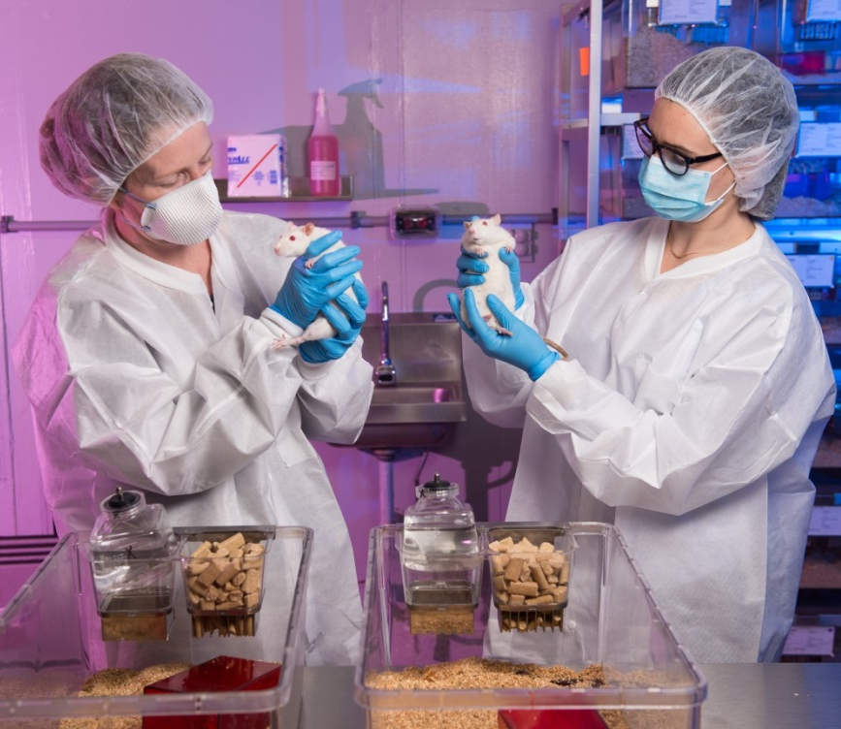
GENERAL ADVICE: Mentorship
Find a mentor to be a resource.
Try to find someone in the department of surgery familiar with the specifics of the surgical specialties you are interested in.
See How to Shadow a Surgeon module.
Image courtesy of U.S. Army

Slide 8
GENERAL ADVICE: Test Preparation
Time spent studying for Step 1 and/or Level 1 varies between institution, advisor, and applicant.
Some schools incorporate study time into their curriculum at the end of year 2.
On average, students commit to serious board preparation for 6 weeks or, at most, 8 weeks.
Have a schedule and study plan in place.
When to take the Step 1 and/or Level 1 varies. It is typically completed at the end of year 2 or beginning of year 3. Speak to your advisor to determine the appropriate time for you and your study schedule/timeline.

Slide 9
GENERAL ADVICE: Test Preparation (cont.)
Osteopathic medical students should complete USMLE Step 1 in addition to COMLEX-USA Level 1.
100% of surgery programs require USMLE Step 1 scores.*
If you have a significant personal event leading up to the exam, talk to your dean about delaying.
Many residency programs’ first screening of applicants is by Step 1 and/or Level 1 score.
49% of surgery programs answered “never” when asked if they would “consider applicants who fail the exam on the first attempt.”*
* According to the 2016 NRMP Program Director Survey

Slide 10
CLINICAL YEARS

Slide 11
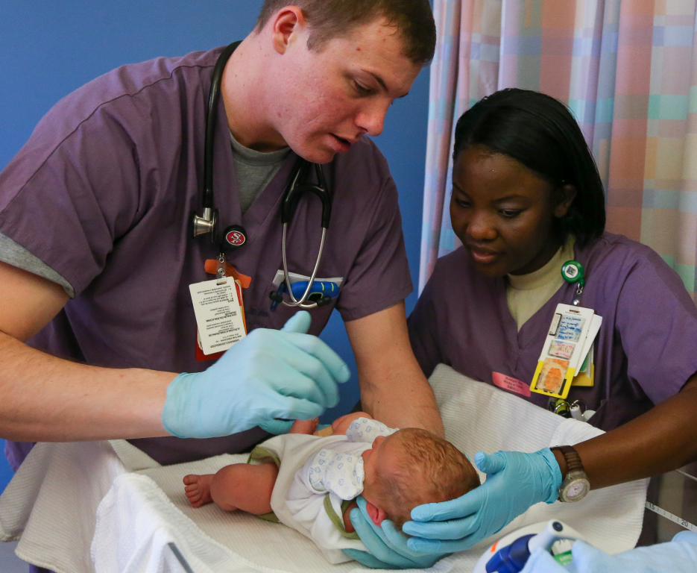
CLINICAL ADVICE: Rotations
It does not matter when you take your core surgery rotation during year 3, but consider completing the rotations you are most interested in before February-April, when VSAS opens for application to away elective rotations.
Your institution may control your rotation sequence schedule.
Image courtesy of U.S. Army

Slide 12
CLINICAL ADVICE: Rotations (cont.)
Begin looking to see what away rotations are available as early as February when some of the applications open.
Formulate a strategy for year 4.
The number of away rotation experiences varies between surgical specialty. Some do not participate in VSAS.
Find a specialty-specific advisor who is familiar with strategizing year 4 and VSAS to assist you in planning.
If unsure whom to choose as a mentor, start with the program director of the discipline you are interested in. They may know who in the department is familiar with certain application guidelines and strategies.

Slide 13
CLINICAL YEARS: Test Preparation
Studying for Step 2 and/or Level 2 varies.
Most students study for 4 weeks on average.
The clinical rotations and NBME shelf exams also prepare you.
When to take the Step 2 and/or Level 2 varies. Your school may have a deadline. Speak to your advisor. If Step 1 and/or Level 1 score(s) is below average, you may consider completing Step 2 and/or Level 2 immediately after required clinical rotations and shelf exams at the end of year 3. Many programs are interested in knowing Step 2 scores by ROL in February of year 4, though usually not required for application.

Slide 14
CLINICAL YEARS: Test Preparation (cont.)
Osteopathic medical students should consider completing USMLE Step 2 CK and USMLE Step 2 CS in addition to COMLEX-USA Level 2-CE and COMLEX-USA Level 2-PE1.
According to the 2016 NRMP Program Director Survey:
86% of surgery programs require USMLE Step 2 CK scores
78% use USMLE Step 2 CS

Slide 15
APPLICATION ADVICE: Written Materials
You may register with ERAS in June, and are encouraged to begin working on your application. Have it prepared when application submission opens in September.
Personal Statement:
Speak to your advisor for advice about how to write your personal statement.
Have multiple people read it and provide feedback.

Slide 16
APPLICATION ADVICE: Written Materials (cont.)
Letters of Recommendation
You will need three letters of recommendation.
Your personal statement and CV should be updated and readily available for requesting letters.
If you have only worked with one or two surgery attendings, you need a fourth-year elective/sub-I or a research project to expose you to additional surgeons who can write letters for you.

Slide 17
APPLICATION ADVICE: Ranking Residencies
Ask everyone which programs are worth considering.
Information about residency programs may be accessed through AMA-FREIDA. Some specialties participate in early matches, although general surgery follows the typical match timeline.
Image courtesy of U.S. Army

Slide 18
APPLICATION ADVICE: Ranking Residencies (cont.)
Compile rank order list as early as possible after completion of interviews, considering the factors that led you to apply, plus the impressions of the interview and residents/physicians you met.
Consider program qualities, acceptance rate, board scores, applicant pool, personal experience there, geography, etc.
Be realistic considering the program’s competitiveness.

Slide 19
APPLICATION ADVICE: Ranking Residencies (cont.)
According to the 2016 NRMP Program Director Survey, students who matched to a surgical residency ranked a median of 13 programs, whereas students who did not match ranked a median of 5 programs.
Rank all of the programs in which you could envision yourself happy there.
Do not rank programs you would not want to attend.

Slide 20
APPLICATION ADVICE: Additional Considerations
The bulk of research, volunteerism, club involvement, and leadership activities will likely take place during years 1 and 2. Become involved in opportunities during years 3 and 4 that you are passionate about, and can speak about in a residency interview.
These should not take the place of clinical rotations, grades, and board scores.
Research direction may change to include case reports.
Military members
Speak to your advisor about the military match timeline difference.
Remain aware of the criteria to meet for both the military and civilian application and interview timelines and match requirements.
Image courtesy of U.S. Army

